Slide 1
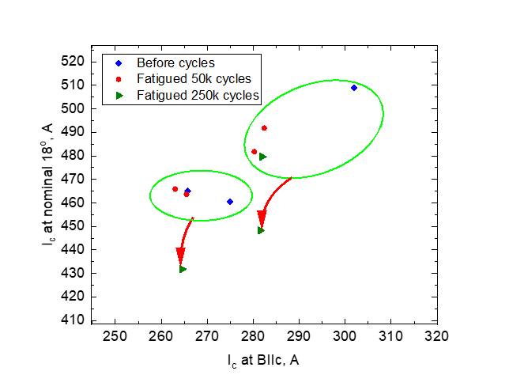
Fatigue cycling of high-temperature superconducting
REBCO tapes at 4.2 K
R. Walsh¹, K. Radcliff¹, X. Hu¹, D. Abraimov¹, I. Dixon¹, H. Bai¹
National High Magnetic Field Laboratory, Florida State University
Funding Grants: G.S. Boebinger (NSF DMR-1644779); G.S. Boebinger, M. Bird, L. Cooley (NSF DMR-1938789)
One major concern for future high-temperature superconducting (HTS) magnets is the degradation of their Rare-Earth Barium Copper Oxygen (REBCO) tapes due to cycling loading to high stress as the HTS magnet cycles between zero and high field.
MagLab researchers performed fatigue cycling load tests on REBCO tapes received from Superpower. The tapes are 4 mm wide with a total thickness of 95 μm, including 50 μm thick of Hastelloy and 40 μm thick of Copper. The samples were loaded up to 0.4% strain at 4.2 K. Half the samples were loaded through 50,000 cycles while the others were loaded through 250,000 cycles.
The critical current (Ic), the maximum superconducting current able to be carried by the tape, was then measured in a magnetic field of 15 T with the applied field 18° away from parallel to the tape surface. The test results show no obvious Ic drop at 50,000 cycles and about 7% Ic drop at 250,000 cycles. Edge cracks are known to exist in REBCO tapes due to slitting during manufacturing. Images made via a Scanning Electron Microscope showed the cracks growing during 250,000 cycles, but remaining less than 3.2% of the total tape width.
Although the observed degradation is not desirable, it is still at an acceptable level for HTS magnet design. These results show that REBCO tape remains a promising material for future HTS magnets that will experience cyclic operation to peak fields.
(a)
Critical current (Ic) of REBCO tapes before and after 4.2K fatigue cycling…after 50,000 and 250,000 cycles to 0.4% maximum strain.
(b)
(c)
127.5 μm
46.37 μm
Facilities/Instrumentation used: MagLab Applied Superconductivity Center and MagLab Magnet Science and Technology Division, including MTS Landmark, Yatestar, Scanning Electron Microscope, and the 15 T/17 T transport current measurement system.
Cracks penetrate from the edge of REBCO tape (b) < 40 microns before fatigue cycling cracks and (c) > 120 microns after 250,000 fatigue cycles.

Slide 2
Fatigue cycling of high-temperature superconducting
REBCO tapes at 4.2 K
R. Walsh¹, K. Radcliff¹, X. Hu¹, D. Abraimov¹, I. Dixon¹, H. Bai¹
National High Magnetic Field Laboratory, Florida State University
Funding Grants: G.S. Boebinger (NSF DMR-1644779); G.S. Boebinger, M. Bird, L. Cooley (NSF DMR-1938789)
What is the finding? We subjected Rare-Earth Barium Copper Oxygen (REBCO) tape to cyclic tensile loading similar to what is intended to occur in the MagLab’s 32 T magnet as well as future ultra-high field magnets. Afterwards we measured the performance of the tape. We saw no degradation after 50,000 cycles which is the number of cycles we intend for the magnet to survive. Some degradation was seen when tapes were subjected to 250,000 cycles.
We know that cracks exist at the edge of the tape due to the manufacturing process. These cracks did grow up to 3.2% of the tape width during the 250,000 cycle test, which is acceptable.
Why is this important? The MagLab’s magnets are expected to cycle up to 50,000 times during their lifetime. It is essential to verify that the materials in these magnets will continue to operate for this large number of high stress cycles. This test demonstrated that REBCO tape is a promising material for future HTS magnets at the MagLab.
Why did this research need the MagLab? The MagLab is one of very few facilities worldwide with the equipment and expertise needed to perform fatigue testing at 4.2 K and critical current measurements with the magnetic field at the correct angle with respect to the tape.
(a)
Critical current (Ic) of REBCO tapes before and after 4.2K fatigue cycling…after 50,000 and 250,000 cycles to 0.4% maximum strain.
(b)
(c)
127.5 μm
46.37 μm
Facilities/Instrumentation used: MagLab Applied Superconductivity Center and MagLab Magnet Science and Technology Division, including MTS Landmark, Yatestar, Scanning Electron Microscope, and the 15 T/17 T transport current measurement system.
Cracks penetrate from the edge of REBCO tape (b) < 40 microns before fatigue cycling cracks and (c) > 120 microns after 250,000 fatigue cycles.

