Slide 1
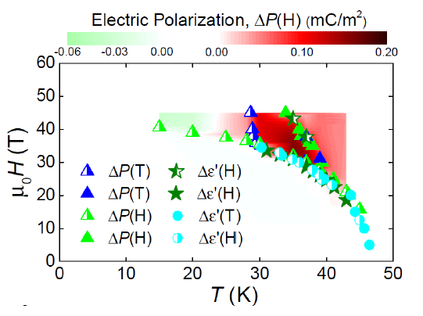
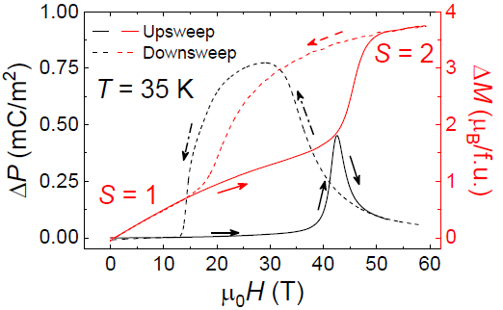
Magnetoelectric coupling at a transition between two spin states
S. Chikara^{1,2}, J. Gu³, X.-G. Zhang³, H.-P. Cheng³, N. Smythe⁴, J. Singleton¹, B, Scott⁴, E. Krenkel⁵, J. Eckert⁵, and V. S. Zapf¹ 1. NHMFL-PFF 2. NHMFL-DC 3. University of Florida 4. Los Alamos National Lab 5. Harvey Mudd College
Funding Grants: G.S. Boebinger (NSF DMR-1644779), Los Alamos Laboratory-Directed Research and Development,
“Center for Molecular Magnetic Quantum Materials” Energy Frontier Research Center (DOE BES)
Traditionally, magnetoelectric coupling and multiferroic behavior are studied in inorganic oxide materials in which ferromagnetic order or antiferromagnetic order couple to electric polarization. Materials with magnetoelectric coupling have potential application in low-power magnetic sensing, new computational devices, and high-frequency electronics.
MagLab users studied a spin state transition, a different type of magnetic order common in molecular materials that offers greater coupling to the lattice and therefore enhanced potential for magnetoelectric coupling. At the low-spin to high-spin transition in a Mn³⁺-based molecular material denoted “Mn(taa)”, the spin state changes from S = 1 to S = 2 at a first-order phase transition. The high spin state is Jahn-Teller active, which allows three choices for distorting the molecules in the crystalline lattice, thereby creating electric dipoles. These electric dipoles undergo different orderings controlled by magnetic field and temperature. The upper figure shows the DC-field phase diagram of Mn(taa) with three different ferro- or para-electric phases depending on magnetic field and temperature.
This work demonstrates that multi-ferroic-like magnetoelectric behavior is possible using a spin state transition with a resulting magnetic-field- induced electric polarization that is within 10% of the record of any magnetoelectric material. This discovery vastly expands the possible materials and types of magnetic orders at which magnetoelectric coupling can be studied. In molecular materials, such spin state transitions are common and widely studied, since the soft lattice accommodates the change in orbital occupation that accompanies the spin state transition.
a)
b)
Facilities used: 45T Hybrid Magnet; 65T Pulsed Magnets.
Citation: S Chikara, J Gu, X-G Zhang, H-P Cheng, N Smythe, J Singleton, B Scott, E Krenkel, J Eckert, and VS Zapf. “Magnetoelectric behavior via a spin state transition,” Nature Comm. 10, 4043 (2019)
doi.org/10.1038/s41467-019-11967-3
Figure: a) Phase diagram in DC fields of Mn(taa) in which the color scale is the electric polarization. b) Electric polarization ΔP and magnetization ΔM change in pulsed fields showing the spin crossover and region of electric polarization.

Slide 2
Magnetoelectric coupling at a transition between two spin states
S. Chikara^{1,2}, J. Gu³, X.-G. Zhang³, H.-P. Cheng³, N. Smythe⁴, J. Singleton¹, B, Scott⁴, E. Krenkel⁵, J. Eckert⁵, and V. S. Zapf¹ 1. NHMFL-PFF 2. NHMFL-DC 3. University of Florida 4. Los Alamos National Lab 5. Harvey Mudd College
Funding Grants: G.S. Boebinger (NSF DMR-1644779), Los Alamos Laboratory-Directed Research and Development,
“Center for Molecular Magnetic Quantum Materials” Energy Frontier Research Center (DOE BES)
What is the finding? An intense magnetic field applied to a molecular crystalline material – denoted “Mn(taa)” – is found to induce a transition between two different spin states that doubles the magnetization. The magnetic field also induces electric dipoles on the molecules within the crystal, dipoles that order in multiple patterns at high magnetic fields.
Why is this important? Materials in which magnetic and electric properties couple together have potential applications to reduce energy consumption for magnetic sensing, computing, and high frequency devices. Voltages rather than currents can switch under magnetic control, reducing energy dissipation by orders of magnitude. Here we open a new class of materials with magnetoelectric coupling – those with spin state switching instead of more traditional long-range ferro- or antiferromagnetic ordering. These new materials have extremely strong coupling between magnetism and the crystal lattice, such that magnetic fields induce structural phase transitions, toggle the existence of electric dipoles, and arrange the dipoles in various ordered patterns. The observed magnetoelectric coupling is relatively strong, fully 10% of the record for more traditional magnetoelectric materials that employ (anti)ferromagnetic order to couple to electric polarization. Thus spin state transition materials are an important new class of materials to study magnetoelectric coupling.
Why did this research need the MagLab? Magnetic fields well over 30T were needed to create spin state switching in this discovery material – though materials that switch at much lower fields are currently under development. Even for materials with low-field switching, high magnetic fields will be required to map the entire phase diagram and develop a full understanding of the ordering and magnetoelectric coupling mechanisms.
a)
b)
Facilities used: 45T Hybrid Magnet; 65T Pulsed Magnets.
Citation: S Chikara, J Gu, X-G Zhang, H-P Cheng, N Smythe, J Singleton, B Scott, E Krenkel, J Eckert, and VS Zapf. “Magnetoelectric behavior via a spin state transition,” Nature Comm. 10, 4043 (2019)
doi.org/10.1038/s41467-019-11967-3
Figure: a) Phase diagram in DC fields of Mn(taa) in which the color scale is the electric polarization. b) Electric polarization ΔP and magnetization ΔM change in pulsed fields showing the spin crossover and region of electric polarization.
Notes:
1. What is the finding?
Here to be included a short description in layman language of the finding
2. Why this finding is important?
A short description of why the finding is important for scientific community, technology, society, etc…
3. Why NHMFL?
The answer to this question should provide information on why this finding could be achieved (only) at NHMFL (what unique capability of MagLab was essential for this finding).

