Slide 1
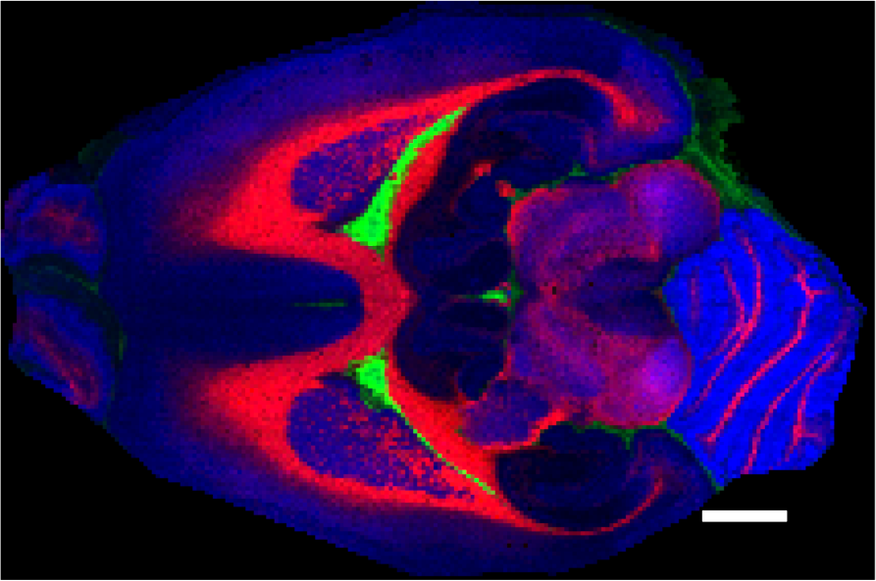
Ultrahigh Performance Molecular Imaging by MALDI at 21 Teslas
Andrew P. Bowman¹, Greg T. Blakney², Christopher L. Hendrickson²,
Shane R. Ellis¹, Ron M. A. Heeren¹, Donald F. Smith²
1. M4I Institute, Maastricht University, Maastricht 6629ER, NL; 2. NHMFL, FSU, Tallahassee, Florida
Funding Grants: G.S. Boebinger (NSF DMR-1157490, NSF DMR-1644779);
R.M.A. Heeren (LINK Program, Province of Limburg, NL, EUROLIPIDS, Euregio)
Mass spectrometry imaging (MSI) combines the chemical specificity of mass spectrometry with spatial localization to provide thousands of label-free, molecular images directly from complex biological tissue sections. The MagLab’s ICR program partnered with users from the Netherlands to combine the ultrahigh performance of the MagLab’s 21 tesla Fourier transform ion cyclotron resonance (FT-ICR) mass spectrometer with an imaging source for ultrahigh performance molecular imaging. These high-magnetic-field experiments exemplify the advantages of high mass resolving power and high mass accuracy for identifying imaged molecules in MSI studies.
A matrix-assisted laser desorption ionization (MALDI) ion source was coupled to the 21T FT-ICR MS and rat brain sections were imaged. Exact mass analysis identified 1,364 unique lipid species, and molecules with mass differences as small as 1.79 mDa were resolved and imaged (see top figures with zoom mass inset, assigned elemental compositions, and molecular classes).
The bottom figure shows the spatial distributions in the brain of three different lipids. This technique is now available for users to image lipids, drugs and drug metabolites, as well as intact proteins from biological tissue sections.
C₄₂H₇₃N₁O₇P₁¹³C₁
PE(P-38:6) ¹³C₁
C₄₀H₇₆O₁₀P₁
PG 34:1
1.79 mDa
747.512
747.514
747.516
747.518
747.520
747.522
m/z
Facilities used: ICR, 21 T FT-ICR mass spectrometer
Citation: Bowman, AP; Blakney, GT; Hendrickson, CL; Ellis, SR; Heeren, RMA; Smith, DF. Ultra-High Mass Resolving Power, Mass Accuracy, and Dynamic Range MALDI Mass Spectrometry Imaging by 21-T FT-ICR MS, Anal. Chem. 92, No. 4, pp. 3133-3142 (2020) https://doi.org/10.1021/acs.analchem.9b04768.
2 mm
Red: Phosphatidylcholine O-36:2
Green: Sphingomyelin 40:1
Blue: Phosphatidylcholine 40:6
Image Credit: Don Smith, MagLab

Slide 2
Ultrahigh Performance Molecular Imaging using the 21T ICR Magnet
Andrew P. Bowman¹, Greg T. Blakney², Christopher L. Hendrickson²,
Shane R. Ellis¹, Ron M. A. Heeren¹, Donald F. Smith²
1. M4I Institute, Maastricht University, Maastricht 6629ER, NL; 2. NHMFL, FSU, Tallahassee, Florida
Funding Grants: G.S. Boebinger (NSF DMR-1157490, NSF DMR-1644779);
R.M.A. Heeren (LINK Program, Province of Limburg, NL, EUROLIPIDS, Euregio)
What is the finding? The MagLab has partnered with MagLab users from the Netherlands to develop molecular imaging featuring ultrahigh mass resolution and mass accuracy, which is demonstrated here on a rat brain tissue slice.
Why is this important? Mass spectrometry imaging (MSI) is an emerging technology with applications in human health and disease, including cancer, neurodegeneration, and infection. MSI provides detailed pictures of tissue slices showing the specific locations of particular, selected biomolecules. Identification of the biomolecules is often difficult due to limitations on mass spectral resolving power and mass measurement accuracy.
The MagLab’s 21T ICR magnet provides the highest resolving power and most accurate mass molecular imaging achieved to date. Molecules with extremely small mass differences (as small as 1.79mDa, equal to the mass of only three electrons) can be separated in an image for the first time, revealing quite different distributions in the rat brain for these two molecules. More than 1300 lipids were imaged in these experiments. The figure shows the spatial distributions in the brain of three different lipids.
Why did this research need the MagLab? The MagLab’s 21 tesla (T) Fourier transform ion cyclotron resonance (FT-ICR) mass spectrometer provides uniquely high mass resolving power and mass accuracy needed to build these images.
2 mm
Facilities used: ICR, 21 T FT-ICR mass spectrometer
Citation: Bowman, AP; Blakney, GT; Hendrickson, CL; Ellis, SR; Heeren, RMA; Smith, DF. Ultra-High Mass Resolving Power, Mass Accuracy, and Dynamic Range MALDI Mass Spectrometry Imaging by 21-T FT-ICR MS, Anal. Chem. 92, No. 4, pp. 3133-3142 (2020) https://doi.org/10.1021/acs.analchem.9b04768.
Red: Phosphatidylcholine O-36:2 Green: Sphingomyelin 40:1
Blue: Phosphatidylcholine 40:6 Image Credit: Don Smith, NHMFL

