Slide 1
High-Temperature Superconducting Solenoid
Made With REBCO CORC® Cable D.C. van der Laan² and J.D. Weiss², U.P. Trociewitz¹, D. Abraimov¹, A. Francis¹, J. Gillman¹, D.S. Davis¹, Y. Kim¹, V. Griffin¹, G. Miller¹, H.W. Weijers¹, L.D. Cooley¹, D.C. Larbalestier¹, X.R. Wang³ 1. NHMFL Applied Superconductivity Center; 2. Advanced Conductor Technologies (ACT); 3. LBNL Funding Grants: G.S. Boebinger (NSF DMR-1644779, State of Florida); D. van der Laan (DOE DE-SC0009545, DE-SC0014009); X.R. Wang (DOE DEAC02-05CH11231)
A high-temperature superconducting (HTS) multi-tesla insert solenoid was made with REBCO conductor on round core (CORC®), which is a high-current-carrying cable wound from Rare-Earth Barium Copper Oxide (REBCO) HTS-tape conductor. It was tested in a background magnet operating at fields of up to14 T. Charging rates of 20A/s to 50A/s were possible without inducing a quench.
A combined central magnetic field of 15.9T and a peak magnetic field on the conductor of 16.8T at a critical current of 4.4kA was reached at a winding current density of 169A/mm², an engineering current density of 282A/mm², and a source stress (hoop) of 275MPa.
This coil is a first in a planned series of increasingly larger and higher-field solenoids built with CORC® technology. Besides showing promise for the high field accelerator magnet arena, successful cable technologies are milestones on the route toward higher-field solenoid magnet systems.
(left) Picture of the solenoid made with REBCO CORC cable. The coil was 60mm tall, with an ID of 100mm and an OD of 143mm. It consisted of 45 turns using 19 meters of CORC® cable.
(right) Voltage of the solenoid as a function of the current, measured at 4.2K in different background magnetic fields of 10T (black), 12T (red) and 14T (blue). The inductive voltage has been subtracted. The solid lines are fits to the data. The dashed line is the voltage criterion of 0.1 µV/cm.
Citation: van der Laan, D.C.; Weiss, J.D.; Trociewitz, U.P.; Abraimov, D.V.; Francis, A.; Gillman, J.; Davis, D.S.; Kim, Y.K.; Griffin, V.S.; Miller, G.E.; Weijers, H.W.; Cooley, L.D.; Larbalestier, D.C.; Wang, X.R., A CORC ® cable insert solenoid: the first high-temperature superconducting insert magnet tested at currents exceeding 4kA in 14T background magnetic field
Superconductor Science and Technology, 33 (5), 05LT03 (2020) doi.org/10.1088/1361-6668/ab7fbe

Slide 2
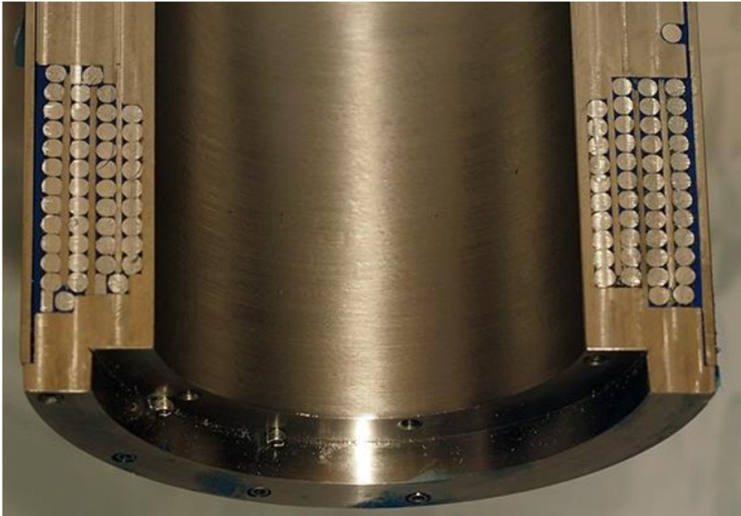
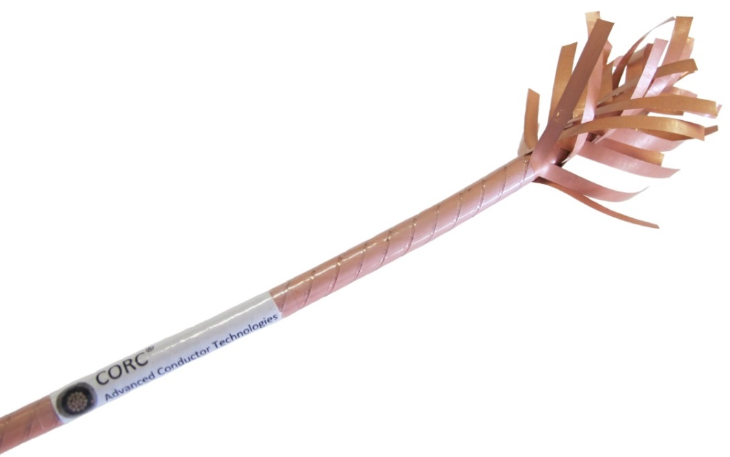
High-Temperature Superconducting Solenoid
Made With REBCO CORC® Cable D.C. van der Laan² and J.D. Weiss², U.P. Trociewitz¹, D. Abraimov¹, A. Francis¹, J. Gillman¹, D.S. Davis¹, Y. Kim¹, V. Griffin¹, G. Miller¹, H.W. Weijers¹, L.D. Cooley¹, D.C. Larbalestier¹, X.R. Wang³ 1. NHMFL Applied Superconductivity Center; 2. Advanced Conductor Technologies (ACT); 3. LBNL Funding Grants: G.S. Boebinger (NSF DMR-1644779, State of Florida); D. van der Laan (DOE DE-SC0009545, DE-SC0014009); X.R. Wang (DOE DEAC02-05CH11231)
What is the finding? A high field solenoid was built with high-current-carrying, high temperature superconducting cable and tested at high fields. When nested in a 14T high-field outsert magnet, the coil generated a total of 16.8T.
Why is this important? This is the first high-temperature superconducting insert magnet tested at such high currents: 4kA in 14T background magnetic field. Superconducting magnet systems based on high temperature superconducting materials can offer highest field strengths at a fraction of the operating costs of resistive magnets. This successful coil test clearly shows that REBCO conductor on round core (CORC®) is a very capable cable technology for high field magnets. CORC® cable enables engineers to envision high-current, low-inductance magnet systems for applications in research solenoids as well as accelerator magnets for the high energy physics community.
Why did this research need the MagLab? This work is a result of a DOE/NSF funded collaboration between Applied Conductor Technologies and the MagLab. A 14T large bore magnet, a 10kA current supply, and a quench protection facility newly installed at the MagLab were used for the test.
Cross section of a model coil with the same geometry of the solenoid that was made in preparation for the actual test.
View of a typical CORC® cable, showing
its Rare-Earth Barium Copper Oxide (REBCO) tape constituents. The cable used for the coil had a diameter of 4.56mm and consisted of 28 REBCO tapes applied in 14 layers.
Citation: van der Laan, D.C.; Weiss, J.D.; Trociewitz, U.P.; Abraimov, D.V.; Francis, A.; Gillman, J.; Davis, D.S.; Kim, Y.K.; Griffin, V.S.; Miller, G.E.; Weijers, H.W.; Cooley, L.D.; Larbalestier, D.C.; Wang, X.R.
A CORC ® cable insert solenoid: the first high-temperature superconducting insert magnet tested at currents exceeding 4kA in 14T background magnetic field, Superconductor Science and Technology, 33 (5), 05LT03 (2020) doi.org/10.1088/1361-6668/ab7fbe
(Cable image courtesy of ACT, D. van der Laan)

