Slide 1
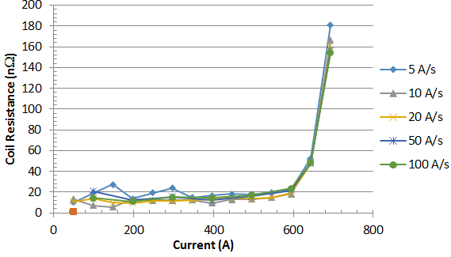
Integrated Coil Form Technology for Ultra High Magnetic Fields
Thomas Painter, Kwangmin Kim, Mike White, Robert Stanton
National High Magnetic Field Laboratory, Florida State University
Funding Grants: G.S. Boebinger (NSF DMR-1157490); T.A. Painter (EPSRC EP/R016615/1)
REBCO (Rare Earth Barium Copper Oxide) tape has the high current density and high strength needed to enable ultra-high field high-temperature superconducting (HTS) magnets. To minimize the cost and maximize the usefulness of these magnets, one typically wants the magnet to be as small as possible and to reach full field as quickly as possible. While several REBCO coil-fabrication technologies have been proposed in recent years, the MagLab recently tested a new technology, the Integrated Coil Form (ICF), which shows potential for realizing both smaller HTS magnets and faster sweep rates.
In an ICF solenoid, several strands of REBCO tape are wound without twisting onto a helical steel coil-form. Multiple ICF solenoids are nested concentrically together to form a test coil. This results in a high-current HTS cable with high current density and strength. However, it is well known that Low Temperature Superconducting (LTS) cables must be twisted to avoid quenching due to ac loss heating and uneven current sharing during ramping. The high aspect ratio of REBCO tape (4 mm wide by 0.1 mm thick) means that while twisted architectures are possible, all cables built to date display inefficient packing, low strength, and/or high manufacturing costs [1,2]. In contrast, the ICF concept for HTS cabled magnets provides very high current density and strength at modest cost.
A recently tested ICF coil featured nine tapes in parallel and demonstrated high ramp rates without quenching. During testing at 77K, it reached 700A independent of ramp rate as shown in figure. Further, the projected critical current density of this test coil in a 14T background field is 516A/mm², approximately three times that of the best solenoid test coil using HTS twisted cable [3], a recent success from a MagLab/private sector collaboration.
Figure: The transition from the superconducting to resistive state in this Integrated Coil Form Test Coil occurs at around 700A, independent of that ramp rate that ranges from 5A/s to 100A/s
Facilities and instrumentation used: DC Field Facility, Cell 4.
Citation: Data are not yet published.
References:
[1] W. Fietz, et al, “High-Current HTS Cables: Status and Actual Development”, IEEE Trans. App. Sup. Vol. 26, No. 4, June 2016.
[2] N. Bykovsky, et al, “Strain Management in HTS High Current Cables”, IEEE Trans. App. Sup. Vol. 25, No. 3, June 2015,
[3] van der Laan, D. et al, “A CORC cable insert solenoid: the first high-temperature superconducting insert magnet tested at currents exceeding 4kA in 14T background magnetic field” , D.C. van der Laan, et al. Superconductor Science and Technology, 33 (5), 05LT03 (2020) doi.org/10.1088/1361-6668/ab7fbe

Slide 2
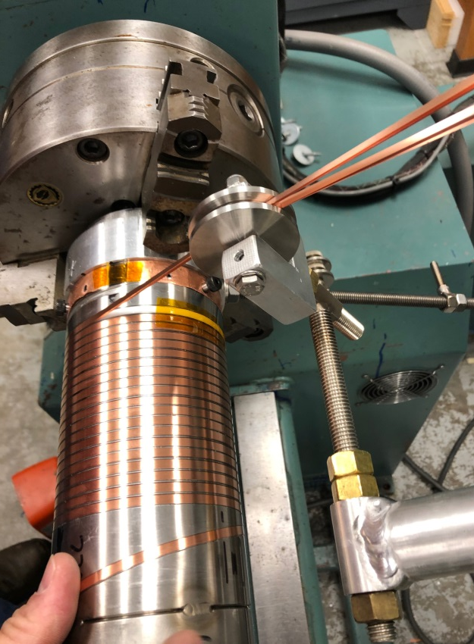
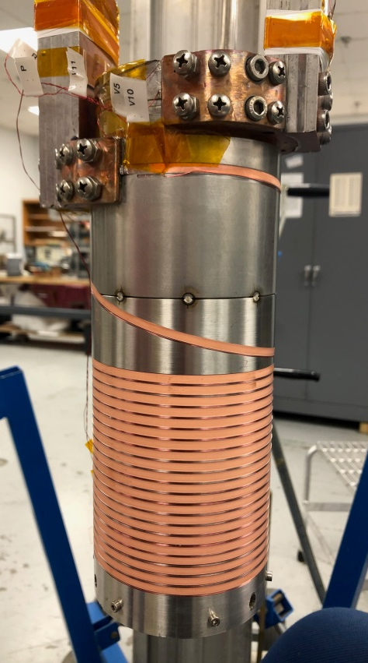
Integrated Coil Form Technology for Ultra High Magnetic Fields
Thomas Painter, Kwangmin Kim, Mike White, Robert Stanton
National High Magnetic Field Laboratory, Florida State University
Funding Grants: G.S. Boebinger (NSF DMR-1157490); T.A. Painter (EPSRC EP/R016615/1)
What is the finding? Recent tests of the MagLab’s Integrated Coil Form (ICF) technology suggest that high-temperature superconducting (HTS) REBCO tape may enable simpler REBCO cables to be built and operate reliably than is possible with traditional low-temperature superconducting (LTS) cables.
Why is this important? This may allow a compact, stacked-tape cable to be efficiently deployed in the extremely-well-reinforced ICF coil technology. This may play a central role in the MagLab’s quest to realize a 60T hybrid magnet, a national goal articulated in the 2005 COHMAG and 2013 MagSci reports issued by the National Academies of Science.
Why did this research need the MagLab? The infrastructure and experienced staff at the MagLab were essential for conceiving and developing the ICF technology and building the test coils. The MagLab is unique in its collection of leading experts not only in magnet materials science but in magnet design, fabrication and precision machining. The latest state of the art HTS tapes are extremely fragile. Knowledge and experience of mechanical design and winding practices developed in the MagLab’s 32T all-superconducting magnet were essential to building a damage-free ICF test coil.
The first Integrated Coil Form test coil, wound using REBCO superconducting tape, is shown above on the left. The cable is wound onto a high precision custom-machined thick walled tube with helical grooves that match the cross-section of a multiple tape, stacked cable. Stainless steel ribs between turns help reinforce the coil against high magnetic loads. The stack of tapes are wound directly onto the coil form as shown on the right.
Facilities and instrumentation used: DC Field Facility, Cell 4.
Citation: Data are not yet published.
Notes:
1. What is the finding?
Here to be included a short description in layman language of the finding
2. Why this finding is important?
A short description of why the finding is important for scientific community, technology, society, etc…
3. Why NHMFL?
The answer to this question should provide information on why this finding could be achieved (only) at NHMFL (what unique capability of MagLab was essential for this finding).

