Slide 1
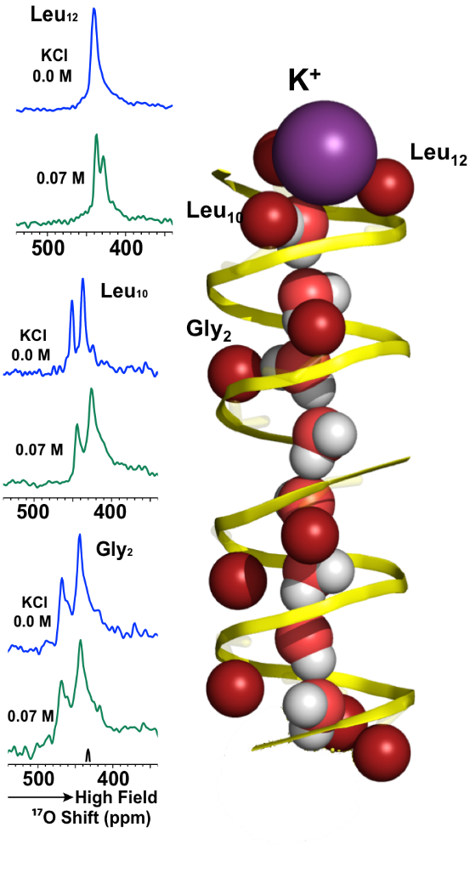
Functionality of “Water Wires” That Span a Cellular Membrane
Joana Paulino¹, Myunggi Yi², Ivan Hung¹, Zhehong Gan¹, Xiaoling Wang¹,
Eduard Y. Chekmenev³,Huan-Xiang Zhou⁴, Timothy A. Cross^{1,5}
National High Magnetic Field Laboratory; 2. Pukyong National Univ.; 3. Wayne State University;
4. University of Illinois at Chicago; 5. Florida State University
Funding Grants: G.S. Boebinger (NSF DMR-1157490, NSF DMR-1644779); T.A. Cross (NIH: AI23007, AI119178, ) W.W. Brey (DMR-1039938) H.-X. Zhou (NIH GM118091); M. Yi (PNU-CD 2017-0984); M. Bird (DMR-0603042)
Single file strings of water molecules, known as “water wires”, span cellular membranes through protein structures, facilitating the transport of protons, cations, and small molecules. To study these water wires, researcher labeled specific sites lining the pore that is formed by a gramicidin A (gA) dimer with ¹⁷O labeled carbonyl oxygens.
¹⁷O is an NMR (Nuclear Magnetic Resonance) sensitive nucleus, for which the world-record high magnetic field of the MagLab’s Series Connected Hybrid magnet (36 Tesla) was required to provide sufficiently-high-resolution ¹⁷O spectra.
gA is a structurally symmetric dimer that gives rise to single carbon and nitrogen signals for single sites. However, when labeling a single carbonyl oxygen site in the monomer, researchers observed two signals, not one. There are 26 carbonyl oxygens lining the pore and 8 water molecules in the water wire, each of which can interact with only one carbonyl. As such, only some carbonyl oxygens interact with a water molecule. The observation of two signals dictates that specific water interactions with carbonyl oxygens are stable on the millisecond timescale of NMR resonances, as opposed to the prediction from decades of computational studies that universally claimed stability on the sub-nanosecond timescale – a dramatic difference in interaction strength and in our understanding of water interactions in the confines of an aqueous pore.
gA is an antibiotic supporting a water-wire, long studied (>4000 publications in PubMed) by biophysicists to understand how water-wires facilitate transport of polar solutes.
The gA pore allows waters and
cations to transit down concentration gradients. Even in the absence of cations, the two ¹⁷O labeled carbonyl sites (e.g. Glycine-2) generates 2 different signals – one that is hydrogen bonded to water and the other that isn’t. Similarly, for other carbonyl sites, such as Leucine-10 and Leucine-4. The magnitude of the shift is dependent on the strength of the interaction between the water proton and carbonyl oxygen.
These stronger interactions dictate that our general understanding of how water interacts with lining of protein pores is not well understood and the models of how water facilitates solute transport across membranes must be further investigated.
Facilities and instrumentation used: DC User Facility – 36T Series Connected Hybrid; NMR & MRI User Facility – Field Stabilization, NMR Probes constructed by the Magnetic Resonance Technology Group of the NMR & MRI User Facility.
Citation: Paulino, J.; Yi, M.; Hung, I.; Gan, Z.; Wang, X.; Chekmenev, E.Y.; Zhou, H.; Cross, T.A., Functional stability of water wire-carbonyl interactions in an ion channel, Proceedings of the National Academy of Sciences, (2020) doi.org/10.1073/pnas.2001083117

Slide 2
Functionality of “Water Wires” That Span a Cellular Membrane
Joana Paulino¹, Myunggi Yi², Ivan Hung¹, Zhehong Gan¹, Xiaoling Wang¹,
Eduard Y. Chekmenev³,Huan-Xiang Zhou⁴, Timothy A. Cross^{1,5}
National High Magnetic Field Laboratory; 2. Pukyong National Univ.; 3. Wayne State University;
4. University of Illinois at Chicago; 5. Florida State University
Funding Grants: G.S. Boebinger (NSF DMR-1157490, NSF DMR-1644779); T.A. Cross (NIH: AI23007, AI119178, ) W.W. Brey (DMR-1039938) H.-X. Zhou (NIH GM118091); M. Yi (PNU-CD 2017-0984); M. Bird (DMR-0603042)
What is the finding? Water molecules in the interior of proteins responsible for transporting nutrients into and out of cells interact much more strongly with these proteins than previously thought. This forces a fundamental change in our understanding of transport processes through these pores.
Why is this important? These water molecules form a linked chain – a “water wire”. As the chain is pulled into (or out of) the cells, ions that substitute for a water molecule are drawn into (or pushed out of) the cell. The fact that the waters interact more strongly with the protein requires a change in our understanding of the energetics that govern these processes. Surprisingly, overlaps between the water molecules and the protein were found to be stable for a million times longer than previously concluded from computational modeling. Researchers will now seek to understand this striking discrepancy between computer models and this new and compelling experimental data.
Why did this research need the MagLab? Unique access to the world’s highest field magnet for magnetic resonance spectroscopy (the MagLab’s 36T Series Connected Hybrid magnet) was required for researchers to be able to assess the energetics of the water-protein interactions.
Two views of the pore, formed by the gramicidin A protein, that spans cell membranes. (A) The multicolored sticks represent carbons (green), hydrogens (white), and a few nitrogens (blue) near the external surface of this structure that together stabilize the structure in the membrane environment. The oxygens (dark red spheres) line a pore through the membrane that stabilizes a single file of water molecules, a
A.
“water wire” that threads the membrane. One end of the water wire is shown in (B) as a bright red oxygen with two white hydrogens. This 35.2T NMR experiment found that water hydrogens interact strongly with nearby protein oxygens. These waters help solvate salts, such as potassium and sodium that pass through this pore.
B.
Facilities and instrumentation used: DC User Facility – 36T Series Connected Hybrid; NMR & MRI User Facility – Field Stabilization, NMR Probes constructed by the Magnetic Resonance Technology Group of the NMR & MRI User Facility.
Citation: Paulino, J.; Yi, M.; Hung, I.; Gan, Z.; Wang, X.; Chekmenev, E.Y.; Zhou, H.; Cross, T.A., Functional stability of water wire-carbonyl interactions in an ion channel, Proceedings of the National Academy of Sciences, (2020) doi.org/10.1073/pnas.2001083117

