Slide 1
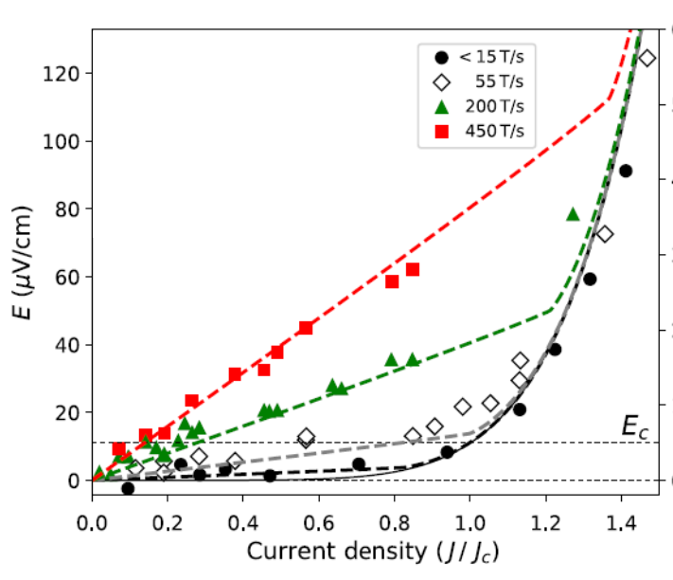
Smart non-linear transport technique
expands the frontier of superconductor research
Maxime Leroux^{1,2}, Fedor F. Balakirev¹, Leonardo Civale², Boris Maiorov¹
1. National High Magnetic Field Laboratory, Pulsed Field Facility, LANL 2. MPA-Q, LANL
Funding Grants: G.S. Boebinger (NSF DMR-1157490, NSF DMR-1644779); L.Civale (BES FWP LANLE8L5)
MagLab scientists developed a smart technique for rapidly measuring non-linear transport in pulsed magnetic fields, measurements that have unveiled new physics for fast-moving magnetic vortices. This new technique has attracted users from research groups in the USA, Europe, and Japan to study critical currents in cuprates, iron-based, and new nickel-based superconductors in magnetic fields up to 65T. Non-linear transport is also an important probe to study charge-density-wave systems and topological materials.
In superconductors, measurements of non-linear electrical transport is necessary to determine their current-carrying properties. However, during these measurements, sudden changes in sample voltage can destroy the sample. Thus, until now, transport experiments of superconductors in pulsed magnetic fields have been limited to very low currents.
To solve this problem, MagLab scientists developed a new technique using Field Programmable Gate Arrays that vary the current in response to changing sample voltage in less than 10 nanoseconds, allowing several non-destructive current-voltage curves to be measured in a single 50msec-long magnetic field pulse.
These measurements of critical current up to 65T unveiled novel dynamic vortex responses as a consequence of the fast-changing pulsed magnetic fields.
Measuring non-linear electric field – current density (E-J) curves in pulsed magnetic fields to 65T allowed researchers to determine critical current densities (J_{c}) at record high magnetic fields.
YGdBa₂Cu₃O₇
Magnetic
Field(T)
Only Pulsed Fields
Time(ms)
The data revealed new vortex physics from the E-J curves measured in rapidly-changing magnetic fields. The collaboration developed a model that quantitatively describes the curves with no free parameters.
Facility used: Pulsed field facility 65T magnets.
Citation: Leroux, M.; Balakirev, F.F.; Miura, M.; Agatsuma, K.; Civale, L.; Maiorov, B., Dynamics and Critical Currents in Fast Superconducting Vortices at High pulsed Magnetic Fields, Physical Review Applied, 11, 054005 (2019) doi.org/10.1103/PhysRevApplied.11.054005

Slide 2
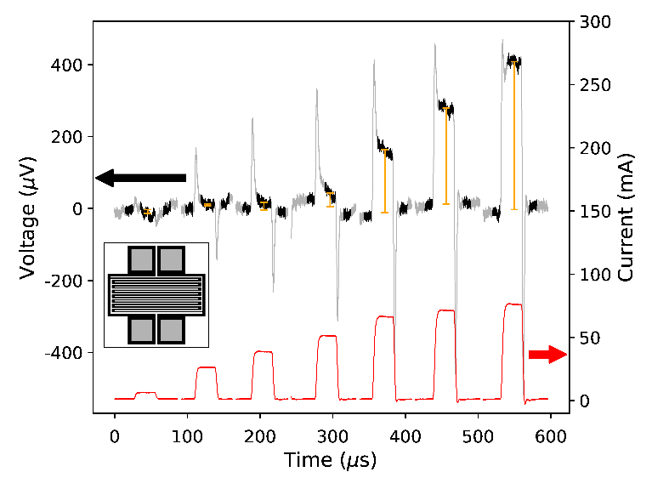
Smart non-linear transport technique
expands the frontier of superconductor research
Maxime Leroux^{1,2}, Fedor F. Balakirev¹, Leonardo Civale², Boris Maiorov¹
1. National High Magnetic Field Laboratory, Pulsed Field Facility, LANL 2. MPA-Q, LANL
Funding Grants: G.S. Boebinger (NSF DMR-1157490, NSF DMR-1644779); L.Civale (BES FWP LANLE8L5)
What is the finding? MagLab scientists developed a fast, “smart” technique to measure how much electrical current a superconductor can carry. This technique is used during the short (50 millisecond) duration of a 65 tesla magnet pulse.
Why is this important? High temperature superconductors are useful because they can carry large electrical currents without friction and, thus, at least in principal, can be used to create very high magnetic fields. The “critical current” of a superconductor is a measure of the maximum current that it can sustain in a given magnetic field. Measuring the critical current is an important measurement whenever a new superconductor is discovered. Knowing the critical current at the highest possible magnetic fields provides foundational data for future higher-field magnets.
Why did this research need the MagLab? The MagLab’s pulsed magnets were necessary to achieve the high fields at which many new classes of superconductors are able to sustain superconductivity. MagLab expertise in extremely fast electronics enabled the development of this technique.
MagLab researchers have used their fast, programmable microcircuits to collaborate with users from the USA, Europe, and Japan to precisely measure how much current various superconductors can sustain in magnetic fields up to 65T…all without burning the samples.
YGdBa₂Cu₃O₇
Non-linear transport in pulsed magnets expands the frontier for the study of superconductors at high magnetic fields. At top, the
voltage and current response of a superconducting sample as a function of time. The ability to measure non-linear Voltage – Current (V-I) curves allows the determination of the critical current densities (J_{c}) at record high magnetic fields.
Lower panel shows Jc vs H up to 65T for a YGdBa₂Cu₃O₇ thin film at different temperatures.
YGdBa₂Cu₃O₇
Magnetic
Field(T)
Only Pulsed Fields
Time(ms)
Facility used: Pulsed field facility 65T magnets.
Citation: Leroux, M.; Balakirev, F.F.; Miura, M.; Agatsuma, K.; Civale, L.; Maiorov, B., Dynamics and Critical Currents in Fast Superconducting Vortices at High pulsed Magnetic Fields, Physical Review Applied, 11, 054005 (2019) doi.org/10.1103/PhysRevApplied.11.054005

