Slide 1
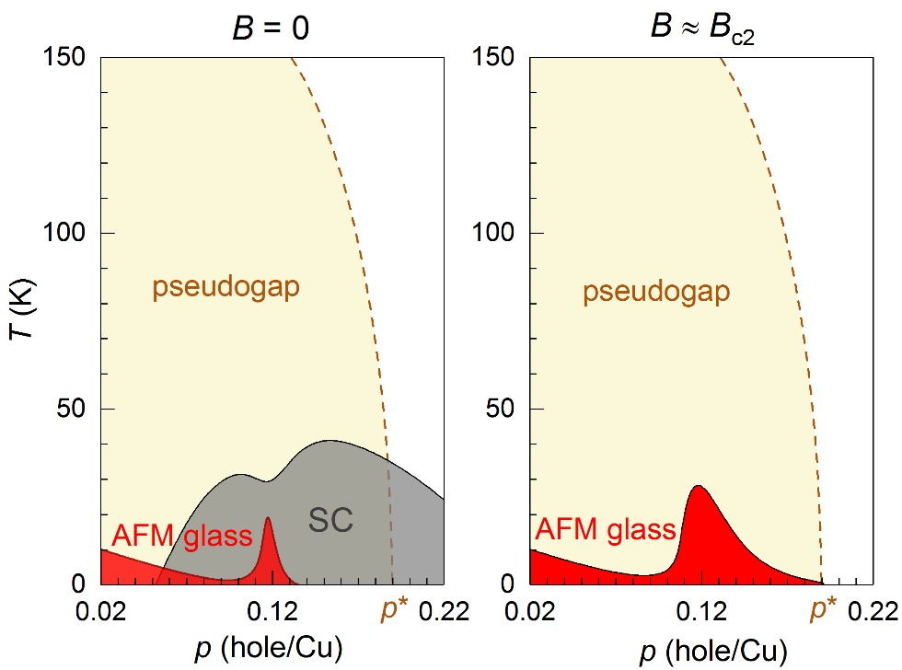
High magnetic fields reveal hidden magnetism in a cuprate superconductor
M. Frachet¹*, I. Vinograd¹*, R. Zhou¹, S. Benhabib¹, S. Wu¹, H. Mayaffre¹, S. Krämer¹,
S. K. Ramakrishna², A. P. Reyes², C. Proust¹, D. LeBoeuf¹, M.-H. Julien¹
1. Laboratoire National des Champs Magnétiques Intenses, Grenoble & Toulouse, France; 2. NHMFL
Funding Grants: C. Proust, D. LeBoeuf, M.-H. Julien (ANR); R. Zhou (NNSFC, CAS); G.S. Boebinger (NSF DMR-1644779)
The nature of the pseudogap phase of hole-doped cuprate superconductors still eludes explanation. Several experiments have suggested that this phase ends at a critical hole doping level p*~0.19, but the nature of the ground state for lower doping is still an open question.
In this work, this group of researchers used high magnetic fields to quench superconductivity in La_{2−p}Sr_{p}CuO₄ to access the ground state and study its magnetic properties with local (NMR) and bulk (ultrasound) measurements. The experiments discovered that the antiferromagnetic glass, known to be the ground state at low doping levels, actually survives up to a critical hole doping level, p*~0.19 (Fig. 1). Thus the magnetic ground state is partially preempted by the appearance of superconductivity. This research required the resources of three high magnetic field laboratories: the LNCMI Grenoble, LNCMI Toulouse and the NHMFL. The MagLab’s 45T hybrid was used for NMR measurements between 20T and 45T. This MagLab asset uniquely enabled the NMR experiments above 35T for which superconductivity is suppressed, which is essential for detecting the upsurge of magnetism.
These results imply that other high-field experiments near the pseudogap edge in La_{2-p}Sr_{p}CuO₄ are likely to be influenced by this glassy magnetism. More fundamentally, it also shows that the antiferromagnetic glass phase spans from the doped Mott insulator at p = 0.02 all the way up to p* ~ 0.19, which suggests a connection between the pseudogap and the physics of Mott insulators.
Figure 1. Left: the phase diagram of La_{2-p}Sr_{p}CuO₄ in zero external magnetic field (B = 0) shows no obvious connection between the antiferromagnetic (AFM) glass and pseudogap phases. Right: at magnetic fields sufficiently strong that superconductivity is suppressed, the AFM glass actually extends to the critical doping, p*~0.19, of the pseudogap phase, thereby revealing a hitherto hidden connection between the two phases.
Facilities and instrumentation used: 45 T Hybrid magnet
Citation: Frachet, M.; Vinograd, I.; Zhou, R.; Benhabib, S.; Wu, S.; Mayaffre, H.; Kramer, S.; Ramakrishnan, S.; Reyes, A.P.; Debray, J.; Kurosawa, T.; Momono, N.; Oda, M.; Komiya, S.; Ono, S.; Horio, M.; Chang, J.; Proust, D.; LeBoeuf, D.; Julien, M. H., Hidden magnetism at the pseudogap critical point of a cuprate superconductor, Nature Physics, 16, 1745-2481 (2020) doi.org/10.1038/s41567-020-0950-5

Slide 2
High magnetic fields reveal hidden magnetism in a cuprate superconductor
M. Frachet¹*, I. Vinograd¹*, R. Zhou¹, S. Benhabib¹, S. Wu¹, H. Mayaffre¹, S. Krämer¹,
S. K. Ramakrishna², A. P. Reyes², C. Proust¹, D. LeBoeuf¹, M.-H. Julien¹
1. Laboratoire National des Champs Magnétiques Intenses, Grenoble & Toulouse, France; 2. NHMFL
Funding Grants: C. Proust, D. LeBoeuf, M.-H. Julien (ANR); R. Zhou (NNSFC, CAS); G.S. Boebinger (NSF DMR-1644779)
What is the finding? A connection has been discovered between a particular form of magnetism (the so-called “antiferromagnetic glass” phase shown in Fig. 1) and the “pseudogap”, an emblematic phenomenon of the cuprates. The cuprates are a family of layered copper oxides that show superconductivity at high temperatures. This research group studied a particular cuprate whose chemical formula is La_{2-p}Sr_{p}CuO₄.
Why is this important? Understanding the pseudogap state is thought to be key to understanding cuprate superconductivity, which is itself is thought to be a crucial step toward the realization of room temperature superconducting applications. These high-field experiments tell us something fundamental about the pseudogap: despite being a metal, its magnetic properties are less like a normal metal and much closer to those of an insulator with strongly repelling electrons. This work also concludes that other high-field measurements in La_{2-p}Sr_{p}CuO₄ near the pseudogap edge at p*~0.19 might be influenced by this glassy magnetism.
Why did this research need the MagLab? Superconductivity actually hinders the development of magnetism. The MagLab’s unique 45T hybrid magnet was instrumental for the nuclear magnetic resonance (NMR) experiments, since fields of ~40T proved necessary to both quench superconductivity and detect the concomitant upsurge of magnetism at low temperatures. To reach the conclusions of this study, this group used two complementary techniques (NMR & sound velocity) and three different high-field facilities, the DC magnets in Grenoble and Tallahassee and the pulsed magnets in Toulouse. The MagLab’s 45T hybrid was utilized for the NMR measurements between 20T and 45T.
Figure 1. Left: the phase diagram of La_{2-p}Sr_{p}CuO₄ in zero external magnetic field (B = 0) shows no obvious connection between the antiferromagnetic (AFM) glass and pseudogap phases. Right: at magnetic fields sufficiently strong that superconductivity is suppressed, the AFM glass actually extends to the critical doping, p*~0.19, of the pseudogap phase, thereby revealing a hitherto hidden connection between the two phases.
Facilities and instrumentation used: 45 T Hybrid magnet
Citation: Frachet, M.; Vinograd, I.; Zhou, R.; Benhabib, S.; Wu, S.; Mayaffre, H.; Kramer, S.; Ramakrishnan, S.; Reyes, A.P.; Debray, J.; Kurosawa, T.; Momono, N.; Oda, M.; Komiya, S.; Ono, S.; Horio, M.; Chang, J.; Proust, D.; LeBoeuf, D.; Julien, M. H., Hidden magnetism at the pseudogap critical point of a cuprate superconductor, Nature Physics, 16, 1745-2481 (2020) doi.org/10.1038/s41567-020-0950-5

