Slide 1
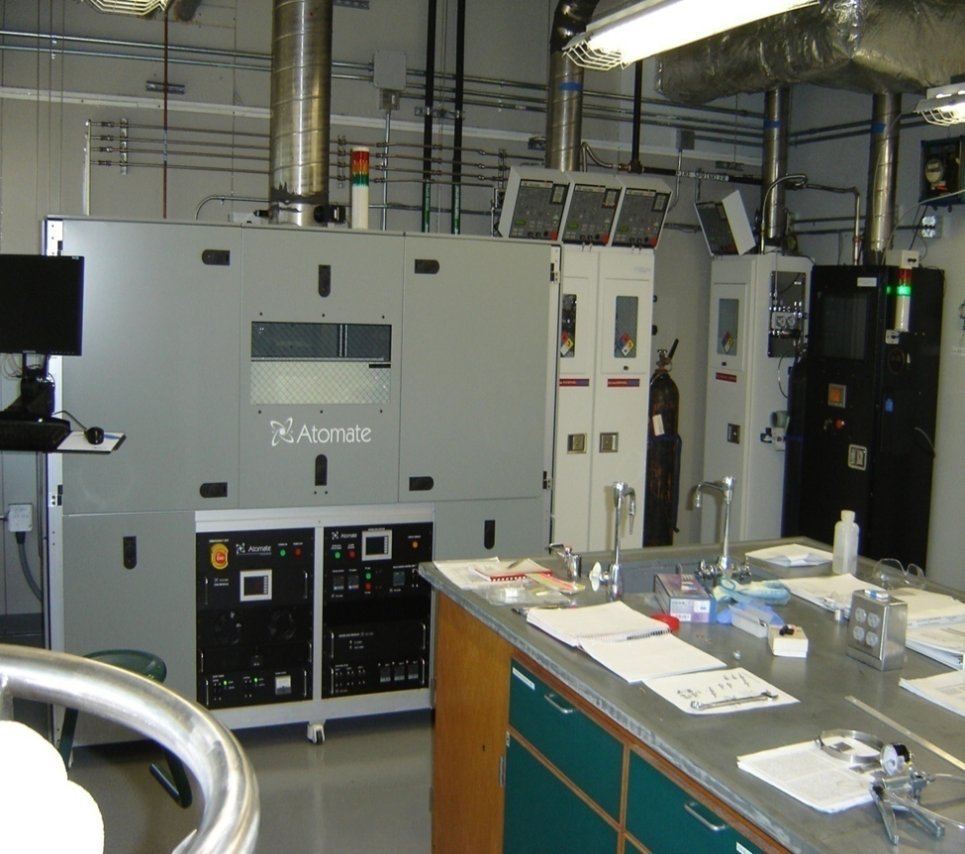
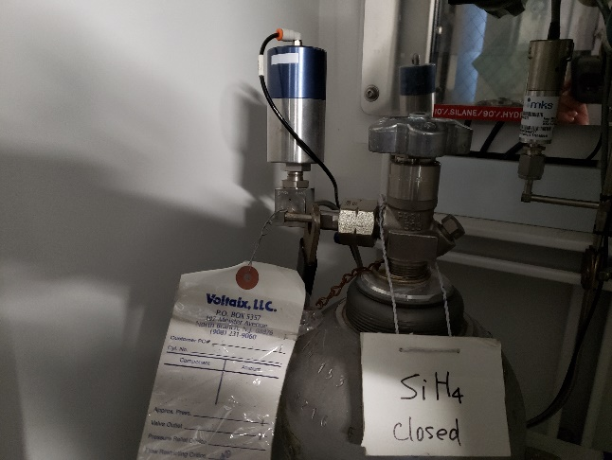
Safely Disassembling a Chemical Vapor Deposition System
at the MagLab
Funding Grants: G.S. Boebinger (NSF DMR-1157490, NSF DMR-1644779)
What was the status of the Low-Pressure Chemical Vapor Deposition (LPCVD) System?
-- A professor, whose research involved chemical vapor deposition of semiconductor nanostructures using toxic gasses, departed Florida State University (FSU) and the MagLab, leaving the equipment in a safe state.
-- After several years of sitting dormant, during which time it was determined that no future hire would be sought to utilize this expensive system, it was decided to remove the system.
-- Recognizing that disassembly could involve new hazards, a full Integrated Safety Management (ISM) analysis was initiated.
What were the potential hazards?
High pressure and/or poisonous gases
Flammable and pyrophoric gas mixture
Electrical power as an ignition source
Assumed unknown state of carrier gas lines
What controls under the Integrated Safety Management System (ISM) were used to limit risk?
Three MagLab subject matter experts were consulted.
An independent subject matter expert from AirGas was consulted on the hazardous gasses.
A Safety Standard Operating Procedure was developed and approved that included:
Two qualified workers always present during work
Ventilation continuously monitored during work
FSU’s chemical safety office handled the hazardous waste disposal.
Chemical Vapor Deposition System in MagLab’s Room C318 that needed to be safely disassembled.
To err on the side of safety, it was assumed that all volumes were in an unknown state throughout the gas handling system consisting of carrier gas lines and the gas cabinet. The gas cabinet contained:
10% phosphine balance hydrogen
10% germane balance hydrogen
1% diborane balance helium
There was an issue with a control valve (right photo) in the purging process that prohibited the safety group from completing the final purge, potentially trapping gas in the final length of tubing from the last cylinder, which contained 10% silane balance hydrogen. The ISM process addressed this situation safely.

