Slide 1
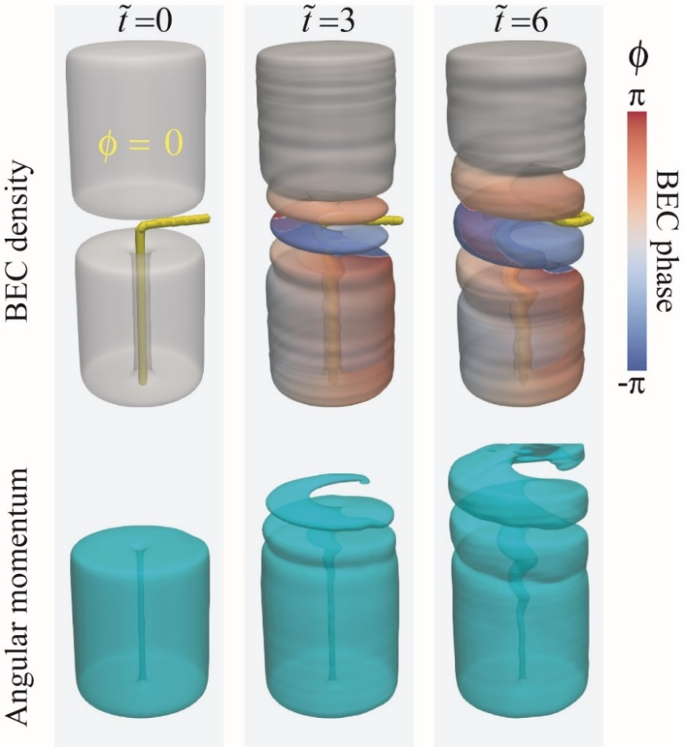
Rotating Superfluids Merge Like Corkscrews
Toshiaki Kanai^{1,2}, Wei Guo^{1,3}, Makoto Tsubota⁴, Dafei Jin⁵,
National High Magnetic Field Laboratory, Tallahassee, USA; 2. Dept. of Physics, Florida State University;
3. Mechanical Engineering Dept., Florida State University; 4. Dept. of Physics, Osaka City University, Osaka, Japan; 5. Argonne National Laboratory, Argonne, USA
Funding Grants: G.S. Boebinger (NSF DMR-1157490, NSF DMR-1644779); W. Guo (NSF DMR-1807291); M. Tsubota (JP17K05548); D. Jin (DE-AC02-06CH11357)
When rotating classical fluids merge, the viscous shear force at the interface can lead to the formation of vortical structures, the drifting of which assists angular momentum transfer from one fluid body to another. However, for inviscid quantum fluids such as Bose-Einstein Condensates (BECs), little is known on what flow structures may form at the interface and how the angular momentum transfer is achieved between rotating BECs.
Researchers report the first numerical study of the merging dynamics of two rotating atomic BECs in three dimensional space. A soliton sheet resembling a “corkscrew” spontaneously emerges at the interface (see yellow line in the figure). Angular momentum transfer is achieved via a novel mechanism: the solitonic “corkscrew” exerts a torque that directly creates angular momentum in the initially static BEC and annihilates angular momentum in the rotating BEC. Strikingly, this rapid angular momentum transfer occurs without involving fluid transfer between the two BECs.
Uncovering this fascinating angular momentum transport mechanism not only enriches our knowledge of merging BECs but also has a far-reaching impact due to its relevance to the dynamical evolution of various rotating coherent matter-wave systems, such as the merging of spinning neutron stars and the collision of revolving galactic dark matter halos that are believed to form Bose-Einstein Condensates.
Bose-Einstein Condensate
(BEC) density
Figure: Evolution of the Bose-Einstein Condensate (BEC) density and angular momentum during the merging of a rotating BEC with an initially static BEC.
Facilities and instrumentation used: The work was done at the Cryogenics Lab of the National High Magnetic Field Laboratory.
Citation: T. Kanai, W. Guo, M. Tsubota, and D. Jin, “Torque and Angular Momentum Transfer in Merging Rotating Bose-Einstein Condensates”, Phys. Rev. Lett., 124, 105302 (2020). DOI: https://doi.org/10.1103/PhysRevLett.124.105302

Slide 2
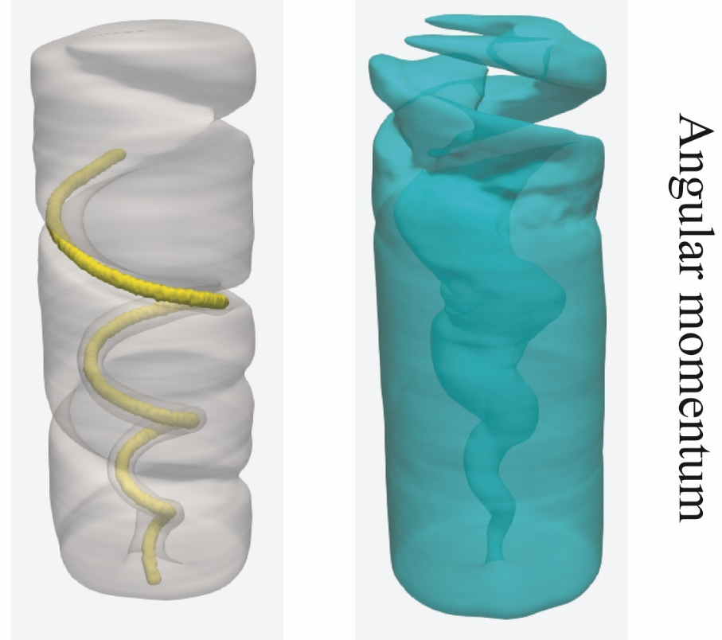
Rotating Superfluids Merge Like Corkscrews
Toshiaki Kanai^{1,2}, Wei Guo^{1,3}, Makoto Tsubota⁴, Dafei Jin⁵,
National High Magnetic Field Laboratory, Tallahassee, USA; 2. Dept. of Physics, Florida State University;
3. Mechanical Engineering Dept., Florida State University; 4. Dept. of Physics, Osaka City University, Osaka, Japan; 5. Argonne National Laboratory, Argonne, USA
Funding Grants: G.S. Boebinger (NSF DMR-1157490, NSF DMR-1644779); W. Guo (NSF DMR-1807291); M. Tsubota (JP17K05548); D. Jin (DE-AC02-06CH11357)
What is the finding? Superfluids have no viscosity. This research reveals how rotating superfluid drops merge. Unlike the eddies found in classical fluids, a “corkscrew” structure transfers rotation from one superfluid drop to another by exerting torques on the two drops without transferring fluid.
Why is this important? As Lord Kelvin and Helmholtz revealed in the 19th century, eddies can form at the interface of a rotating water drop and the surrounding static water body, which spreads out the angular momentum (a measure of the amount of rotation). The work reveals a new mechanism for angular momentum transfer between rotating superfluids, such as Bose-Einstein condensates (BECs). The mechanism involves the emergence of a “corkscrew” structure that serves a function similar to that of a real corkscrew for opening wine bottles: the rotating BEC exerts a torque through the “corkscrew” and forces the static BEC to rotate! Uncovering this intriguing mechanism can have a far-reaching impact on the study of various rotating superfluid systems, such as the merging of spinning neutron stars that consist of neutron-pair superfluid and the collision of revolving galactic dark matter halos that are also believed to form BECs.
Why did this research need the MagLab? The cryogenics lab at the Maglab has extensive experience with both basic and applied research on superfluids, the base of this research.
Bose-Einstein Condensate
(BEC) density
Figure: On the left, calculated BEC density profile showing the “corkscrew” structure that spontaneously forms in a rotating BEC after merging with an initially static BEC. On the right, the corresponding profile of the angular momentum.
Facilities and instrumentation used: The work was done at the Cryogenics Lab of the National High Magnetic Field Laboratory.
Citation: T. Kanai, W. Guo, M. Tsubota, and D. Jin, “Torque and Angular Momentum Transfer in Merging Rotating Bose-Einstein Condensates”, Phys. Rev. Lett., 124, 105302 (2020). DOI: https://doi.org/10.1103/PhysRevLett.124.105302

