Slide 1
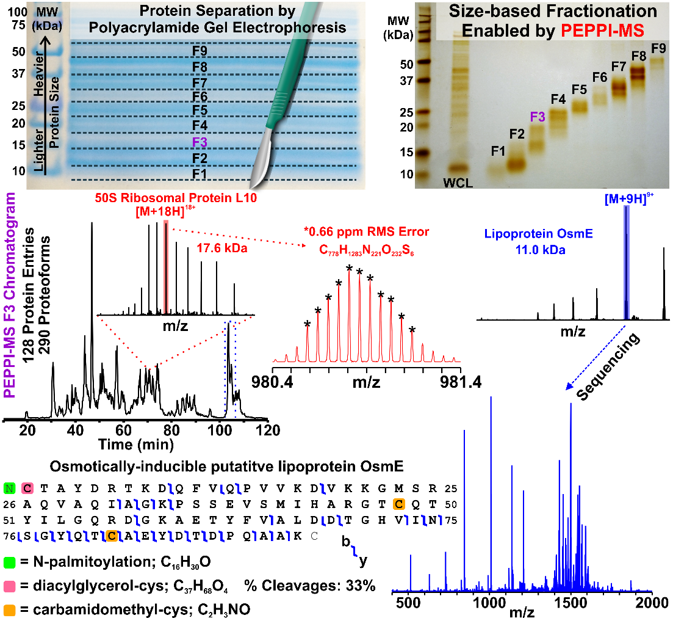
Prefractionation of Intact Proteins for Mass Spectrometry
David S. Butcher¹, Ayako Takemori², Nobuaki Takemori², and Lissa C. Anderson¹
1. National High Magnetic Field Laboratory, Florida State University, Tallahassee, FL
2. Advanced Research Support Center, Ehime University, Toon, Ehime, Japan
Funding Grants: G.S. Boebinger (NSF DMR-1644779); N. Takemori (JSPS KAKHENI 16K08937, 18H04559, 19K05526 )
Intact protein mass analysis, or “top-down” proteomics (TDP), provides molecular understanding of phenotype that is otherwise unobtainable. Polyacrylamide gel electrophoresis (PAGE) is a widespread analytical tool that provides approximate molecular weight-based prefractionation of intact proteins. Until now there has been no means to efficiently recover intact proteins from PAGE gels, which has long been a barrier for coupling PAGE with high resolution, accurate mass TDP.
A new technique, PEPPI-MS (Passively Eluting Proteins from Polyacrylamide gels as Intact species for Mass Spectrometry), prefractionates protein mixtures into discrete molecular weight (MW) ranges with widely available PAGE materials and equipment. These TDP experiments identified more than 1000 proteoforms from PEPPI-MS samples; performance equivalent to other far more complex and expensive prefractionation strategies.
PEPPI-MS will empower many laboratories to prepare samples for intact protein mass analysis. PEPPI-MS does not require expensive or specialized equipment or consumables, and provides several advantages over other methods. PAGE parameters such as gel percentage, buffer system, and the MW range of the fractions can be easily tailored to the proteins of interest in the sample to optimize performance.
(top left) prefractionates proteins derived from E. coli whole cell lysate. (right) PEPPI-MS efficiently recovers the intact proteins from PAGE gels, which enables (bottom) rapid top-down protein identification by 21 T FT-ICR mass spectrometry.
Instrumentation used: 21T FT-ICR Mass Spectrometer
Citation: Takemori, A.; Butcher, D. S.; Harman, V. M.; Brownridge, P.; Shima, K.; Higo, D.; Ishizaki, J.; Hasegawa, H.; Suzuki, J.; Yamashita, M.; et al. PEPPI-MS: Polyacrylamide-Gel-Based Prefractionation for Analysis of Intact Proteoforms and Protein Complexes by Mass Spectrometry,
J. Proteome Research, (2020) https://doi.org/10.1021/acs.jproteome.0c00303. (ACS Editor’s Choice Selection granted free public access)

Slide 2
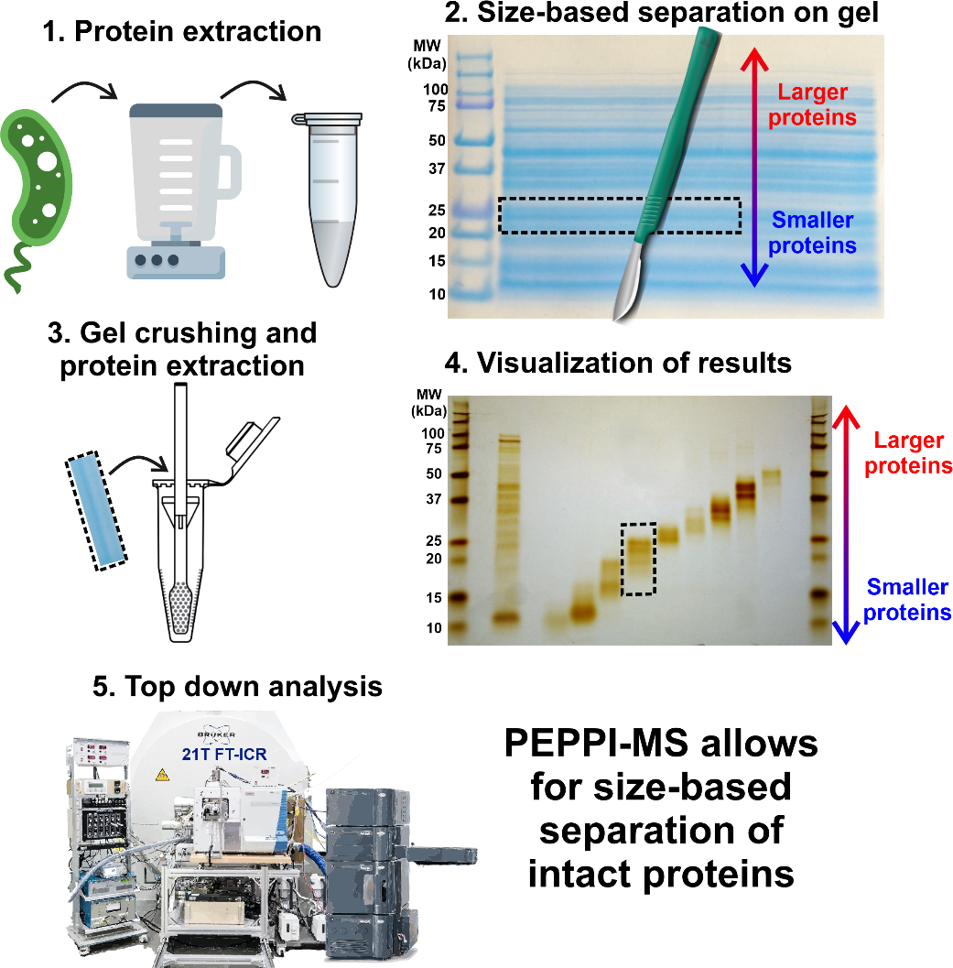
Prefractionation of Intact Proteins for Mass Spectrometry
David S. Butcher¹, Ayako Takemori², Nobuaki Takemori², and Lissa C. Anderson¹
1. National High Magnetic Field Laboratory, Florida State University, Tallahassee, FL
2. Advanced Research Support Center, Ehime University, Toon, Ehime, Japan
Funding Grants: G.S. Boebinger (NSF DMR-1644779); N. Takemori (JSPS KAKHENI 16K08937, 18H04559, 19K05526 )
What is the finding? Intact protein analysis (“top down proteomics”) by mass spectrometry attempts to fully characterize proteins found in biological systems. This can be a difficult problem, as even a relatively simple extract from bacteria contains thousands of proteins.
The complex mixture of proteins can be simplified by prefractionation, in which protein mixtures are separated into several simpler fractions based on size. This collaboration developed a new method for prefractionation called PEPPI-MS (Passively Eluting Proteins from Polyacrylamide gels as Intact species for Mass Spectrometry).
Why is this important? Existing prefractionation methods require expensive, dedicated equipment, which limits access to only a few researchers. PEPPI-MS uses low-cost materials and equipment commonly found in biochemistry laboratories, which makes an important separation strategy for top down proteomics widely available.
Why did this research need the MagLab? Development and optimization of PEPPI-MS required advanced characterization of protein mixtures using the MagLab’s unique 21T FT-ICR mass spectrometry instrument. In recognition of the importance of this new technique, the PEPPI-MS publication was selected ACS Editors’ Choice® and granted free public access.
Facilities and instrumentation: Ion Cyclotron Resonance Facility (21 T Fourier Transform – Ion Cyclotron Resonance Mass Spectrometer)
Citation: Takemori, A.; Butcher, D. S.; Harman, V. M.; Brownridge, P.; Shima, K.; Higo, D.; Ishizaki, J.; Hasegawa, H.; Suzuki, J.; Yamashita, M.; et al. PEPPI-MS: Polyacrylamide-Gel-Based Prefractionation for Analysis of Intact Proteoforms and Protein Complexes by Mass Spectrometry,
J. Proteome Research, (2020) https://doi.org/10.1021/acs.jproteome.0c00303. (ACS Editor’s Choice Selection)

