Slide 1
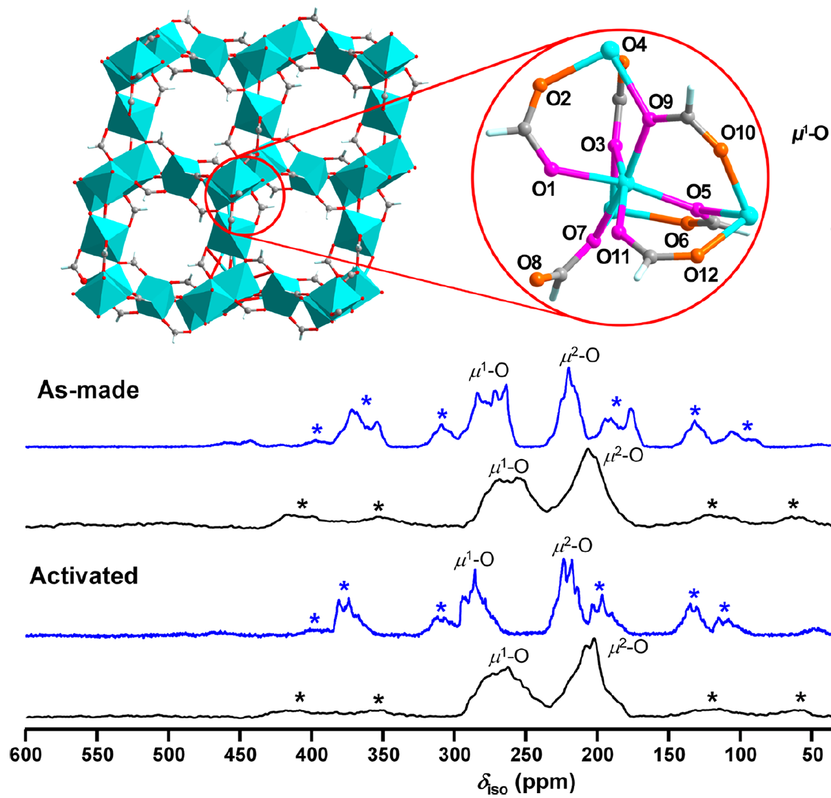
Probing Metal Organic Frameworks with ¹⁷O NMR at 35.2 T
V. Martins¹, J. Xu², X. Wang³, K. Chen³, I. Hung³, Z. Gan³, C. Gervais⁴, C. Bonhomme⁴, S. Jiang⁵,
A. Zheng⁵, B. Lucier¹, Y. Huang¹
1. Western University, London, ON, Canada; 2. Nankai University, Tianjin, China; 3. NHMFL, Tallahassee FL, USA; 4. Sorbonne University, Paris, France; 5. Chinese Academy of Sciences, Wuhan, China
Funding Grants: G.S. Boebinger (NSF DMR-1644779); Y. Huang (NSERC)
Metal-organic frameworks (MOFs) are a new generation of porous materials prepared via self-assembly of metal ions and organic linkers. MOFs have the properties of high thermal stability, permanent porosity, framework flexibility, and exceptionally high surface areas. MOFs promise many potential applications in catalysis, drug delivery, chemical separation, gas adsorption and storage, fuel cells, and even, potentially, classical and quantum data storage.
Solid-state nuclear magnetic resonance (NMR) of oxygen and metal atoms can typically determine the molecular structure of MOFs as well as the interactions between the MOFs and guest molecules like hydrogen, carbon dioxide and methane. Oxygen-17 (¹⁷O) NMR can help to identify the different types of oxygen sites in the framework; however, ¹⁷O is a challenge for NMR because it (i) has low natural abundance, (ii) low NMR frequency, and (iii) broad spectral lines from its quadrupolar interaction.
The MagLab’s series-connected hybrid (SCH) magnet dramatically enhances ¹⁷O NMR signal and spectral resolution…more than any other spectrometer in the world. This allows for the resolution of 12 unique oxygen sites in a α-Mg₃(HCOO)₆ MOF, including the observation of structural differences between as-made and activated (solvent removed) phases of this MOF.
(top) The α-Mg₃(HCOO)₆ metal-organic framework that contains twelve unique oxygen sites. (bottom) Oxygen-17 Magic Angle Spinning NMR spectra at 35.2 T (in blue) and at 21.1T (in black). Note that the twelve unique oxygen sites (asterisks) are only resolved in the MagLab’s unique 35.2T Series Connected Hybrid Magnet.
Facilities and instrumentation used: NMR/MRI facilities and the 35.2T Series Connected Hybrid
Citation: Vinicius Martins, Jun Xu*, Xiaoling Wang, Kuizhi Chen, Ivan Hung, Zhehong Gan, Christel Gervais, Christian Bonhomme, Shijia Jiang, Anmin Zheng, Bryan E. G. Lucier, and Yining Huang. Higher Magnetic Fields, Finer MOF Structural Information: ¹⁷O Solid-State NMR at 35.2 T; Journal of the American Chemical Society 142, 35, 14877-14889; July 30, 2020; DOI: 10.1021/jacs.0c02810

Slide 2
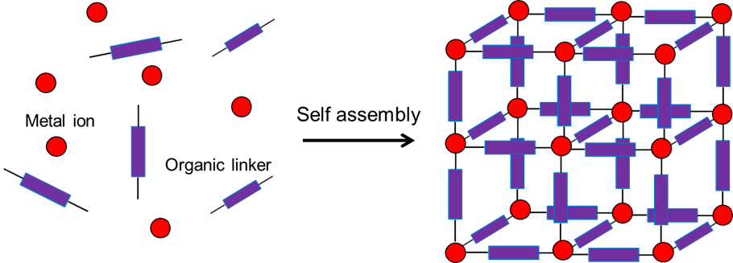
Probing Metal Organic Frameworks with ¹⁷O NMR at 35.2 T
V. Martins¹, J. Xu², X. Wang³, K. Chen³, I. Hung³, Z. Gan³, C. Gervais⁴, C. Bonhomme⁴, S. Jiang⁵,
A. Zheng⁵, B. Lucier¹, Y. Huang¹
1. Western University, London, ON, Canada; 2. Nankai University, Tianjin, China; 3. NHMFL, Tallahassee FL, USA; 4. Sorbonne University, Paris, France; 5. Chinese Academy of Sciences, Wuhan, China
Funding Grants: G.S. Boebinger (NSF DMR-1644779); Y. Huang (NSERC)
What is the finding? The highest-field nuclear magnetic resonance (NMR) spectrometer in the world was able to resolve 12 distinct oxygen sites in the structure of a complex metal-organic framework (MOF) and observe differences in the structures of MOFs that either contain guest molecules or are free from guest molecules.
Why is this important? In order to design better MOFs for use in catalysis, drug delivery, chemical separation, gas adsorption, fuel cells, and/or data storage, scientists must have a precise understanding of their structures. This helps in the design and manufacture of new MOFs from very simple chemicals, and also for tailoring and controlling the properties of MOFs for a wide range of applications.
Why did this research need the MagLab? The NMR spectrometer magnet used for this work, the MagLab’s 35.2 Tesla Series-Connected Hybrid (SCH) magnet, is the largest NMR magnet in the world, and is the only one capable of obtaining high enough signal and resolution to enable observation of all of the different oxygen sites. The ¹⁷O isotope is challenging to observe with lower field instruments, which cannot provide this high degree of information. The SCH will permit many future ¹⁷O NMR studies, as well as studies of elements from across the periodic table in MOFs and other technologically advanced materials!
Metal-organic frameworks (MOFs)
Facilities and instrumentation used: NMR/MRI facilities and the 35.2T Series Connected Hybrid
Citation: Vinicius Martins, Jun Xu*, Xiaoling Wang, Kuizhi Chen, Ivan Hung, Zhehong Gan, Christel Gervais, Christian Bonhomme, Shijia Jiang, Anmin Zheng, Bryan E. G. Lucier, and Yining Huang. Higher Magnetic Fields, Finer MOF Structural Information: ¹⁷O Solid-State NMR at 35.2 T; Journal of the American Chemical Society 142, 35, 14877-14889; July 30, 2020; DOI: 10.1021/jacs.0c02810

