Slide 1
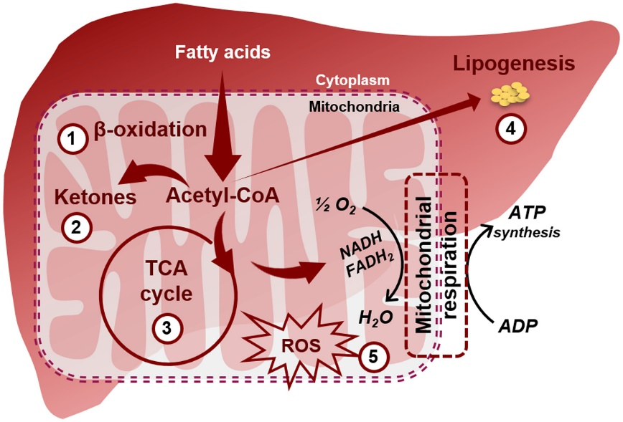
Using Magnetic Resonance to Probe Lipid Synthesis
in Response to Ketogenic Diet
M.S. Muyyarikkandy¹, M. McLeod², M. Maguire¹, R. Mahar², N. Kattapuram¹, C. Zhang¹, C. Surugihalli¹,
V. Muralidan¹, K. Vavilikolanu¹, C.E. Mathews², M.E. Merritt², and N.E. Sunny¹
¹ University of Maryland, College Park, MD; ² University of Florida, Gainesville, FL
Funding: G.S. Boebinger (NSF DMR-1644779); N. Sunny and M.E. Merritt (NIH R01DK112865)
Non-alcoholic Fatty Liver Disease (NAFLD) is a metabolic dysregulation of fatty acid synthesis and oxidation that leads to lipid accumulation in the liver. NAFLD is a burgeoning world health issue, with a current estimate of 25% incidence in the USA. Initial stage NAFLD is innocuous, but in a sub-population of ~10%, it can progress to non-alcoholic steatohepatitis, which can lead to liver failure and the need for transplant, perhaps becoming the main cause for liver transplantation in the next 5 years.
Prior work focused primarily on the metabolic effects of increasing levels of circulating fatty acids on the accumulation of hepatic lipid stores. Here, we further examine the effect of a ketogenic diet on de novo lipogenesis (DNL) in the liver tissue of mice fed one of three diets: low fat (LF), high fat (HF), or HF plus increased branched-chain amino acids (HF-Kt) diet, as shown in the deuterium magnetic resonance (DMR) spectra at the top of the figure.
The chemical selectivity DMR allows detection of site specific ²H enrichment in liver fats after exposure to 1% D₂O added to the drinking water for 4 days. DNL is accurately determined by the enrichment achieved at the methyl position of the fatty acids (labeled a). This methyl peak can only be labeled if the entire fatty acid was synthesized from the most basic starting element, acetyl-CoA. This data shows addition of a ketogenic diet in the context of high fats significantly slows the DNL process.
Using MR estimates of DNL, as well as mass spectrometry based estimates of TCA cycle turnover (bottom panel), we can directly assay the changes in central hepatic metabolism. While the HF-Kt diet slows DNL, it also has complicated multi-factorial effects on hepatic energy homeostasis including an increase of reactive oxygen species (ROS) production. Future work will develop DMR for in vivo use.
Low
Fat
Diet
High Fat Diet
“Ketogenic” addition to High Fat Diet
Instrumentation: AMRIS Facility, Gainesville, FL; 14.1 T Bruker Bio-Spin equipped with 1.7mm TCI CryoProbe and Avance Neo Console
Citation: Muyyarikkandy, M.S.; McLeod, M.; Maguire, M.; Mahar, R.; Kattapuram, N.; Zhang, C.E.; Surugihalli, C.; Muralidaran, V.; Vavilikolanu, K.; Mathews, C.E.; Merritt, M.E.; Sunny, N.E., Branched chain amino acids and carbohydrate restriction exacerbate ketogenesis and hepatic mitochondrial oxidative dysfunction during NAFLD, FASEB Journal, The FASEB Journal. 2020;00:1–18, doi.org/10.1096/fj.202001495R
Notes:
1. What is the finding?
Here to be included a short description in layman language of the finding
2. Why this finding is important?
A short description of why the finding is important for scientific community, technology, society, etc…
3. Why NHMFL?
The answer to this question should provide information on why this finding could be achieved (only) at NHMFL (what unique capability of MagLab was essential for this finding).

Slide 2
Using Magnetic Resonance to Probe Lipid Synthesis
in Response to Ketogenic Diet
M.S. Muyyarikkandy¹, M. McLeod², M. Maguire¹, R. Mahar², N. Kattapuram¹, C. Zhang¹, C. Surugihalli¹,
V. Muralidan¹, K. Vavilikolanu¹, C.E. Mathews², M.E. Merritt², and N.E. Sunny¹
¹ University of Maryland, College Park, MD; ² University of Florida, Gainesville, FL
Funding: G.S. Boebinger (NSF DMR-1644779); N. Sunny and M.E. Merritt (NIH R01DK112865)
Background information: Non-alcoholic Fatty Liver Disease and its subsequent progress to more serious disease will become the main cause for liver transplantation in the next 5 years. No drugs exist for treatment of non-alcoholic fatty liver disease, as the metabolic trigger for transition to more serious disease is still unknown.
What is the finding? MagLab users mice fed low fat diets, high fat diets, and a high fat diet that included “Ketogenic” elements. They administered 1% deuterium (D=²H) in drinking water (D₂O) because it can be tracked using magnetic resonance as lipids are synthesized in response to diet. Finally, they extracted fats for an assessment of lipid synthesis using deuterium magnetic resonance (DMR).
D₂O was incorporated into multiple fatty acids, producing DMR spectra. Peak “a” comes specifically from the methyl group, which is only labeled with deuterium if the fatty acid chain was made completely new from the injested food. The ketogenic addition to a high fat diet significantly slowed new lipid synthesis, as evidenced by the smaller Peak “a”. Other effects (not discussed here), like an increase in reactive oxygen species, also are observed.
Why is this important? Ketogenic diets are now commonly being suggested as a means of lowering levels of hepatic fatty acids. This research illuminates the effects on lipid synthesis of a ketogenic diet at the molecular level.
Why did the research need the MagLab? The MagLab’s AMRIS Facility has a CryoProbe and 14.1 T field strength for magnetic resonance that can detect ²H nuclei with the high sensitivity needed to see metabolic differences.
Low
Fat
Diet
High Fat Diet
“Ketogenic” addition to High Fat Diet
(Above) Deuterium magnetic resonance spectra of fatty
acids shows that treatment with
a ketogenic diet slows new lipid synthesis (peak a) when compared
to low fat and high fat diets.
(Left) Overall hepatic metabolism is significantly altered by diet. This study finds beneficial effects on lipid synthesis, but the ketogenic diet is also found to increase reactive oxygen species (ROS) production in the liver.
Instrumentation: AMRIS Facility, Gainesville, FL; 14.1 T Bruker Bio-Spin equipped with 1.7mm TCI CryoProbe and Avance Neo Console
Citation: Muyyarikkandy, M.S.; McLeod, M.; Maguire, M.; Mahar, R.; Kattapuram, N.; Zhang, C.E.; Surugihalli, C.; Muralidaran, V.; Vavilikolanu, K.; Mathews, C.E.; Merritt, M.E.; Sunny, N.E., Branched chain amino acids and carbohydrate restriction exacerbate ketogenesis and hepatic mitochondrial oxidative dysfunction during NAFLD, FASEB Journal, The FASEB Journal. 2020;00:1–18, doi.org/10.1096/fj.202001495R
Notes:
1. What is the finding?
Here to be included a short description in layman language of the finding
2. Why this finding is important?
A short description of why the finding is important for scientific community, technology, society, etc…
3. Why NHMFL?
The answer to this question should provide information on why this finding could be achieved (only) at NHMFL (what unique capability of MagLab was essential for this finding).

