Slide 1
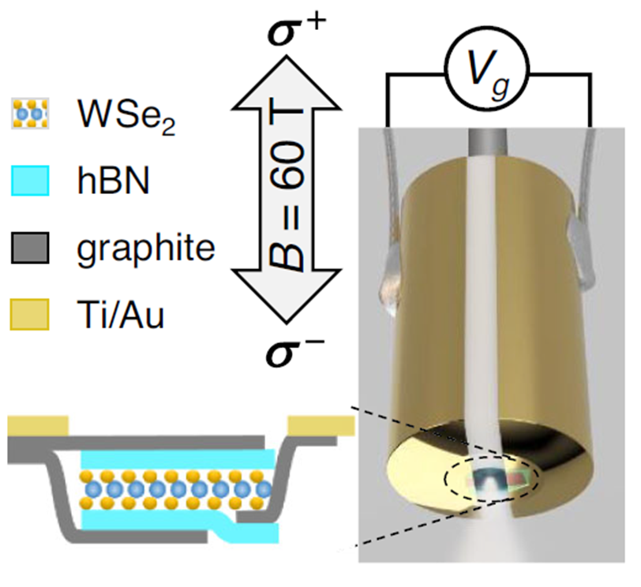
Spontaneous “valley magnetization” in an atomically-thin semiconductor
J. Li¹, M. Goryca¹, N. P. Wilson², A. V. Stier¹, X. Xu², S. A. Crooker¹
NHMFL, Los Alamos National Laboratory; 2. University of Washington
Funding Grants: G.S. Boebinger (NSF DMR-1644779)
S. A. Crooker (DOE BES ‘Science of 100T’, Los Alamos LDRD); X. Xu (DOE DE-SC0018171)
Electron-electron (e-e) interactions underpin many interesting phenomena in 2D layers of mobile charges, including the fractional quantum Hall effect, spin textures (like skyrmions), and quantum Hall ferromagnetism. These phenomena arise from Coulomb repulsion between charges, which in turn typically enhances the susceptibility of spin and related “pseudospin” degrees of freedom (like valley degrees of freedom). The e-e interactions can even cause instabilities and spontaneous transitions to broken-symmetry phases.
These studies show that, in the new family of atomically-thin semiconductors such as WSe₂, e-e interactions can indeed drive instabilities wherein all the charge carriers spontaneously occupy the same “valley pseudospin” state. In this user experiment, a dual-gated WSe₂ monolayer was directly assembled over the core of a single-mode optical fiber, enabling circularly-polarized absorption spectroscopy in pulsed fields to 60T. At certain carrier (hole) densities, Landau levels (LLs) in the K and K’ valleys were brought into near-alignment, at which point discontinuities in the absorption spectra revealed the field-dependent filling and discontinuous emptying of LLs in K’ valley, indicating spontaneous valley polarization.
This work broadens the scope for future studies in atomically-thin materials in general - and valleytronics in particular - by using carrier density-dependent valley Zeeman energy to create strongly interacting electron systems.
(A) (B)
absorption
(C)
K
K’
Energy (eV)
(A) The WSe₂ monolayer-on-fiber assembly used for optical absorption studies in 60T pulsed magnetic fields. (B) Discrete jumps in the absorption of circularly-polarized light as a function of magnetic field indicate filling and spontaneous emptying of Landau levels in the K’ valley for a hole density of 5.55×10¹² cm⁻². (C) Schematic depicting the filling of the 1K’ LL, and its spontaneous emptying due to electron-electron interactions as |B| decreases.
Facilities used: 65 T pulsed magnet in the Pulsed Field Facility.
Citation: Li, J., Goryca, M., Wilson, N.P., Stier, A.V., Xu, X., Crooker, S.A., Spontaneous Valley Polarization of Interacting Carriers in a Monolayer Semiconductor, Phys. Rev. Lett. 125, 147602 (2020); DOI: 10.1103/PhysRevLett.125.147602

Slide 2
Spontaneous “valley magnetization” in an atomically-thin semiconductor
J. Li¹, M. Goryca¹, N. P. Wilson², A. V. Stier¹, X. Xu², S. A. Crooker¹
NHMFL, Los Alamos National Laboratory; 2. University of Washington
Funding Grants: G.S. Boebinger (NSF DMR-1644779)
S. A. Crooker (DOE BES ‘Science of 100T’, Los Alamos LDRD); X. Xu (DOE DE-SC0018171)
What is the finding? In a single atomically-thin layer of the semiconductor WSe₂, optical studies have shown that all of the electrons in the material can spontaneously “polarize” – that is, suddenly jump to the same quantum state in the material -- in analogy to the spontaneous magnetization that occurs in conventional magnetic materials such as iron.
Why is this important? Interactions between electrons underpin some of the most interesting effects in condensed-matter physics (including magnetism). In two-dimensional ‘sheets’ of electrons in very high-quality semiconductors, interactions can result in important new phenomena, such as the Fractional Quantum Hall Effect (for which a Nobel prize was awarded in 1998). These experiments on a new family of atomically-thin semiconductors like WSe₂ show that electron-electron interactions are sufficiently strong to drive instabilities wherein all the electrons prefer to occupy the same quantum state, or “valley” – a phenomenon that is directly analogous to magnetization.
Why did this research need the MagLab? Large magnetic fields up to 60 T were essential for creating conditions wherein the ‘valley magnetization’ could spontaneously occur in the monolayer semiconductor. Equally importantly, large fields were needed to separate the different energy levels, so that they could be experimentally distinguished using light.
(A) (B)
absorption
(C)
Energy (eV)
K’ valley
K valley
K’
K
e-e interaction
(A) The tungsten di-selenide (WSe₂) monolayer-on-fiber assembly used for optical absorption studies in 60 tesla magnetic fields. (B) Discrete jumps in the absorption indicate emptying and spontaneous filling of specific quantum states (the “valley”states). (C) A schematic depicting spontaneous valley polarization, driven by electron interactions.
Facilities used: 65 T pulsed magnet in the Pulsed Field Facility.
Citation: Li, J., Goryca, M., Wilson, N.P., Stier, A.V., Xu, X., Crooker, S.A., Spontaneous Valley Polarization of Interacting Carriers in a Monolayer Semiconductor, Phys. Rev. Lett. 125, 147602 (2020); DOI: 10.1103/PhysRevLett.125.147602

