Slide 1


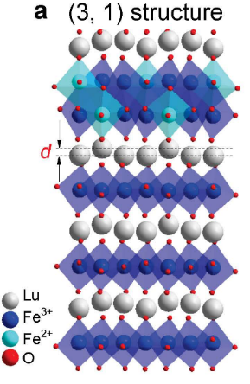
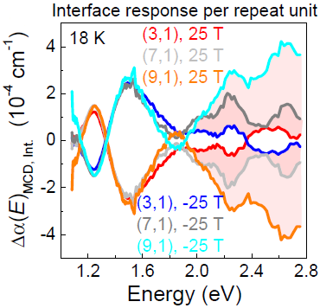
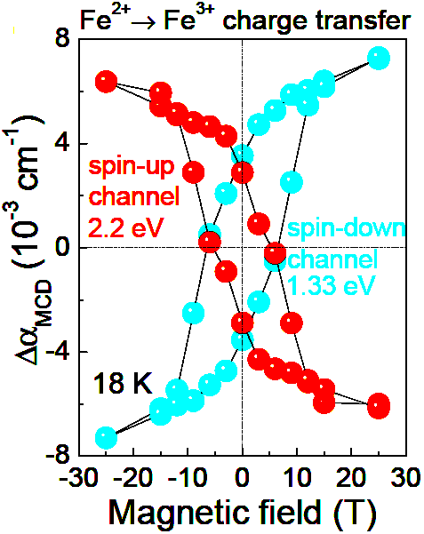
Site-specific spectroscopic measurement of spin and charge in multiferroic superlattices
S. Fan¹, H. Das ², A. Rébola³, K. Smith⁴, J. Mundy⁵ , C. Brooks⁵, M. Holtz⁶, D. Muller⁶, C. Fennie⁶,
R. Ramesh⁷, D. Schlom⁶, S. McGill⁸, and J. Musfeldt^{1,4}
1. University of Tennessee, Physics; 2. Tokyo Institute of Technology; 3. Instituto de Física Rosario-CONICET; 4. University of Tennessee, Chemistry; 5. Harvard University, Physics; 6. Cornell University; 7. University of California, Berkeley; 8. NHMFL
Funding: J. L. Musfeldt (DOE, DE-FG02-45201ER45885), G.S. Boebinger (NSF DMR-1157490, NSF DMR-1644779), S. McGill (NSF, DMR-1644779, DMR-122921), D. Schlom (DOE, DE-SC0002334), D. Muller (NSF, DMR-1719875), H. Das (JSPS, 19K05246 ), and A. Rébola, C. Fennie (NSF, DMR-1539918)
Electric fields can control the magnetism of multiferroic materials, making them technologically interesting. Finding a ferroelectric ferromagnet that is coupled at room temperature is the grand challenge of multiferroics and magnetoelectrics. Heteroepitaxy enlarges the materials design space to achieve this difficult goal. Superlattices of (LuFeO₃)_{m}/(LuFe₂O₄)_{n} are room temperature multiferroics that sport ferroelectric ferrimagnetism. However, the microscopic nature of the interface effects and their connection to the robust magnetism in this system are under-explored and not understood.
The Figure summarizes the magnetic circular dichroic responses of all superlattices studied by this collaboration of MagLab users. Figure (a) shows the crystal structure of the (3,1) superlattice. (b) shows the interface response revealed by subtracting the spectra of bulk LuFeO₃ and LuFe₂O₄ in proper proportion. There is a dramatic intensity change above 2eV at the interfaces of the three superlattices. Analysis of the interface spectra at different energies reveals that increased Lu-layer distortion selectively enhances the spin-up charge transfer. Because the dichroic signal is proportional to magnetization, this implies that enhanced magnetization in the LuFe₂O₄ layers boosts the Curie temperature in these multiferroic superlattices. (c) shows how constant energy cuts of the dichroic spectra reveal optical hysteresis loops.
a
b
c
c
(a) Crystal structure of the (3,1) super-lattice, showing one LuFe₂O₄ slab (with an iron oxide double layer with both Fe²⁺ and Fe³⁺ between a pair of Lu layers) for every three layers of LuFeO₃
(b) Interface magnetic circular dichroic spectra for (3,1), (7,1), and (9,1) superlattices for positive and negative 25T magnetic fields.
(c) Optical hysteresis for the spin-up and spin-down channel Fe²⁺ → Fe³⁺ charge transfer excitations.
Facility used: DC Field Facility: 25T split helix magnet
Citation: Fan, S.; Das, H.; Rebola, A.; Smith, K.A.; Mundy, J.; Brooks, C.; Holtz, M.E.; Muller, D.A.; Fennie, C.J.; Ramesh, R.; Schlom, D.G.; McGill, S.A.; Musfeldt, J., Site-specific spectroscopic measurement of spin and charge in (LuFeO3)m/(LuFe2O4)1 multiferroic superlattices, Nature Communications, 11, 5582 (2020) doi.org/10.1038/s41467-020-19285-9

Slide 2
Site-specific spectroscopic measurement of spin and charge in multiferroic superlattices
S. Fan¹, H. Das ², A. Rébola³, K. Smith⁴, J. Mundy⁵ , C. Brooks⁵, M. Holtz⁶, D. Muller⁶, C. Fennie⁶,
R. Ramesh⁷, D. Schlom⁶, S. McGill⁸, and J. Musfeldt^{1,4}
1. University of Tennessee, Physics; 2. Tokyo Institute of Technology; 3. Instituto de Física Rosario-CONICET; 4. University of Tennessee, Chemistry; 5. Harvard University, Physics; 6. Cornell University; 7. University of California, Berkeley; 8. NHMFL
Funding: J. L. Musfeldt (DOE, DE-FG02-45201ER45885), G.S. Boebinger (NSF DMR-1157490, NSF DMR-1644779), S. McGill (NSF, DMR-1644779, DMR-122921), D. Schlom (DOE, DE-SC0002334), D. Muller (NSF, DMR-1719875), H. Das (JSPS, 19K05246 ), and A. Rébola, C. Fennie (NSF, DMR-1539918)
What is the finding? MagLab users developed a method for extracting interface optical spectra and magnetization in multiferroic superlattices. They employed these techniques to reveal precisely how the enhanced Lu layer distortion increases the temperature for onset of magnetism in a superlattice made of layers of LuFeO₃ and LuFe₂O₄
Why is this important? Understanding the inner workings of multiferroic interface materials is in its infancy. The spectroscopic decomposition method that these users report is a powerful means to learn about how superlattices function via site-specific information gathered directly at the functional interfaces. Opportunities exist to exploit interface materials to advance spintronics and photonics devices. As such, there is broad utility for techniques that reveal interface dynamics that reaches well beyond research into the behavior of multiferroics.
Why did this research need the MagLab? The MagLab’s unique 25T split helix magnet was crucial because it provides direct optical access to the sample in magnetic field. The high coercivity of these superlattices also requires a large ±25 T field to close the hysteresis loop (see Fig c).
a
b
c
(a) Crystal structure of the (3,1) superlattice, showing one LuFe₂O₄ slab (with an iron oxide double layer between two Lu layers) for every three layers of LuFeO₃ (b) Interface magnetic circular dichroic spectra for (3,1), (7,1), and (9,1) superlattices for positive and negative 25T magnetic fields. (c) Optical hysteresis for the spin-up and spin-down channel Fe²⁺ → Fe³⁺ charge transfer excitations.
Facility used: DC Field Facility: 25T split helix magnet
Citation: Fan, S.; Das, H.; Rebola, A.; Smith, K.A.; Mundy, J.; Brooks, C.; Holtz, M.E.; Muller, D.A.; Fennie, C.J.; Ramesh, R.; Schlom, D.G.; McGill, S.A.; Musfeldt, J., Site-specific spectroscopic measurement of spin and charge in (LuFeO3)m/(LuFe2O4)1 multiferroic superlattices, Nature Communications, 11, 5582 (2020) doi.org/10.1038/s41467-020-19285-9

