Slide 1
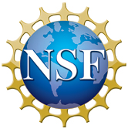
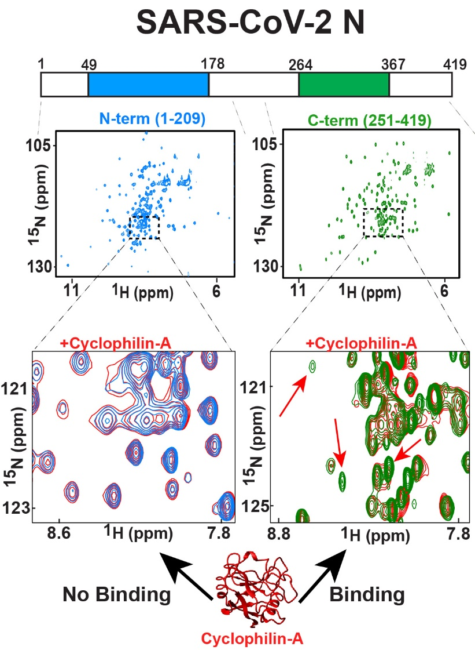
Probing the COVID-19 Nucleocapsid via High-Field NMR
Alexandra Born, Jasmina S. Redzic, Kilsia Mercedes, Aaron Issaian, Beat Vogeli, Angelo D’Alessandro, Elan Z. Eisenmesser
University of Colorado, School of Medicine
Funding Grants: E.Z.Eisenmesser (NSF CLP-1807326); G.S. Boebinger (NSF DMR-1157490, NSF DMR-1644779)
The most abundant protein within SARS-CoV-2 (COVID-19) is the nucleocapsid (N) protein that packages viral RNA and modulates machinery in the targeted host cell during infection. Although several host protein targets of the N protein have been identified, the explicit interaction surfaces and their structures have yet to be identified.
The modular nature of the N protein allows investigators to recombinantly produce the independently folded N- and C-terminal core domains with their flanking regions that have been presumed to be disordered. The collection of NMR assignment spectra and relaxation experiments will allow researchers to identify the explicit dynamic regions, their timescales of motions, and the roles they play in both RNA and host-cell interactions.
For example, Cov N proteins are known to utilize host cell Cyclophilin-A for replication, yet the mechanism remains unknown. Researchers have shown through chemical shift perturbations that the N protein targets Cyclophilin-A through its C-terminal region with ongoing experiments aimed at identifying the specific interaction surfaces and whether inherently dynamic regions are used for such interactions.
Identifying the atomic resolution details of SARS-CoV-2 N protein interactions with its targets will provide avenues for blocking such interactions during the viral life-cycle.
The SARS-CoV-2 N protein comprises two independently folded domains (blue, green) flanked by dynamic regions (white).
Investigators have produced multiple recombinant N protein constructs that include the flanking disordered regions.
NMR is used to screen proposed host protein interactions, thereby confirming their direct interaction and identifying the specific regions of the N protein that are involved in the interaction.
Facilities and instrumentation used: 800 MHz (18.8T), 54 mm bore magnet in the MagLab’s NMR/FSU user facility

Slide 2
Probing the COVID-19 Nucleocapsid via High-Field NMR
Alexandra Born, Jasmina S. Redzic, Kilsia Mercedes, Aaron Issaian, Beat Vogeli, Angelo D’Alessandro, Elan Z. Eisenmesser
University of Colorado, School of Medicine
Funding Grants: E.Z.Eisenmesser (NSF CLP-1807326); G.S. Boebinger (NSF DMR-1157490, NSF DMR-1644779)
What is the finding? MagLab users are characterizing the most abundant protein within the SARS-CoV-2 (COVID-19) virus, called the Nucleocapsid (N) protein. This “N” protein is responsible for both packaging the genetic material (the RNA) of the virus and targeting the host cell machinery to increase virulence. Preliminary studies have revealed that the flexible regions within this N protein are responsible for interacting with targeted host proteins during the viral life cycle. Studies are aimed at determining how these flexible regions move and how they dictate both RNA interactions and interactions with the targeted host cell. These studies include a comparison to the same types of interactions for SARS-CoV-1, the virus responsible for the 2002-2003 SARS outbreak.
Why is this important? High-magnetic-field NMR, combined within recombinant protein methods, facilitates the production of multiple parts of the N protein, allowing MagLab users to completely characterize (a) localized regions of the N protein, (b) their interactions with each other, and (c) the specific regions that the N protein uses to engage both RNA and targeted host proteins. For example, NMR experiments have begun to identify the specific regions of the N protein used to target host proteins, which can be used to develop drugs that block these interactions to fight against COVID-19.
Why did this research need the MagLab? NMR spectra collected at the MagLab allow users to identify each atom within the N protein. Even during the COVID-19 pandemic, remote access to the MagLab's NMR instruments was crucial for collecting spectra and identifying how they change when ligands are added. Such studies have allowed us to quantify movements but also screen proposed host protein interactions quickly.
A schematic of NMR studies of the nucleocapsid from the virus that causes COVID-19, featuring the N protein that comprises 419 residues. Two independently folded domains, one shown here in blue (a small N-terminal domain) and one in green (a dimerization domain), each correspond to a different segment of residues, yet little is known about the movements and the functions of the regions of the structure that are represented in white.
Facilities and instrumentation used: 800 MHz (18.8T), 54 mm bore magnet in the MagLab’s NMR/FSU user facility

