Slide 1
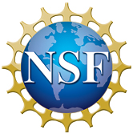
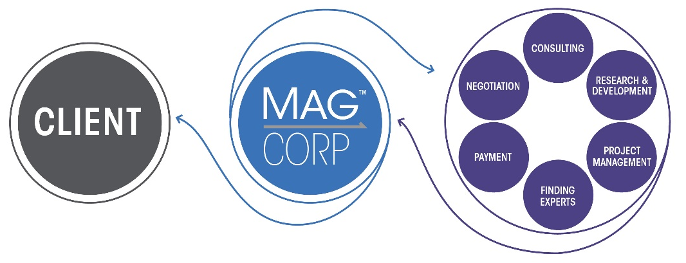
MagCorp to Work with MagLab Scientists and Engineers
to Build Industrial Partnerships
Funding Grants: G.S. Boebinger (NSF DMR-1644779)
MagCorp was founded in 2019 by a trio of current and former MagLab and Florida State University (FSU) employees to leverage the unique capabilities of the MagLab to meet the demands of private industry.
A new five-year agreement with FSU has been signed to share resources and intellectual property rights in an effort to strengthen relationships between the university and private industry. MagCorp will work with MagLab experts to provide solutions for magnetically-enabled technologies across many business sectors including medical technology, defense, consumer products, and manufacturing. Any new technologies or techniques developed by MagLab/FSU scientists and engineers as a result of these projects would be patented and the intellectual property would be split among Florida State University, MagCorp, and the client.
This new agreement creates an expert-driven and proactive method for the MagLab to develop new industrial partnerships through 2025.
More than twenty MagLab scientists and engineers have already begun working on projects related to a variety of areas such as sensors, orthopedics, and textiles.
MagCorp streamlines the process for clients who would like to work with MagLab/FSU experts to solve industrial problems by offering expert finding, consulting, research & development, and project management services.
Learn more at https://magneticscorp.com/

