Slide 1
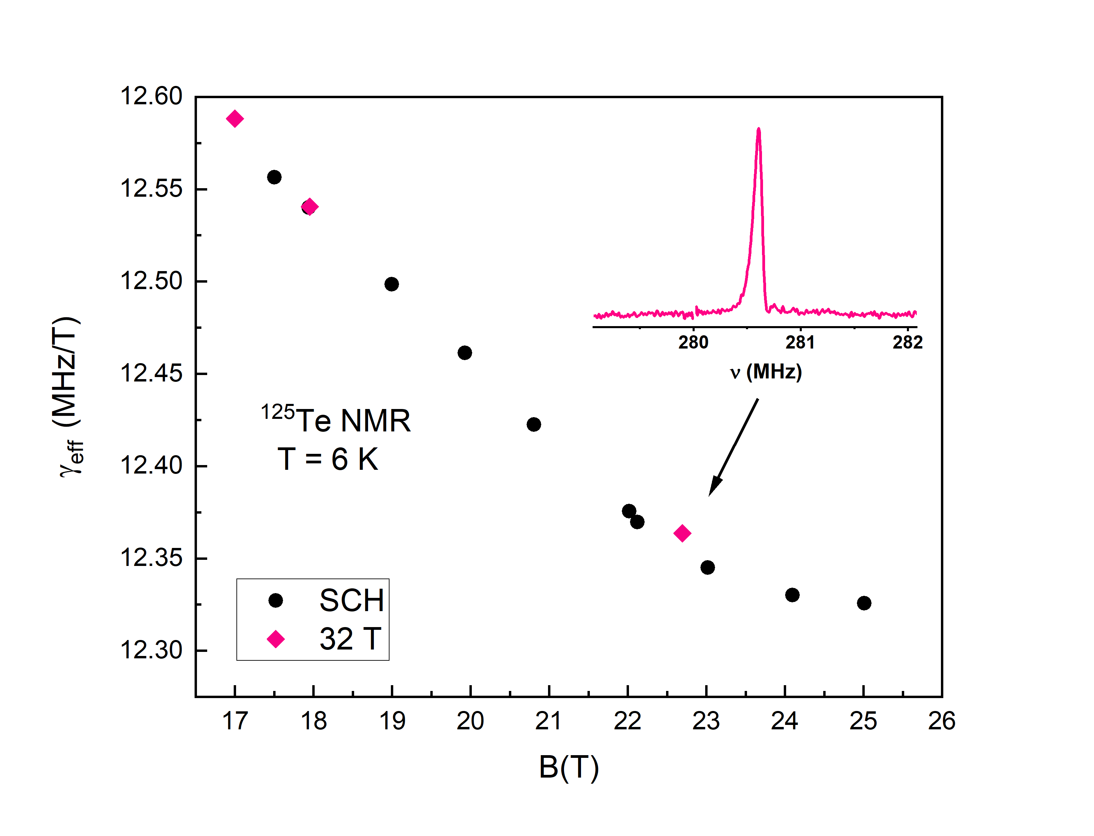
Probing a Purported Spin Nematic State
Utilizing the World Record 32T All-Superconducting Magnet
J. Link,¹ S. Ramakrishna,² A. Reyes,² E.L. Green,² M. Jaime,³ F. Weickert,³ I. Heinmaa,¹
H. Berger,⁴ A. A. Tsirlin,⁵ and R. Stern¹
1. NICPB, Estonia; 2. NHMFL-FSU; 3. NHMFL-LANL; 4. EPFL; 5. Univ. of Augsburg
Funding Grants: G.S. Boebinger (NSF DMR-1644779)
The quantum spin-nematic state (SN) was theoretically predicted over 30 years ago, but has yet to be experimentally found in condensed matter systems, due to the complex nature of this exotic spin-state. Analogous to a type of order found in liquid crystals, this frustrated magnetic state, if real, is predicted to be an avenue for developing quantum information devices. However, scientists are presently limited by the small number of potential experimental observables for a SN state. Nuclear magnetic resonance (NMR) is currently the only feasible measurement technique that is sensitive to local, microscopic magnetism. It can be naturally combined with the high magnetic fields necessary to prove the SN state’s existence.
MagLab users performed NMR measurements on the material β-TeVO₄, a promising SN candidate, in both the 36T Series Connected Hybrid (SCH) magnet and, most recently, the world-record all-superconducting 32T magnet. The experiment is ongoing, but initial results on the 32T magnet are consistent with the ¹²⁵Te spectral shifts measured in the SCH. Future experiments will require long times at high fields to establish whether the purported SN state is real.
These initial results indicate the game-changing nature of the new 32T HTS user magnet and its unique measurement capabilities.
Figure: (Top) Magnet field profile of the new magnet along the z-axis at 32.1T and 3.6T measured with 63Cu NMR. (Left) ¹²⁵Te spectral line and effective gamma with respect to magnetic field. Black circles are from the 36T Series Connected Hybrid while the pink diamonds are from the new HTS 32T magnet. (Right) Phase diagram for H//c highlighting the possible spin-nematic state. [PRB 94 064403 2016] Solid circles are from magnetostriction. Open circles from magnetostriction and thermal expansion. Open triangles from magnetization.
Facilities and instrumentation used: DC Field Facility: SCM4 (The new 32 Tesla all superconducting magnet)

Slide 2
Probing a Purported Spin Nematic State
Utilizing the World Record 32T All-Superconducting Magnet
J. Link,¹ S. Ramakrishna,² A. Reyes,² E.L. Green,² M. Jaime,³ F. Weickert,³ I. Heinmaa,¹
H. Berger,⁴ A. A. Tsirlin,⁵ and R. Stern¹
1. NICPB, Estonia; 2. NHMFL-FSU; 3. NHMFL-LANL; 4. EPFL; 5. Univ. of Augsburg
Funding Grants: G.S. Boebinger (NSF DMR-1644779)
What is the finding? Initial MagLab user experiments demonstrate excellent stability and homogeneity of this first ever high-temperature superconducting (HTS) user magnet. By probing the spin dynamics of the novel high-field quantum spin-nematic (SN) state using solid state nuclear magnetic resonance (NMR), MagLab users hope to definitively prove its existence in condensed matter systems.
Why is this important? A primary goal of high-field condensed matter science is to discover new quantum states of matter that may be useful for technological applications, particularly quantum information science. NMR is presently the best option to discover whether SN states exist. SN states are predicted to be an avenue for developing quantum information devices.
Why did this research need the MagLab? The combination of sufficiently stable magnetic fields with high homogeneity is crucial for solid state NMR measurements. The 32T all-superconducting magnet enables scientists to remain at high fields for indefinite periods of time while avoiding extreme power bills. This will allow them to perform measurements of relaxation times that require high stability and high homogeneity at ultra-low temperatures over long periods of time in order to accurately test theoretical predictions for the spin nematic phase.
Figure: (Top) Magnet field profile of the new magnet along the z-axis at 32.1T and 3.6T measured with 63Cu NMR. (Left) ¹²⁵Te spectral line and effective gamma with respect to magnetic field. Black circles are from the 36T Series Connected Hybrid while the pink diamonds are from the new HTS 32T magnet. (Right) Phase diagram for H//c highlighting the possible spin-nematic state. [PRB 94 064403 2016] Solid circles are from magnetostriction. Open circles from magnetostriction and thermal expansion. Open triangles from magnetization.
Facilities and instrumentation used: DC Field Facility: SCM4 (The new 32 Tesla all superconducting magnet)

