Slide 1
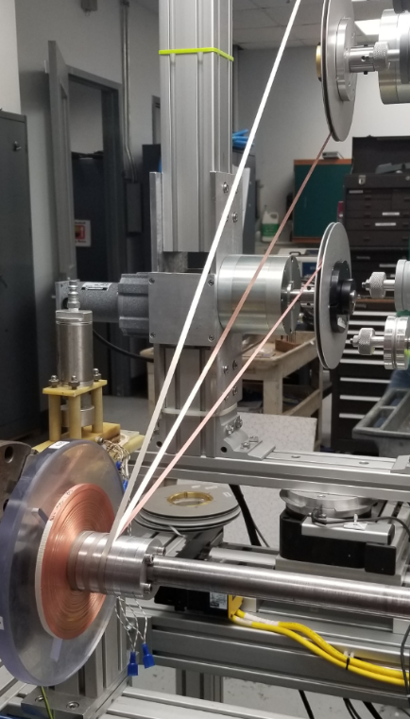
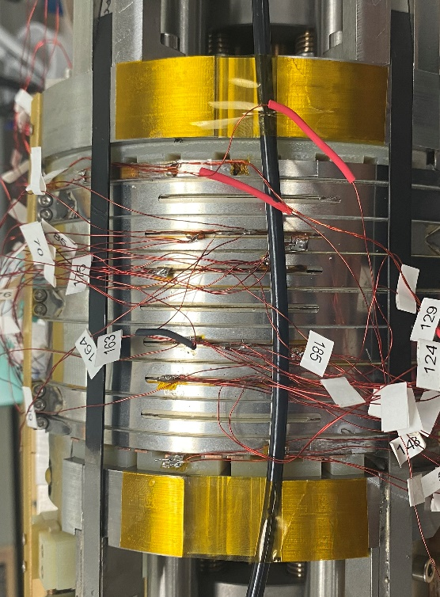
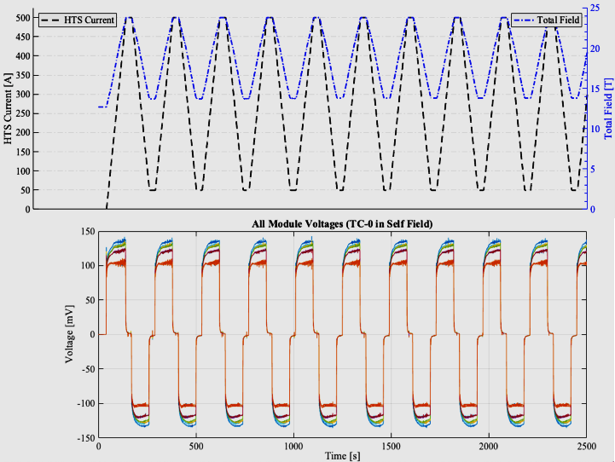
“Test Coil Zero” on the Path to 40T
E. Bosque, H. Bai, M. Bird, A. Gavrilin, S. Gundlach, B. Jarvis, K. Kim, D. Kolb-Bond, S. Marshall, A. Voran, P. Xu,
National High Magnetic Field Laboratory
Funding Grants: G.S. Boebinger (NSF DMR-1644779; NSF DMR-1839796)
The MagLab has wound its first mid-sized high-temperature superconducting (HTS) coil using insulated Rare Earth Barium Copper Oxygen (REBCO) conductor wound with a two-in-hand technique. This mid-sized “Test Coil 0” was operated within a 12T background field and generated an additional 12T. Test Coil 0 is an important landmark on the path to a 40T HTS User Magnet.
Test Coil 0 consists of a stack of 8 double pancake modules that required new crossover, joint, and terminal technology able to withstand high strain operating conditions of a completed magnet. As the MagLab is a user facility and its users will sweep the future 40T magnet, magnet cycling lifespan is a crucial design criteria for the 40T magnet, unlike accelerator and NMR magnets that operate at a fixed field.
Test Coil 0 was designed to put the conductor into high strain (>0.5%) over many cycles. Though other MagLab-built REBCO test coils have reached many thousands of cycles, those coils were significantly smaller, consisting of only 1.9m and 250m of conductor, respectively. Test Coil 0 was wound with over 1300m of conductor and was fatigue cycled 225 times with no signs of damage!
Test Coil 0 addressed many technical challenges. With an operating current of 500A (~250A in each tape), it nearly doubled the ratio of transport current to critical current, reaching 50%. (The 40T design targets a 70% critical current ratio.) In addition, all of the test coil components were proven to perform well up to a transport current of 550A.
Fig 1: Reinforcement is co-wound between each pair of REBCO tapes. Image: E.Bosque, MagLab
Fig 2: “Test Coil 0”, wound and instrumented just before being inserted into a 12T test bed magnet Image: B.Jarvis, MagLab
Fig 3: (top) A sampling of ten rapid (~250sec) fatigue cycles to 500A. Voltages (bottom) show a healthy coil.
2
1
3
Facilities and instrumentation used: HTS Winding Shop (MS&T)
and the 14 T Cryogenic magnet (ASC).

Slide 2
“Test Coil Zero” on the Path to 40T
E. Bosque, H. Bai, M. Bird, A. Gavrilin, S. Gundlach, B. Jarvis, K. Kim, D. Kolb-Bond, S. Marshall, A. Voran, P. Xu,
National High Magnetic Field Laboratory
Funding Grants: G.S. Boebinger (NSF DMR-1644779; NSF DMR-1839796)
What is the finding? Winding a superconducting test coil with two, parallel tapes, instead of just a single tape, was shown to be advantageous for use in future high-field high-temperature superconducting (HTS) magnets. A MagLab test coil was cycled 225 times at high strain (>0.5% on the conductor). The coil generated 12T in the presence of a 12T external magnetic field.
Why is this important? This “two-in-hand” test coil is a significant step towards a 40T User Magnet at the MagLab. Operating at ~50% of the tapes’ critical current (i.e. maximum current carrying capability), the technology is marching closer to the target of 70% critical current in the final design. Also, this coil is significantly larger than any other coil that has been fatigue cycled over 100 times, containing 1300m of conductor, more than five times more conductor than the next largest test coil. Energized to a current of 500A, cyclic testing of this coil also proved that the myriad of components necessary to build a magnet can perform well under these very high field conditions.
Why did this research need the MagLab? The MagLab is host to a team of highly experienced magnet builders, designers, and analysts. Resources include high-field test bed magnets, and the ability to perform cutting-edge numerical modeling simulations that guide the testing plans.
1
Fig 1: Reinforcement is co-wound between each pair of REBCO tapes. Image: E.Bosque, MagLab
Fig 2: “Test Coil 0”, wound and instrumented just before being inserted into a 12T test bed magnet Image: B.Jarvis, MagLab
Fig 3: (top) A sampling of ten rapid (~250sec) fatigue cycles to 500A. Voltages (bottom) show a healthy coil.
2
3
Facilities and instrumentation used: HTS Winding Shop (MS&T)
and the 14 T Cryogenic magnet (ASC).

