Slide 1
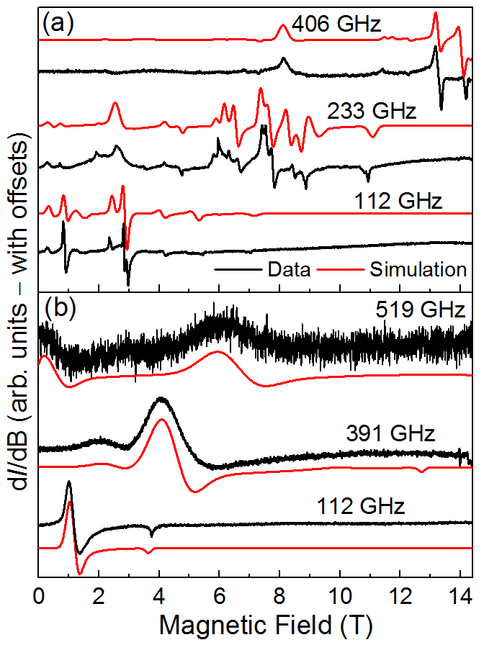
Strong Magnetic Coupling in Molecular Magnets
through Direct Metal-Metal Bonds
K. Chakarawet¹, M. Atanasov^{2,3}, J. Marbey⁴, P. C. Bunting¹, F. Neese², S. Hill⁴ and J. R. Long^{1,5}
1. UC Berkeley; 2. Max Planck Inst. for Coal Research; 3. Bulgarian Academy of Science; 4. NHMFL FSU; 5. LBNL
Funding Grants: G. S. Boebinger (NSF DMR-1644779); S. Hill (NSF DMR-1610226); J. R. Long (NSF CHE-1800252).
Magnetic molecules that retain their magnetization below a characteristic blocking temperature (T_{B}) – so-called single-molecule magnets (SMMs) – are of great interest for future information storage technologies. Up to now, attempts at coupling multiple anisotropic magnetic ions have involved weak superexchange interactions mediated via non-magnetic bridging atoms. This study demonstrates direct metal-metal orbital overlap in a series of M₄ (M = Ni, Cu) clusters, resulting in itinerant electron magnetism similar to metallic ferromagnets.
High-field, high-frequency (from 112GHz to 519GHz) electron paramagnetic resonance (HFEPR) measurements were performed on neutral and cationic forms of [Ni₄(NP^{t}Bu₃)₄]^{0/+} (^{t}Bu = tert-butyl, see Figure) in order to accurately ascertain the spin ground states and interaction parameters associated with these new SMMs. High-fields and frequencies were essential due to very large spectral splittings resulting from strong magnetic anisotropy.
The combination of HFEPR and magnetic data with correlated electronic structure calculations provides fundamental insights into the electronic itinerancy and strong ferromagnetic coupling in molecules featuring direct metal-metal orbital overlap. As such, these investigations suggest new strategies for designing SMMs with strongly coupled giant spin ground states and enhanced blocking temperatures.
[Ni₄(NP^{t}Bu₃)₄]^{0/+}
Nickel
Nitrogen
Phosphorus
Carbon
Spin, S = 2
D = −1.93 cm⁻¹
(b) Spin S = ⁵/₂
D = +7.95 cm⁻¹
Figure: (Left) Multi-frequency, derivative-mode (dI/dB, where I is transmitted intensity) HFEPR spectra for powder samples of (a) neutral and (b) cationic [Ni₄(NP^{t}Bu₃)₄]^{0/+}. Spectral simulations are included with the experimental data. (Right) Molecular structure along with the deduced spin states and axial zero-field splitting parameters, D, a measure of the associated magnetic anisotropy.
Facilities and instrumentation used: EMR program, 15/17 Tesla Transmission Spectrometer.
Citation: Chakarawet, K.; Atanasov, M. E.; Marbey, J.; Bunting, P. C.; Neese, F.; Hill, S.; Long, J. R., Strong Electronic and Magnetic Coupling in M4 (M = Ni, Cu) Clusters via Direct Orbital Interactions Between Low-Coordinate Metal Centers, Journal of the American Chemical Society, 142, 19161-19169 (2020) doi.org/10.1021/jacs.0c08460

Slide 2
Strong Magnetic Coupling in Molecular Magnets
through Direct Metal-Metal Bonds
K. Chakarawet¹, M. Atanasov^{2,3}, J. Marbey⁴, P. C. Bunting¹, F. Neese², S. Hill⁴ and J. R. Long^{1,5}
1. UC Berkeley; 2. Max Planck Inst. for Coal Research; 3. Bulgarian Academy of Science; 4. NHMFL FSU; 5. LBNL
Funding Grants: G. S. Boebinger (NSF DMR-1644779); S. Hill (NSF DMR-1610226); J. R. Long (NSF CHE-1800252).
What is the finding? This study demonstrates the possibility of designing magnetic molecules featuring direct metal-metal bonds, similar to those found in metallic ferromagnets such as elemental iron.
Why is this important? The work identifies new strategies for bottom-up synthetic assembly of robust ferromagnetic nanoparticles using low-cost, earth-abundant elements that may one day operate at room temperature or above. Such objects hold promise for the development of future molecular-scale magnetic storage applications, featuring information densities exceeding those of current technologies by one to two orders of magnitude.
Why did this research need the MagLab? Due to the strong magnetic interactions among the itinerant electrons in these metallic nanoparticles, high magnetic fields combined with spectrometers covering a wide range of microwave frequencies are essential for gaining fundamental insights into this promising new class of magnetic materials. Such world-unique experimental capabilities can only be found within the MagLab’s Electron Magnetic Resonance (EMR) facility.
Ni₄(NP^{t}Bu₃)₄
Spin: S = 2
Nickel
Nitrogen
Phosphorus
Carbon
Figure: Molecular structure of the neutral Ni₄(NP^{t}Bu₃)₄ (^{t}Bu = tert-butyl) molecule investigated in this work; H atoms have been omitted for clarity. The four nitrogens (blue) coordinating the Ni atoms (green) form a square, resulting in Ni$⋯$Ni distances that are within range of direct metal-metal bonds (dashed lines). This gives rise to strong ferromagnetic coupling (magnetic alignment) among the four itinerant unpaired electron spins (red arrows).
Facilities and instrumentation used: EMR program, 15/17 Tesla Transmission Spectrometer.
Citation: Chakarawet, K.; Atanasov, M. E.; Marbey, J.; Bunting, P. C.; Neese, F.; Hill, S.; Long, J. R., Strong Electronic and Magnetic Coupling in M4 (M = Ni, Cu) Clusters via Direct Orbital Interactions Between Low-Coordinate Metal Centers, Journal of the American Chemical Society, 142, 19161-19169 (2020) doi.org/10.1021/jacs.0c08460

