Slide 1
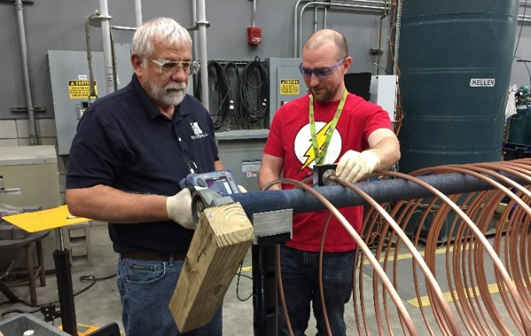
Nondestructive testing and minimizing defects
in high-strength conductors for use in pulsed magnets
Jun Lu, Todd Adkins, Iain Dixon, Doan Nguyen and Ke Han
National High Magnetic Field Laboratory
Funding Grants: G.S. Boebinger (NSF DMR-1157490 and 1644779)
The MagLab’s high-field pulsed magnets use wires made of high strength copper alloys and nanocomposites operating near their mechanical breaking points. Since flaws in the conductor can drastically shorten the lifetime of a magnet, it is important to ensure the wires are free of flaws. It is known that internal chevron-shaped cracks can occur in high-strength materials during the drawing process due to a number of causes, among them an unsuitable drawing-die schedule, too-rapid drawing speed, or inadequate lubrication. In addition, very small dents and inclusions of foreign materials on the wire surface also can also compromise the performance of the final wire.
The MagLab developed non-destructive testing (NDT) techniques for inspection of Glidcop AL60 wires (copper wires containing alumina particles) to be applied when the precursor wire arrives from commercial vendors after consolidation and extrusion, but prior to drawing the material to its final dimensions. The techniques include eddy current testing (ECT), x-ray radiography, and ultrasonic testing.
Chevron cracks were found in some AL60 conductors by all three NDT techniques. Surface inclusions were also found by ECT. As such, an ECT wire inspection capability suitable for long wire lengths was developed and implemented, along with a method to repair surface defects and a method to minimize the chance of creating chevron cracks.
Although all pulsed magnets eventually fail due to high mechanical stresses, the MagLab expects the lifetime of future pulsed magnets to increase due to these advances in quality control and improvement.
(a)
(b)
(c)
No flaw
Small flaw
Large flaw
Department: Magnet Science and Technology
Citation: Lu, J.; Adkins, T.; Dixon, I.R.; Nguyen, D.N.; Han, K., Nondestructive Testing of High Strength Conductors for High Field Pulsed Magnets,
IEEE Transactions on Applied Superconductivity, 30 (4), 6900405 (2020) doi.org/10.1109/TASC.2020.2980525
Fig (a) Eddy current inspection of a long length precursor. (b) A chevron crack found by x-ray tomography.
(c) Ultrasound echo from flaws of different sizes. The flaw gives rise to the early echo (the peak near 2μs), as well as the diminished amplitudes of all the other echos.
Notes:
1. What is the finding?
Here to be included a short description in layman language of the finding
2. Why this finding is important?
A short description of why the finding is important for scientific community, technology, society, etc…
3. Why NHMFL?
The answer to this question should provide information on why this finding could be achieved (only) at NHMFL (what unique capability of MagLab was essential for this finding).

Slide 2
Nondestructive testing and minimizing defects
in high-strength conductors for use in pulsed magnets
Jun Lu, Todd Adkins, Iain Dixon, Doan Nguyen and Ke Han
National High Magnetic Field Laboratory
Funding Grants: G.S. Boebinger (NSF DMR-1157490 and 1644779)
What is the finding? The MagLab has developed and tested new methods for detecting flaws in precursor wire being received from commercial suppliers. Eddy-current, X-ray, and ultra-sound protocols were evaluated (see Figure). The system based on eddy-currents was most effective and has been implemented to inspect the long lengths of wire necessary for the construction of pulsed magnets. In addition, the MagLab developed methods to repair surface defects and to minimize the chance of creating internal cracks.
Why is this important? When drawing high-strength wire, internal chevron-shaped cracks can occur due to a number of causes, among them an unsuitable drawing-die schedule, too-rapid drawing speed, or inadequate lubrication. In addition, very small dents and inclusions of foreign materials on the wire surface can occur. Because the MagLab’s pulsed magnets operate at 90% of ultimate stress, small flaws in the conductors can significantly reduce the lifetime of the magnets.
Although all pulsed magnets eventually fail due to high mechanical stresses, as a result of this work, the MagLab expects the lifetime of future pulsed magnets to exceed those of past pulsed magnets.
Why did the MagLab need to do this research? Usually, this question is worded “Why did this research need the MagLab?”, but here the MagLab has a unique need to develop its own expertise in the detection and mitigation of conductor defects in order to improve the performance of its own pulsed magnets. World-record performance often demands the development of unusual expertise!
(a)
(b)
(c)
(b)
No flaw
Small flaw
Large flaw
Department: Magnet Science and Technology
Citation: Lu, J.; Adkins, T.; Dixon, I.R.; Nguyen, D.N.; Han, K., Nondestructive Testing of High Strength Conductors for High Field Pulsed Magnets,
IEEE Transactions on Applied Superconductivity, 30 (4), 6900405 (2020) doi.org/10.1109/TASC.2020.2980525
Fig (a) Eddy current inspection of a long length precursor. (b) A chevron crack found by x-ray tomography.
(c) Ultrasound echo from flaws of different sizes. The flaw gives rise to the early echo (the peak near 2μs), as well as the diminished amplitudes of all the other echos.
Notes:
1. What is the finding?
Here to be included a short description in layman language of the finding
2. Why this finding is important?
A short description of why the finding is important for scientific community, technology, society, etc…
3. Why NHMFL?
The answer to this question should provide information on why this finding could be achieved (only) at NHMFL (what unique capability of MagLab was essential for this finding).

