Slide 1
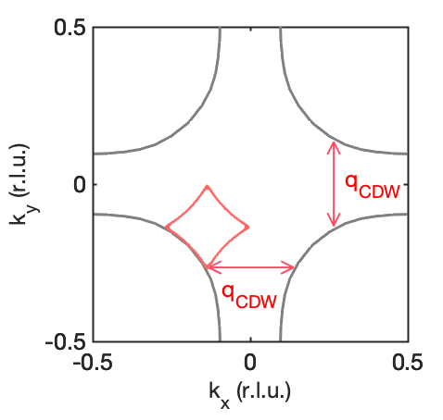
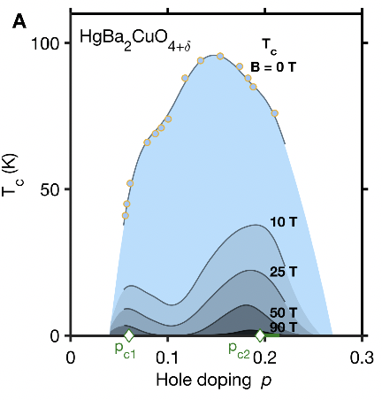
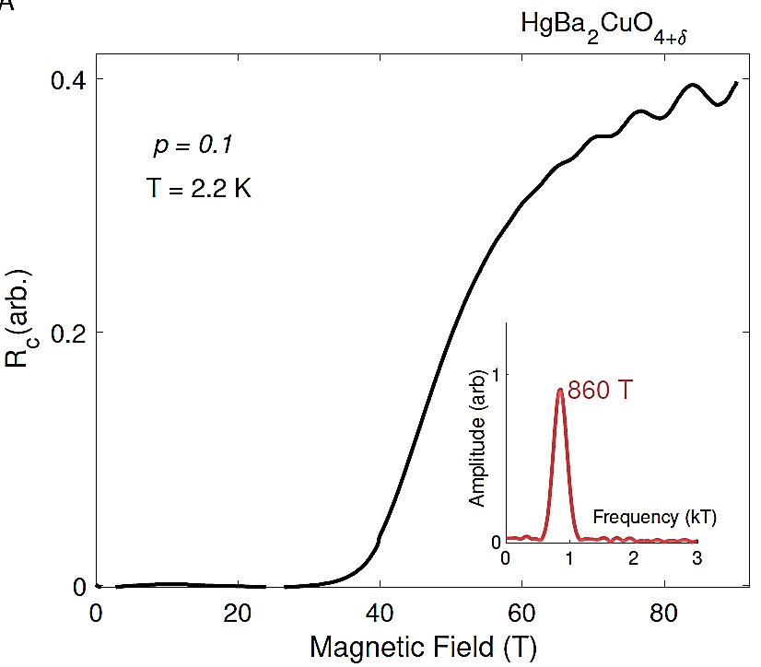
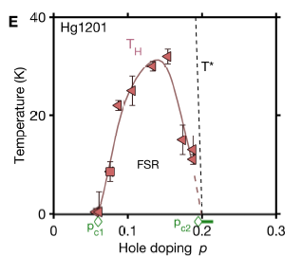
Ninety teslas peek under the superconducting dome
of a high-temperature superconductor
M. K. Chan¹, R. D. McDonald¹, B. J. Ramshaw², J. B. Betts¹, A. Shekhter³, E. D. Bauer⁴, N. Harrison⁵
1. NHMFL, Los Alamos National Laboratory; 2. Cornell University;
3. NHMFL, Tallahassee; 4. MPA-Q, Los Alamos National Laboratory.
Funding Grants: G.S. Boebinger (NSF DMR-1644779); N. Harrison (DOE-BES, Science of 100 T)
A prevalent theoretical paradigm of unconventional superconductivity posits that the superconductivity results from quantum critical fluctuations associated with a zero-temperature phase transition. Termed a quantum critical point, these phase transitions are “hidden” by the strength of the superconducting phase that surrounds it.
Recent experiments utilized extreme magnetic fields up to 90 teslas to suppress superconductivity in the high-temperature superconductor HgBa₂CuO_{4+𝞭}. The MagLab’s extreme fields were required to suppress superconductivity down to low temperatures over a broad range of hole-doping. Electrical transport revealed a Fermi-surface undergoing reconstruction: likely a signature of a charge-density-wave phase transition. The Fermi-surface reconstruction was discovered to terminate at zero temperature coincident with hole concentrations where the superconductivity is most robust to magnetic fields. These results link the reconstructed Fermi surface phase to two quantum critical points that were heretofore hidden by the superconducting dome in the cuprate phase diagram.
This work was made possible by the MagLab’s unique 1.43GW generator, which delivers 600 MJ electrical pulses to generate magnetic fields of up to 100T repeatedly, thus permitting a systematic doping and temperature mapping of the Fermi surface reconstruction near quantum critical points.
a
b
890 T
c
T = 2.2 K
reconstruction
(a) Superconductivity is suppressed in underdoped HgBa₂CuO_{4+𝞭}, revealing quantum oscillations above 65T whose frequency (lower inset) reflects the reconstructed Fermi-surface area resulting from a charge-density-wave phase (upper left inset). (b) Superconducting temperature (Tc) in magnetic field reveals two regions of robust superconductivity near 0.07 and 0.19 doping, coinciding with the dopings at which the Fermi-surface reconstruction temperature (T_{H}) approaches zero in (c), indicating two revealed quantum critical points.
Magnets used: 65T short pulse and 100T multi-shot magnets
Citation: Chan, M.K.; McDonald, R.; Ramshaw, B.J.; Betts, J.; Shehter, A.; Bauer, E.D.; Harrison, N.,
Extent of Fermi-surface reconstruction in the high-temperature superconductor HgBa₂CuO_{4+δ},
Proceedings of the National Academy of Sciences of the USA (PNAS), 117, 9782 (2020) doi.org/10.1073/pnas.1914166117

Slide 2
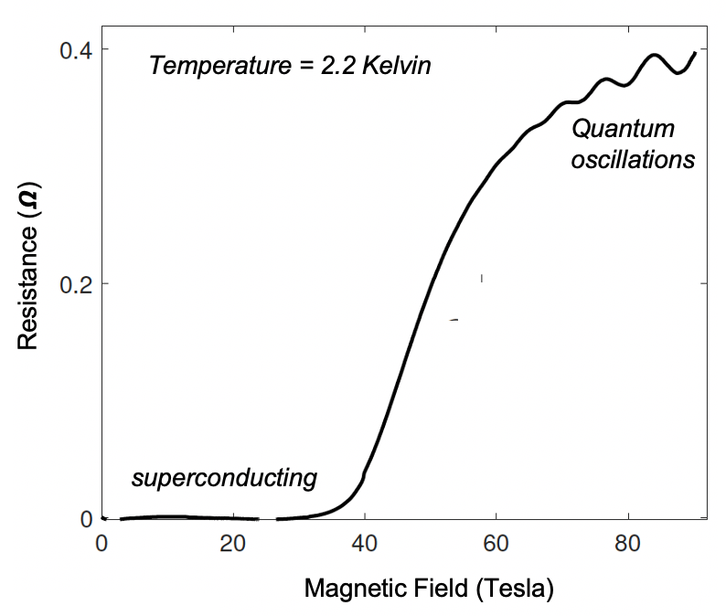
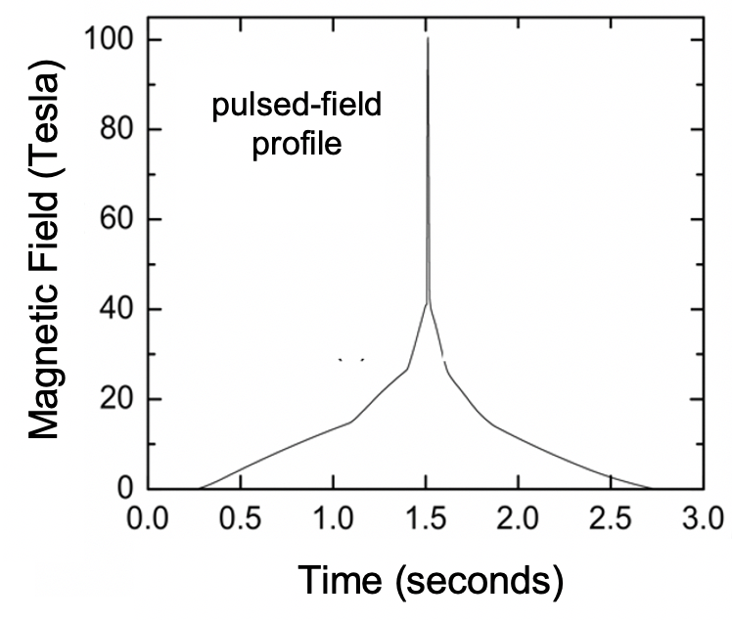
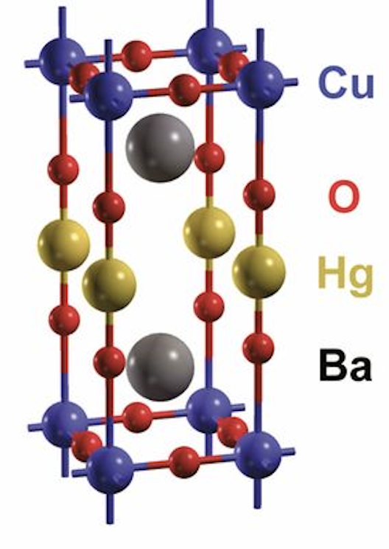
Ninety teslas peek under the superconducting dome
of a high-temperature superconductor
M. K. Chan¹, R. D. McDonald¹, B. J. Ramshaw², J. B. Betts¹, A. Shekhter³, E. D. Bauer⁴, N. Harrison⁵
1. NHMFL, Los Alamos National Laboratory; 2. Cornell University;
3. NHMFL, Tallahassee; 4. MPA-Q, Los Alamos National Laboratory.
Funding Grants: G.S. Boebinger (NSF DMR-1644779); N. Harrison (DOE-BES, Science of 100 T)
What is the finding? A study of the high-temperature superconductor HgBa₂CuO_{4+𝞭} revealed signatures of a charge-density-wave phase comprised of spatial modulations of the electron charge. Ninety tesla experiments connected this phase to superconductivity by revealing two zero-temperature phase transitions where superconductivity is most robust
Why is this important? Superconductivity describes the ability of some materials to conduct electrical current without any loss of energy at low temperatures. More than thirty years after its discovery, there is no comprehensive theory of high-temperature superconductivity in the cuprates. One leading theoretical paradigm ascribes superconductivity to a zero-temperature phase transition, termed a quantum critical point, that is “hidden” by the strong superconducting phase. These experiments provide support for the idea of quantum criticality underlying superconductivity in the cuprates.
Why did this research need the MagLab? These conclusions would not be accessible without the reliable and repeated provision of extremely intense (>90T) pulsed magnetic fields that are required to suppress superconductivity in this cuprate. The unique 1.43GW generator at Los Alamos has delivered electrical pulses that reliably generate the largest non-destructive magnetic fields in the world, having delivered hundreds of pulses between 90T and 100T.
Superconductivity is suppressed by a 90T magnetic field pulse (inset) in the high-temperature superconductor HgBa₂CuO_{4+𝞭}, revealing quantum oscillations above 65T that evidence a charge-density-wave phase. The intense magnetic fields make it possible to experimentally establish that this phase exists only over a limited range of carrier concentration, bounded by the carrier concentrations at which the superconductivity is the most robust.
Magnets used: 65T short pulse and 100T multi-shot magnets
Citation: Chan, M.K.; McDonald, R.; Ramshaw, B.J.; Betts, J.; Shehter, A.; Bauer, E.D.; Harrison, N.,
Extent of Fermi-surface reconstruction in the high-temperature superconductor HgBa₂CuO_{4+δ},
Proceedings of the National Academy of Sciences of the USA (PNAS), 117, 9782 (2020) doi.org/10.1073/pnas.1914166117

