Slide 1
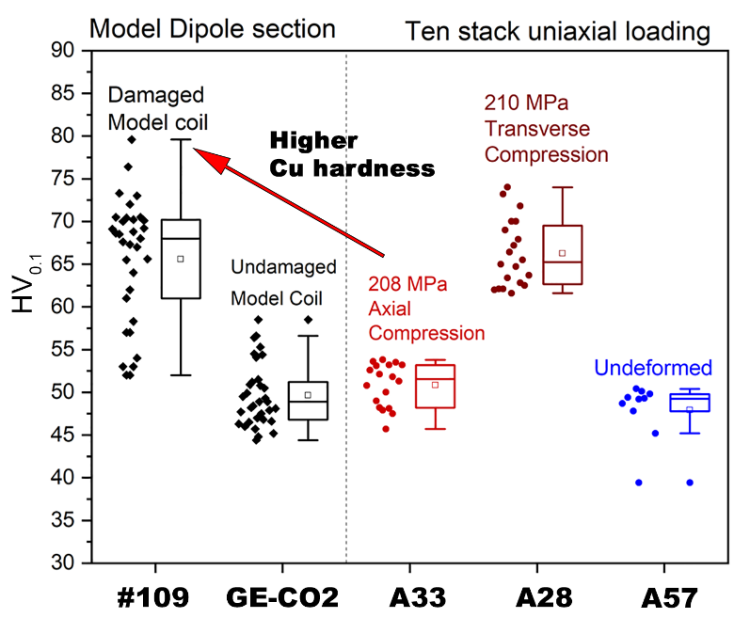
Tracking the Potential for Damage in Nb₃Sn Superconducting Coils
from the Hardness of Surrounding Copper
S Balachandran¹, J. Cooper¹, O. B. Van Oss², P J. Lee¹,
L. Bottura³, A. Devred³, F. Savary³, C. Scheuerlein³, F. Wolf³
¹Applied Superconductivity Center, NHMFL; ²Columbia University; ³CERN
Funding Grants: CERN PO CA7854000, G.S. Boebinger (NSF DMR-1644779, State of Florida)
The 11T dipole magnet needed for the high luminosity upgrade of CERN’s Large Hadron Collider (LHC) is a key milestone for future superconducting Nb₃Sn magnets. The MagLab’s Applied Superconductivity Center has been a driver of superconducting wire research for High Energy Physics programs funded by the U.S. Department of Energy for decades. This team recently determined the source of failure in a prototype 11 T low-temperature superconducting (LTS) accelerator magnet assembled at CERN through a collaboration that includes an undergraduate funded by the NSF’s Research Experiences for Undergraduates program.
Metallographic autopsies of both degraded and undamaged 11T dipole magnet sections found Nb₃Sn filament cracks in the degraded sections (Fig 1) but not in undamaged sections. Locations of high fracture density matched those predicted for excessive stress during a critical step in the magnet assembly. The strain history in the surrounding Cu was estimated by micro-hardness (Fig 2) and compared with test samples that had been strained under known uniaxial stresses. The magnet values correlated well with the control samples stressed under known loads.
Results indicate that copper hardening in Nb3Sn conductor is a tell-tale that a magnet has been pushed beyond its stress limit. The experience gained will guide future design and models of large low-temperature superconducting magnets.
Fig 1: Electron microscope image showing cracks in a conductor that was extracted from a damaged Nb₃Sn coil that was part of a prototype 11T accelerator dipole magnet built at CERN. The cracks resulted from overstresses experienced during assembly of the model coil.
Fig. 2: Comparison of the Cu hardness indicates stresses of over 210 MPa were reached locally in the Nb₃Sn conductor in the damaged magnet model coil (compare data in two red boxes), resulting in damage to the model coil in the form of Nb₃Sn filament breakage. A hardness value over 75 in nearby Cu leads to damage in Nb₃Sn magnets.
From the Magnet
From Test Samples
and Known Stresses
Copper Hardness Value
Facilities: Applied Superconductivity Center
Citation: Balachandran, S.; Cooper, J.; Lee, P.; Van Oss, O.; Bottura, L.; Savary, F.; Scheuerlein, C.; Wolf, F.; Devred, A.,
Metallographic analysis of 11T dipole coils for High Luminosity-Large Hadron Collider (HL-LHC),
Superconductor Science and Technology 34, 025001 (2021) doi.org/10.1088/1361-6668/abc56a

Slide 2
Tracking the Potential for Damage in Nb₃Sn Superconducting Coils
from the Hardness of Surrounding Copper
S Balachandran¹, J. Cooper¹, O. B. Van Oss², P J. Lee¹,
L. Bottura³, A. Devred³, F. Savary³, C. Scheuerlein³, F. Wolf³
¹Applied Superconductivity Center, NHMFL; ²Columbia University; ³CERN
Funding Grants: CERN PO CA7854000, G.S. Boebinger (NSF DMR-1644779, State of Florida)
What is the finding? Cracks were discovered in a model Nb₃Sn superconducting accelerator magnet designed for the High Luminosity Upgrade of CERN’s Large Hadron Collider. This upgrade will advance the frontier of particle physics. By comparing with control samples, it was determined that high stresses during assembly led to the formation of the cracks.
Why is this important? Large superconducting magnets, including the MagLab’s 45T Hybrid and 32T SC magnets, medical magnets, and magnets for particle accelerators all produce extreme stress during operation. While magnets are designed to support high stress, margins are now so close to physical limits that stresses during assembly can lead to unacceptable degradation of magnet conductor. Methods developed here will allow actual stress levels in complex magnet structures to be compared to computer models.
Why did this research need the MagLab? The MagLab’s Applied Superconductivity Center is expert in microstructural evaluation of Nb₃Sn superconductors, including those used by CERN to fabricate these high-field accelerator magnets.
Training and education is an important component of the mission of the MagLab. Author Orion B. Van Oss is an undergraduate from Columbia University who worked during Summer 2019 as an REU student at the MagLab.
Electron microscope image showing cracks in a conductor that was extracted from a damaged Nb₃Sn coil that was part of a prototype 11T accelerator dipole magnet built at CERN. The cracks resulted from overstresses experienced during assembly of the model coil.
From Test Samples
and Known Stresses
Comparison of the calibrated increase in Cu hardness indicates stresses of over 210 MPa were reached locally in the Nb₃Sn conductor within the damaged magnet model coil (compare data in two red boxes), resulting in damage to the model coil in the form of Nb₃Sn filament breakage.
From the Magnet
Copper Hardness Value
Facilities: Applied Superconductivity Center
Citation: Balachandran, S.; Cooper, J.; Lee, P.; Van Oss, O.; Bottura, L.; Savary, F.; Scheuerlein, C.; Wolf, F.; Devred, A.,
Metallographic analysis of 11T dipole coils for High Luminosity-Large Hadron Collider (HL-LHC),
Superconductor Science and Technology 34, 025001 (2021) doi.org/10.1088/1361-6668/abc56a

