Slide 1
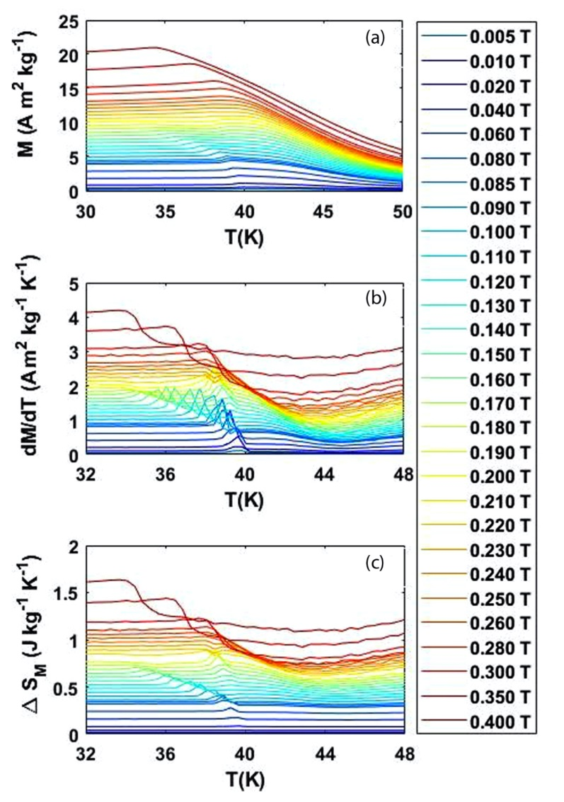
Broadening Participation: Bridging the Research Capability Gap to Access Scientists at Smaller Institutions
C. Dhital¹, J.F. DiTusa²
Kennesaw State University; 2. Louisiana State University
Funding Grants: G.S. Boebinger (NSF DMR-1157490, NSF DMR-1644779); J.F. DiTusa (DOE DE-SC0012432)
Researchers at colleges and universities that are not in the Research-1 (R1) tier typically face a larger number of obstacles for their research than their colleagues at R1 universities and national laboratories. The MagLab has discovered a pool of potential users who are unable to take advantage of the high-field magnets of the DC Field Facility due to their inability to access lower-field magnet systems that would allow them to characterize the materials they are studying and to produce the low-field data that justified the need for higher magnetic fields.
To address this capability gap, the DC Field Facility added two low-field superconducting magnet systems, SCM5 and SCM6, that allow users to characterize fundamental material properties ‒ including resistance, magnetization, susceptibility, and heat capacity ‒ at magnetic fields up to 7T and 9T, respectively. These systems enable users to obtain critical information needed early in the life-cycle of a protracted study of a new material that may eventually call for use of the MagLab’s high-field magnets.
This work, published in Physical Review B, enabled Dhital, a faculty member at Kennesaw State University, to utilize SCM5 to explore magnetic phase transitions in the alloys MnSi_{1–x} Al_{x} and Fe_{1–y}Co_{y}Si. One of the findings is the substantial survivability of topological skyrmion excitations in both materials, in spite of a factor of ten difference in disorder between the two materials.
Magnetic entropy changes in MnSi_{0.962}Al_{0.038}. (a) Magnetization M as function of temperature T (b) The temperature derivative, dM/dT, of the data shown in (a). For clarity these curves are offset by 0.1 A m² kg⁻¹ K ⁻¹ (c) The change in magnetic entropy 𝚫S_{M} . For clarity the curves are offset by 0.04 J kg⁻¹ K ⁻¹ The entropy data are obtained using internal field, after demagnetization correction.
Facilities and instrumentation used: DC Field Facility, SCM5.
Citation: Dhital, C.; DiTusa, J.F., Entropic signatures of the skyrmion lattice phase in MnSi_{1-x}Al_{x} and Fe_{1-y}Co_{y}Si, Physical Review B 102, 224408 (2020) doi.org/10.1103/PhysRevB.102.224408

Slide 2
Broadening Participation: Bridging the Research Capability Gap to Access Scientists at Smaller Institutions
C. Dhital¹, J.F. DiTusa²
Kennesaw State University; 2. Louisiana State University
Funding Grants: G.S. Boebinger (NSF DMR-1157490, NSF DMR-1644779); J.F. DiTusa (DOE DE-SC0012432)
What is the finding? Barriers to research faced by scientists at non-Research 1 (non-R1) institutions can be overcome by providing instrumentation and expertise for low-magnetic-field experiments at the MagLab. Results from these experiments can determine whether there is a scientific justification to request time on the MagLab’s unique high-field magnets.
Why is this important? One of the requirements of the competitive, peer-reviewed process for accessing high field magnet time at the MagLab is prior data at lower magnetic fields, data that demonstrates a need for access to the high-field magnets. Most non-R1 institutions do not have low magnetic field research instruments on their campuses, due to the costs associated with purchase, operation (specifically access to liquid helium), and maintenance of these systems. Prior to the launching of this low-magnetic-field user program at the MagLab, there had been a de facto exclusion of a portion of the Nation’s scientific community from access the MagLab’s high-field user facilities.
Why did this research need the MagLab? The MagLab recently added two low-field research magnets to its DC Field Facility user program. As a result, Chetan Dhital, an early career faculty member from Kennesaw State University in Georgia, was able to perform important low-field characterization of topological skyrmion excitations in two materials, leading to intriguing results published in Physical Review B.
Magnetic entropy changes in MnSi_{0.962}Al_{0.038}. (a) Magnetization M as function of temperature T (b) The temperature derivative, dM/dT, of the data shown in (a). For clarity these curves are offset by 0.1 A m² kg⁻¹ K ⁻¹ (c) The change in magnetic entropy 𝚫S_{M} . For clarity the curves are offset by 0.04 J kg⁻¹ K ⁻¹ The entropy data are obtained using internal field, after demagnetization correction.
Facilities and instrumentation used: DC Field Facility, SCM5.
Citation: Dhital, C.; DiTusa, J.F., Entropic signatures of the skyrmion lattice phase in MnSi_{1-x}Al_{x} and Fe_{1-y}Co_{y}Si, Physical Review B 102, 224408 (2020) doi.org/10.1103/PhysRevB.102.224408

