Slide 1
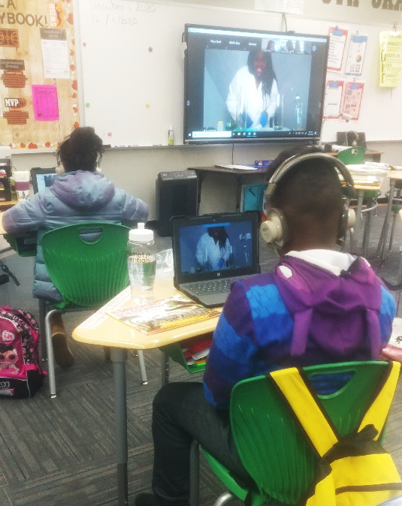
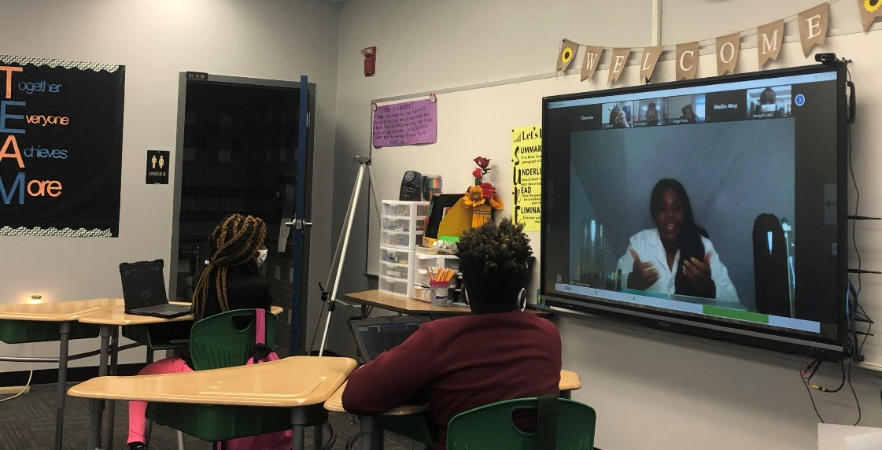
MagLab K-12 Education: Pineview Science Day
C.R. Villa¹, C. Conner², L.C. Jones³, R.M. Hughes¹
1-Center for Integrating Research and Learning at the National High Magnetic Field Laboratory,
2- Pineview Elementary School 3- S.T.E.M.ING While Black
Funding Grants: G.S. Boebinger (NSF DMR-1157490, NSF DMR-1644779)
What is the event? Since 2018, the National MagLab through the Center for Integrating Research and Learning (CIRL) has assisted with the planning and organization of the STEM Day for Pineview Elementary, a Title I school in Tallahassee. In 2020, this event was changed to a virtual event due to COVID 19 with the MagLab’s help. The MagLab partnered with S.T.E.M.ING While Black to find role models who are representative of the school population.
Why is this important? African American/Black, Latino/a and Indigenous Peoples are underrepresented in STEM fields compared to their overall representation in the United States. Improving representation is important to improving the STEM enterprise and must begin as early as elementary school where youth begin to lose interest in STEM because of a lack of relevance and sense of belonging.
The Pineview STEM Day is just one example of the work that MagLab scientists and CIRL do to connect local students with potential careers in STEM. Being able to see role models who are of their same race and ethnicity allows them to see themselves in those STEM careers. By partnering with S.T.E.M.ING While Black the MagLab was able to find excellent role models for students in each grade at Pineview Elementary, a predominantly African American school.
Why did this program need the MagLab? CIRL was able to connect teachers and students with diverse scientists both at the MagLab and from across the nation due to our extensive networks. This event contributes to fulfilling our mission of building a diverse STEM workforce.
Facilities: Center for Integrating Research and Learning, Pineview Elementary School

