Slide 1
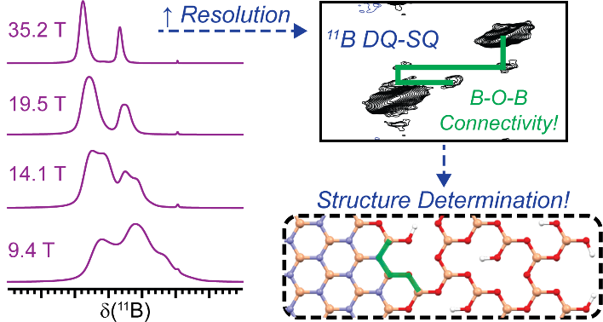
Structure of Boron-Based Catalysts from ¹¹B Solid-State NMR at 35.2T
R.W. Dorn,^{1,2} M.C. Cendejas,³ K. Chen,⁴ I. Hung,⁴ N.R. Altvater,³ W.P. McDermott,³ Z. Gan,⁴ I. Hermans,³* A.J. Rossini^{1,2}*
1. US DOE, Ames Laboratory, Ames IA; 2. Iowa State University, Ames IA; 3. University of Wisconsin-Madison, Madison WI; 4. NHMFL, Tallahassee FL;
Funding Grants: I. Hermans & A.J. Rossini (NSF 1916809); G.S. Boebinger (NSF DMR-1644779)
Boron-based oxidative dehydrogenation catalysts, such as hexagonal boron nitride (h-BN) and silica-supported boron oxides, are highly selective catalysts for the oxidative dehydrogenation (ODH) of light alkanes to olefins. Light olefins, such as propylene, are critical chemical feedstocks. The identification of molecular structure of the active sites in catalysts is crucial for the rational design and development of improved ODH catalysts.
MagLab users from Iowa State University and the U.S. DOE Ames Laboratory use high-field solid-state nuclear magnetic resonance (NMR) of boron to characterize boron-based catalysts. Boron-11 (¹¹B) NMR is potentially an ideal technique to determine structure within boron-based materials because it is sensitive to the local chemical environment and the symmetry surrounding the nucleus. However, it can be challenging to identify all of the ¹¹B NMR signals, because they often overlap due to quadrupolar broadening. The MagLab’s 35.2T Series-Connected Hybrid resolves the ¹¹B NMR lines, enabling the identification of structure within h-BN and silica-supported boron oxide ODH catalysts (featuring only 1wt.% boron) by recording two-dimensional ¹¹B homonuclear correlation spectra to determine structure in the catalyst. These studies are infeasible in lower-field, conventional NMR magnets.
(Left) The MagLab’s 35.2T Series-Connected Hybrid Magnet dramatically enhances ¹¹B NMR spectral resolution beyond that of any other spectrometer in the world.
(Right Top) The Series-Connected Hybrid enables high resolution two-dimensional ¹¹B homonuclear correlation spectra, from which (Right Bottom) the identification of structure within h-BN and silica-supported boron oxide ODH catalysts can be determined.
Facilities and instrumentation used: NMR/MRI, 36T SCH.
Citation: Dorn, R.W.; Cendejas, M.C.; Chen, K.; Hung, I.; Altvater, N.R.; McDermott, W.P.; Gan, Z.; Hermans, I.; Rossini, A.J.,
Structure Determination of Boron-Based Oxidative Dehydrogenation Heterogeneous Catalysts With Ultrahigh Field 35.2T ¹¹B Solid-State NMR Spectroscopy, American Chemical Society Catalysis, 10, 13852-13866 (2020) doi.org/10.1021/acscatal.0c03762

Slide 2
Structure of Boron-Based Catalysts from ¹¹B Solid-State NMR at 35.2T
R.W. Dorn,^{1,2} M.C. Cendejas,³ K. Chen,⁴ I. Hung,⁴ N.R. Altvater,³ W.P. McDermott,³ Z. Gan,⁴ I. Hermans,³* A.J. Rossini^{1,2}*
1. US DOE, Ames Laboratory, Ames IA; 2. Iowa State University, Ames IA; 3. University of Wisconsin-Madison, Madison WI; 4. NHMFL, Tallahassee FL;
Funding Grants: I. Hermans & A.J. Rossini (NSF 1916809); G.S. Boebinger (NSF DMR-1644779)
What is the finding? By using the highest-field nuclear magnetic resonance (NMR) spectrometer in the world, ¹¹B NMR signal resolution can be increased enough to observe the molecular structures of important catalysts like hexagonal boron nitride and silica-supported boron oxide.
Why is this important? Boron-based catalysts are highly selective catalysts for the oxidative dehydrogenation of light alkanes to olefins. Light olefins, such as propylene, are critical chemical feedstocks in the manufacture of plastics and other products. This ultra-high field NMR study enabled an accurate determination of structure within these important catalysts. This sheds new light on the active sites for catalysis within boron-based materials, which in turn will facilitate the rational design and development of next-generation catalysts.
Why did this research need the MagLab? The NMR spectrometer magnet used for this work, the 35.2 Tesla Series-Connected Hybrid (SCH) magnet, is the only magnet capable of providing sufficient resolution and sensitivity to unambiguously identify the structural connectivity of all boron species in these catalysts. The SCH will permit many future studies of boron-based heterogenous catalysts.
Boron Oxidative Dehydrogenation Catalysts
Before Catalysis
After Catalysis
Hexagonal
Boron Nitride
Amorphous
Boron Oxide
Facilities and instrumentation used: NMR/MRI. 36T SCH.
Citation: Dorn, R.W.; Cendejas, M.C.; Chen, K.; Hung, I.; Altvater, N.R.; McDermott, W.P.; Gan, Z.; Hermans, I.; Rossini, A.J., Structure Determination of Boron-Based Oxidative Dehydrogenation Heterogeneous Catalysts With Ultrahigh Field 35.2T ¹¹B Solid-State NMR Spectroscopy, American Chemical Society Catalysis, 10, 13852-13866 (2020) doi.org/10.1021/acscatal.0c03762

