Slide 1
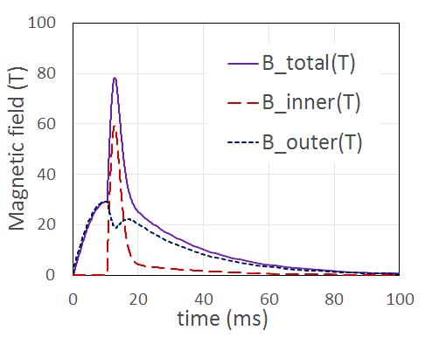
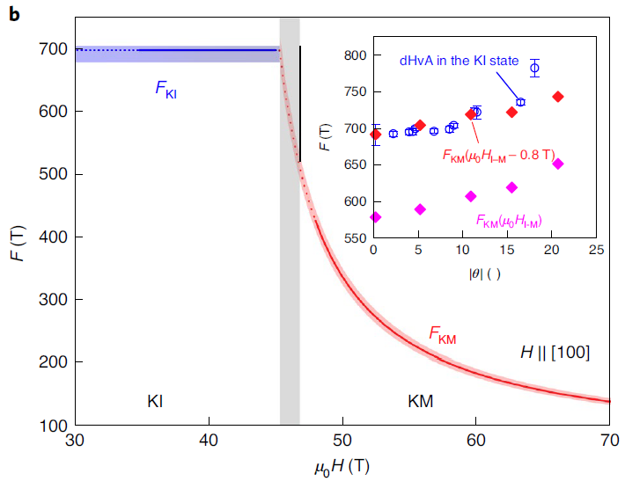
First Science from the 75T Duplex Magnet
Magnet: Doan N. Nguyen, James R Michel, Jason D. Lucero, Pulsed Field Facility at MagLab/LANL
Science: Z.Xiang, L.Chen, K-W.Chen, C.Tinsman, Tomoya Asaba, Lu Li, Univ. of Michigan; Y.Sato, Y. Kasahara, Y.Matsuda, Kyoto University; H.Lu, M.Jaime, F.Balakirev, J. Singleton, MagLab/LANL; F.Iga, Ibaraki University
Funding Grants: G.S. Boebinger (NSF DMR-1644779)
Duplex magnets are designed with two nested coils independently energized by two different capacitor banks to provide more design flexibility in maximizing the peak magnetic fields generated. The MagLab successfully developed a 75T duplex magnet that has been tested to a maximum field of 76.8T and has been serving users since February 2020 with magnetic fields up to 75T and a short cooling time (~1 hour) between pulses.
This new magnet was key to a new understanding of quantum oscillations in the Kondo Insulator, YbB₁₂, which were extended ‒ for the first time ‒ deep into a metallic state induced at high magnetic fields. By tracking the Fermi surface area deduced from
Magnetic field waveforms of the duplex magnet, showing the contributions to the total magnetic field from the inner and outer coils. The total magnetic field reaches 76.8T.
the quantum oscillations, researchers concluded that the same quasiparticle band gives rise to quantum oscillations in both the insulating state at low magnetic fields and the metallic state at high magnetic fields.
The extra field from the Duplex Magnet enabled the observation of the exotic charge-neutral fermions from the low-magnetic-field state being gradually “drowned” in a sea of normal electrons as the magnetic field was increased. This first-time observation ‒ tracked across a wide range of magnetic field ‒ confirms a strange fact: that charge-neutral carriers at low magnetic fields form a Fermi surface that gives rise to quantum oscillations.
YbB₁₂
KM state
KI state
Facilities and instrumentation used: Pulsed Field Facility – MagLab/LANL, with support from the MagLab’s Magnet Science and Technology Division
Citation: [1] J.Michel, D.N.Nguyen, J.D.Lucero, Design, Construction, and Operation of New Duplex Magnet at Pulsed Field Facility-NHMFL, IEEE Transactions on Applied Superconductivity, 30 (4), 0500105 (2020)
doi.org/10.1109/TASC.2020.2970670
[2] Z.Xiang, L.Chen, K-W.Chen, C.Tinsman, Y.Sato, T.Asaba, H.Lu, Y.Kasahara, M.Jaime, F.Balakirev, F.Iga, Y.Matsuda, J.Singleton, L.Li, Unusual high-field metal in a Kondo Insulator, Nature Physics, (2021) doi.org/10.1038/s41567-021-01216-0
Frequency of quantum oscillations in the Kondo Insulator (KI) and Kondo Metal (KM) states of YbB₁₂. The light gray bar marks the insulator-to-metal transition as the magnetic field is increased. The fit to high field data up to 70T extrapolates back to match the frequency observed in the KI state, indicating the oscillations originate from the same quasiparticle band in both states.

Slide 2
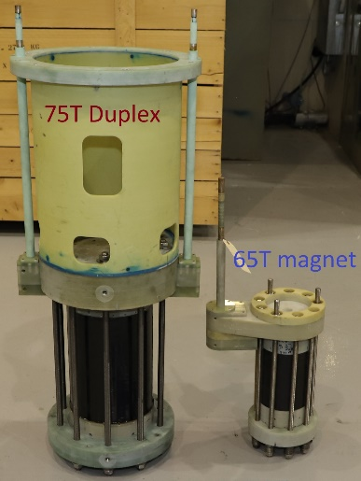
First Science from the 75T Duplex Magnet
Magnet: Doan N. Nguyen, James R Michel, Jason D. Lucero, Pulsed Field Facility at MagLab/LANL
Science: Z.Xiang, L.Chen, K-W.Chen, C.Tinsman, Tomoya Asaba, Lu Li, Univ. of Michigan; Y.Sato, Y. Kasahara, Y.Matsuda, Kyoto University; H.Lu, M.Jaime, F.Balakirev, J. Singleton, MagLab/LANL; F.Iga, Ibaraki University
Funding Grants: G.S. Boebinger (NSF DMR-1644779)
What is the finding? Duplex magnets are designed with two independent, nested coils energized by two separate capacitor banks. A new magnet providing 75T pulses to users was developed at the MagLab’s Pulsed Field Facility [1]. It enabled researchers to track quantum oscillations, a standard signature of a metal, deep into a metallic state that only exists at magnetic fields above 46T in YbB₁₂, a mysterious compound made of Ytterbium and Boron. The magnet and resulting magnet pulse are shown at right.
Why is this important? YbB₁₂ has long been known to exhibit quantum oscillations even in a low-magnetic-field regime in which the compound is an electronic insulator. Until recently, this state of affairs, an insulator that exhibits quantum oscillations, would have been considered an oxymoron and a physical impossibility. However, the extended magnetic field range of the duplex magnet enabled this experiment to link the quantum oscillations in the high-magnetic-field metallic state to the quantum oscillations in the low-magnetic-field insulating state, proving that they arise from the same particles and, thus, putting on firm ground a new understanding wherein insulators can exhibit quantum oscillations [2].
Why did this research need the MagLab? The MagLab’s Pulsed Field Facility has long been a leading center in design and construction of high-field pulsed magnets designed for ease of operation by users. The duplex magnet enabled this scientific conclusion by providing an extended range over which the sensitive measurement of quantum oscillations could be made.
Magnetic field waveforms of the duplex magnet, showing the contributions to the total magnetic field from the inner and outer coils. The total magnetic field reaches 76.8T.
The 75T duplex magnet and the previous standard workhorse magnet (a 65T magnet consisting of a single coil).
Facilities and instrumentation used: Pulsed Field Facility at MagLab/LANL, with support from the MagLab’s Magnet Science and Technology Division
Citation: [1] J.Michel, D.N.Nguyen, J.D.Lucero, Design, Construction, and Operation of New Duplex Magnet at Pulsed Field Facility-NHMFL, IEEE Transactions on Applied Superconductivity, 30 (4), 0500105 (2020) doi.org/10.1109/TASC.2020.2970670
[2] Z.Xiang, L.Chen, K-W.Chen, C.Tinsman, Y.Sato, T.Asaba, H.Lu, Y.Kasahara, M.Jaime, F.Balakirev, F.Iga, Y.Matsuda, J.Singleton, L.Li, Unusual high-field metal in a Kondo Insulator, Nature Physics, (2021) doi.org/10.1038/s41567-021-01216-0

