Slide 1
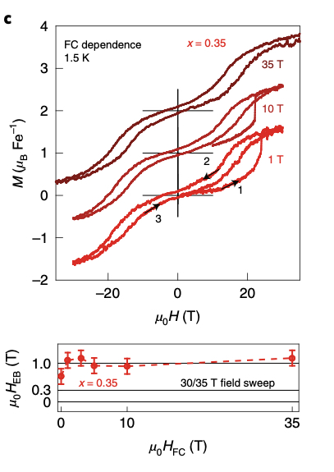
Exchange bias due to coupling between coexisting
antiferromagnetic and spin-glass orders
Eran Maniv^{1,2}, Ryan A. Murphy¹,Shannon C. Haley^{1,2}, Spencer Doyle^{1,2}, Caolan John^{1,2},
Ariel Maniv^{3,4}, Sanath K. Ramakrishna⁴, Yun-Long Tang^{1,2}, Peter Ercius²,
Ramamoorthy Ramesh^{1,2}, Arneil P. Reyes⁴, Jeffrey R. Long^{1,2} and James G. Analytis^{1,2}
1. University of California, Berkeley, CA, USA. 2. Lawrence Berkeley National Laboratory, Berkeley, CA, USA.
3. Nuclear Research Center – Negev, Beer Sheva, Israel. 4. National High Magnetic Field Laboratory, Tallahassee, FL, USA.
Funding Grants: J.G. Analytis (EFRC and Moore GBMF-9067); J.R. Long (DMR-1611525); G.S. Boebinger (NSF DMR-1644779)
Ferromagnetism (FM) and anti-ferromagnetism (AFM) are stable magnetic states with an ordered arrangement of magnetic moments, typically determined by the crystal structure of the host material. By contrast, a spin-glass is a metastable magnetic state in a material in which the magnetic moments of the atoms are disordered in a manner that is a magnetic analog to the amorphous atomic structure of ordinary window glass.
FexNbS2 is an unusual material in that it hosts both AFM and spin-glass states simultaneously, with the AFM state influencing the properties of the spin-glass state via the property of exchange bias. In previously studied thin film materials, this exchange bias results in the magnetization curves being offset by ~ 0.01T. By contrast, in single crystal Fe0.35NbS2, researchers find that the exchange bias is ~ 1T, a factor of 100 greater!
The demonstration of the role of disorder in the physics of exchange bias in a single crystal is a breakthrough. These results offer a compelling basis for more investigations on how bulk disorder impacts the exchange bias in devices beyond engineered thin film materials.
a
Co-existence of Antiferromagnetism and Spin Glass orders in Fe_{X}NbS₂, including schematic of effect of exchange bias on magnetization curves
b
c
d
(b) and (d): Exchange Bias as a function of Magnetic Field Magnitude during Field Cooling
Enlarged image of 35T data from (b). Note asymmetry about the origin, due to the ~1T offset of magnetization curves in Fe_{0.35}NbS₂
a: Schematic of the co-existence of antiferromagnetism and spin glass orders in Fe_{X}NbS₂ b: Out of plane magnetization curves for three different field-cooling conditions for Fe_{0.35}NbS₂. c: Enlarged portion of the data from (b). d: Exchange bias magnitude as a function of the magnitude of field cooling, showing an exchange bias value of ~1T at all values of field cooling.
Facilities and instrumentation used: Cell 8, 35T
Citation: Maniv, E.; Murphy, R.A.; Haley, S.C.; Doyle, S.;
John, C.; Maniv, A.; Ramakrishna, S.K.; Tang, Y.; Ercius, P.; Ramesh, R.; Reyes, A.P.; Long, J.R.; Analytis, J.G., Exchange bias due to coupling between coexisting antiferromagnetic and spin-glass orders, Nature Physics, 17, 1-7 (2021) doi.org/10.1038/s41567-020-01123-w

Slide 2
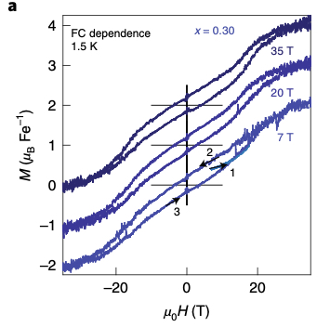
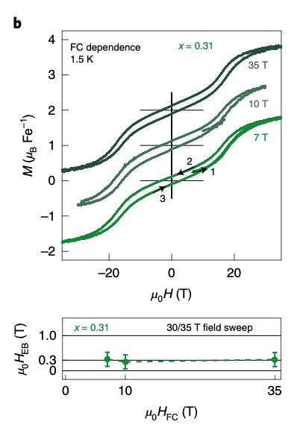
Exchange bias due to coupling between coexisting
antiferromagnetic and spin-glass orders
Eran Maniv^{1,2}, Ryan A. Murphy¹,Shannon C. Haley^{1,2}, Spencer Doyle^{1,2}, Caolan John^{1,2},
Ariel Maniv^{3,4}, Sanath K. Ramakrishna⁴, Yun-Long Tang^{1,2}, Peter Ercius²,
Ramamoorthy Ramesh^{1,2}, Arneil P. Reyes⁴, Jeffrey R. Long^{1,2} and James G. Analytis^{1,2}
1. University of California, Berkeley, CA, USA. 2. Lawrence Berkeley National Laboratory, Berkeley, CA, USA.
3. Nuclear Research Center – Negev, Beer Sheva, Israel. 4. National High Magnetic Field Laboratory, Tallahassee, FL, USA.
Funding Grants: J.G. Analytis (EFRC and Moore GBMF-9067); J.R. Long (DMR-1611525); G.S. Boebinger (NSF DMR-1644779)
What is the finding? MagLab users have demonstrated the potential of combining ordered and disordered magnetic phases to greatly increase the exchange bias in materials. Additionally, the illumination of disorder’s role in the physics of exchange bias in a the constraints of a single crystal is a breakthrough.
Why is this important? Exchange bias is a critical component to a variety of devices such as spin-valves, which are used extensively in high density magnetic storage, and has potentially more exotic applications, such as voltage-mediated magnetic switching for logic devices.
Why did this research need the MagLab? MagLab users could only reach 7T at their home laboratory. To capture the full exchange bias response a significant high magnetic field was needed (up to 35 Tesla), including the application of a high fixed DC magnetic fields for extended periods of time. The users stated that this capability was only available to them at the NHMFL.
a
b
c
d
Increasing exchange bias
e
f
Fig: High-field exchange bias characterization. a-c, Out of plane magnetization curves for three different field-cooling conditions for each intercalation. d-f, Exchange bias magnitude for each intercalation as a function of the magnitude of field cooling. f), Exchange bias value of ~ 1T at all values of field cooling.
Facilities and instrumentation used: Cell 8, 35T
Citation: Maniv, E.; Murphy, R.A.; Haley, S.C.; Doyle, S.;
John, C.; Maniv, A.; Ramakrishna, S.K.; Tang, Y.; Ercius, P.; Ramesh, R.; Reyes, A.P.; Long, J.R.; Analytis, J.G., Exchange bias due to coupling between coexisting antiferromagnetic and spin-glass orders, Nature Physics, 17, 1-7 (2021) doi.org/10.1038/s41567-020-01123-w

