Slide 1
MagLab FAIR Data Empowers ‘Data Users’
Wenrong Chen¹, Xiaowen Liu^{1,2}
Department of BioHealth Informatics, Indiana University—Purdue University Indianapolis
Center for Computational Biology and Bioinformatics, Indiana University School of Medicine
Funding Grants: (Xiaowen Liu, PI) NIH R01GM118470; R01GM125991; R01AI14625; MagLab (G.S. Boebinger, NSF DMR-1644779)
Recently, a new type of MagLab users ‒ ‘Data Users’ ‒ accessed MagLab-generated top-down protein mass spectrometry data on DLD-1 colorectal cancer cells from the MassIVE data repository, along with complementary RNA-sequencing data derived from the same cell line to perform a proteogenomics study. Proteogenomics combines protein data with DNA and RNA data in order to improve identification of proteins with sample-specific sequence alterations, such as those caused by mutations and alternative splicing.
The data had been originally published in 2017 as part of a benchmark study on 21T FT-ICR performance that produced unparalleled results on the number of intact proteins identified per experiment. Few proteogenomic studies have utilized top-down protein data, in which the exact protein forms (called proteoforms) are measured intact, as opposed to bottom-up protein data, which detects and identifies digested peptides and attempts to infer the original proteoform structures. Top-down data makes it possible to simultaneously identify all sequence variants and post-translational modifications for each observed protein, which elucidates combinatorial effects that cannot be captured by bottom-up proteogenomics.
The data were recently re-analyzed by a different set of users with a new proteogenomics software tool, TopPG (see figure), which revealed 112 proteoforms covering 43 single nucleotide variant events, and 128 proteoforms covering 131 splicing variations, including 13 novel events.
RNA-sequencing
Genetic and
splice variations
GCTCTAGTTACGGGTA
ICR data
TopPG
Customized protein
database
Database search
Proteoform identifications
These ‘Data Users’ demonstrated that databases generated by TopPG facilitated identification of novel, sample-specific proteoforms, a discovery that will improve our understanding of biology, health, and disease.
Facility used: Ion Cyclotron Resonance (21 T FT-ICR)
Original Citation: Journal of Proteome Research 2017 16 (2), 1087-1096 DOI: 10.1021/acs.jproteome.6b00696
Dataset: Mass Spectrometry Interactive Virtual Environment (MassIVE) ID: MSV000079978
Data User Citation: Journal of Proteome Research 2021 20 (1), 261-269 DOI: 10.1021/acs.jproteome.0c00369

Slide 2
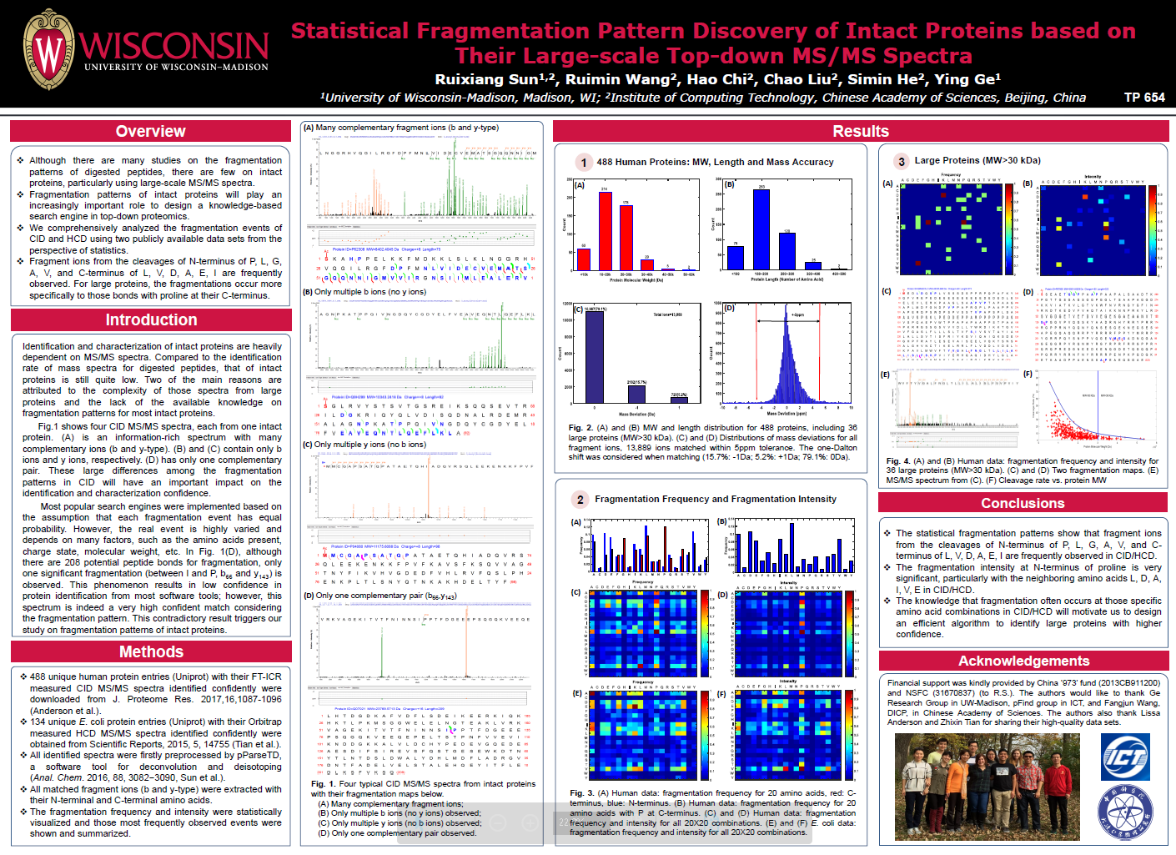
MagLab FAIR Data Empowers ‘Data Users’
1. Institute of Computing Technology, Chinese Academy of Sciences, Beijing, 2.**University of Wisconsin, Madison
3. National Institute of Biological Sciences, Beijing, 4.**Indiana University—Purdue University Indianapolis; **multiple departments
Funding Grants: Ruixiang Sun^{1,3} (China ‘973’ fund 2013CB911200, NSFC 31670837); Ying Ge² (NIH R01GM125085, R01HL096971, GM117058, S10OD018475); Xiaowen Liu⁴ (NIH R01GM118470, R01GM125991, R01AI14625)
MagLab (G.S. Boebinger, NSF DMR-1644779)
What are the developments? Researchers from multiple institutions independently harnessed data that had been previously collected at the MagLab by other researchers and stored under practices consistent with FAIR principles. These new ‘Data Users’ accessed top-down protein mass spectrometry data from colorectal cancer cells. This data was used to: (Fig a) perform statistical analysis of fragmentation patterns to optimize search algorithms for identifying intact proteins from mass spectrometry data, (Fig b) optimize the discovery-mode workflow of MASH Explorer software, and (Fig c) demonstrate use of TopPG software to discover novel proteoforms involved in colorectal cancer.
Why is this important? Reuse of the MagLab’s Ion Cyclotron Resonance facility data improved understanding of protein fragmentation and guided the design of two new software tools. These new ‘Data Users’ demonstrate that MagLab data that is Findable, Accessible, Interoperable, and Reusable (FAIR) fosters knowledge, discovery, and innovation. As FAIR data practices grow, the impact of original MagLab data will be amplified in a self-perpetuating cycle of new discoveries.
Why did this research need the MagLab? High quality data from intact proteins requires ultrahigh mass resolving power, mass accuracy, sensitivity, and spectral acquisition rate. The 21 T FT-ICR mass spectrometer provides all these capabilities, and this particular colorectal cancer data is gaining notoriety as a “gold standard” to test algorithm and software performance.
Poster on “Statistical Fragmentation Pattern Discovery of Intact Proteins Based on Their Large-scale Top-down MS/MS Spectra”.
65th ASMS Conference on Mass Spectrometry and Allied
Topics, Indianapolis, Indiana, June 4-8 (2017).
(a)
DOI: 10.1021/acs.jproteome.0c00469
(b)
DOI: 10.1021/acs.jproteome.0c00369
(c)
Facility used: Ion Cyclotron Resonance (21 T FT-ICR)
Original Publication: Journal of Proteome Research 2017 16 (2), 1087-1096 DOI: 10.1021/acs.jproteome.6b00696
FAIR Data Set: Mass Spectrometry Interactive Virtual Environment (MassIVE) ID: MSV000079978

