Slide 1
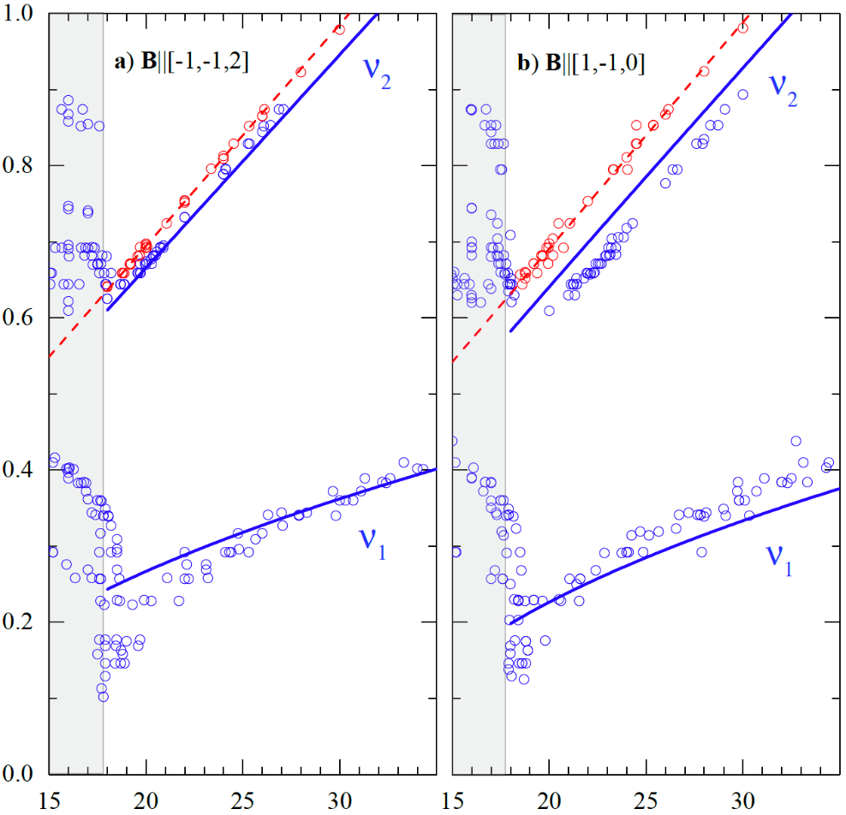
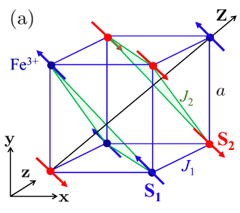
Magnetoelastic Coupling in the Multiferroic BiFeO₃
T. Rõõm,¹ J. Viirok,¹ L. Peedu,¹ U. Nagel,¹ D.G. Farkas,² D. Szaller,^{2,3} V. Kocsis,^{2,4} S. Bordács,² I. Kézsmárki,^{2,5} D.L. Kamenskyi,⁶ H. Engelkamp,⁶ M. Ozerov,⁷ D. Smirnov,⁷ J. Krzystek,⁷ K. Thirunavukkuarasu,^{7,8} Y. Ozaki,⁹ Y. Tomioka,⁹ T. Ito,⁹ T. Datta,¹⁰ and R.S. Fishman¹¹
1. NICPB, Tallinn; 2. MTA-BME Budapest; 3. ISSP Vienna; 4. RIKEN Japan; 5. IoP Augsburg; 6. HFML-EMFL Nijmegen; 7. NHMFL FSU; 8. FAMU; 9. AIST Tsukuba Japan; 10. Augusta University; 11. ORNL
Funding Grants: G.S. Boebinger (NSF DMR-1644779); European Union; Estonian Ministry of Education; Estonian & Hungarian Academy of Science; Austrian Science Fund; Deutsche Forschungsgemeinschaft (DFG); and DOE BES (DE-AC05-00OR22725)
The room-temperature multiferroic BiFeO₃ is one of the most technologically important materials in the rapidly expanding field of spintronics, with applications ranging from nano-electronics to photovoltaics. One of the most useful ways to control the properties of BiFeO₃ thin films is through strain, which unwinds its cycloidal spin structure and stabilizes a canted antiferromagnetic (AF) state. Despite great interest in controlling its magnetic properties, little is known about the effects of magnetoelastic strain on bulk BiFeO₃.
Magnetic fields above 18T are also known to destroy the low-field cycloidal spin structure in BiFeO₃, again stabilizing a canted AF state (see Figure). In this work, high-resolution spectroscopic studies of the spin-wave spectrum in the high-field phase of BiFeO₃ reveal direct evidence for the magneto-elastic coupling through a change in lattice symmetry from rhombohedral to monoclinic. This transformation activates two new coupling terms in the spin Hamiltonian describing the spin-wave spectrum (solid/dashed curves in the Figure are fits to this model). This collaborative study demonstrates how high-field electron magnetic resonance measurements in the terahertz range can be used to determine the magnetoelastic coupling constants in the AF phase of BiFeO₃.
B$∥$Y
B$∥$X
Frequency (THz)
AF
AF
Magnetic field (T)
Facilities and instrumentation used: Joint EMR/DC-Field Facility Operation (Broadband Backward Wave Oscillator (BWO) Spectrometer)
Citation: Rōōm, T.; Viirok, J.; Peedu, L.; Nagel, U.; Farkas, D.G.; Szaller, D.; Kocsis, V.; Bordács, S.; Kézsmárki, I.; Kamenskyi, D.L.; Engel-kamp, H.; Ozerov, M.; Smirnov, D.; Krzystek, J.; Thirunavukkuarasu, K.; Ozaki, Y.; Tomioka, Y.; Ito, T.; Datta, T.; Fishman, R.S., Magnetoelastic distortion of multiferroic BiFeO₃ in the canted antiferromagnetic state, Phys. Rev. B 102, 21440 (2020). DOI: 10.1103/PhysRevB.102.214410

Slide 2
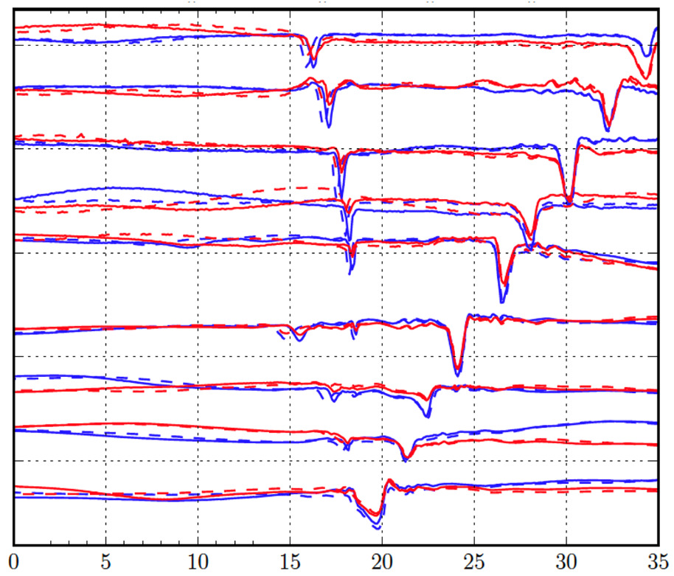
Magnetoelastic Coupling in the Multiferroic BiFeO₃
T. Rõõm,¹ J. Viirok,¹ L. Peedu,¹ U. Nagel,¹ D.G. Farkas,² D. Szaller,^{2,3} V. Kocsis,^{2,4} S. Bordács,² I. Kézsmárki,^{2,5} D.L. Kamenskyi,⁶ H. Engelkamp,⁶ M. Ozerov,⁷ D. Smirnov,⁷ J. Krzystek,⁷ K. Thirunavukkuarasu,^{7,8} Y. Ozaki,⁹ Y. Tomioka,⁹ T. Ito,⁹ T. Datta,¹⁰ and R.S. Fishman¹¹
1. NICPB, Tallinn; 2. MTA-BME Budapest; 3. ISSP Vienna; 4. RIKEN Japan; 5. IoP Augsburg; 6. HFML-EMFL Nijmegen; 7. NHMFL FSU; 8. FAMU; 9. AIST Tsukuba Japan; 10. Augusta University; 11. ORNL
Funding Grants: G.S. Boebinger (NSF DMR-1644779); European Union; Estonian Ministry of Education; Estonian & Hungarian Academy of Science; Austrian Science Fund; Deutsche Forschungsgemeinschaft (DFG); and DOE BES (DE-AC05-00OR22725)
What is the finding? Magnetic resonance spectroscopy at terahertz frequencies and magnetic fields to 35T was used to learn how electron spins interact with each other and with the crystal lattice in BiFeO₃. The spectrum varies with magnetic field orientation, implying that the spins are not simply embedded passively into the crystal, but act back to deform the lattice when the magnetic structure changes.
Why is this important? Multiferroics that respond to both magnetic and electrical stimuli are candidate materials to replace silicon in future logic devices. BiFeO₃ is one of the few multiferroics that retains suitable properties to above room temperature. It has an exotic magnetic structure that is destroyed by magnetic fields above 18T. Spectroscopy of the simpler high-field magnetic state, which had not been studied in detail before, reveals how the lattice deformation couples to the magnetism, providing important information for designing future logic devices based on BiFeO₃.
Why did this research need the MagLab? Static magnetic fields well above 18T are not achievable in commercial magnets. The MagLab also has spectrometers covering the terahertz frequency range needed for these investigations.
403
383
360
339
Normalized Transmission (offset)
323
292
268
250
228
Magnetic field (T)
Normalized transmission through a BiFeO₃ crystal with the magnetic field, B, applied perpendicular to the trigonal (Z) axis; radiation frequencies are indicated on the right in GHz. Dips in transmission correspond to magnetic resonance signals: red (B > 0); blue (B < 0); solid lines increasing field and dashed lines decreasing field.
Facilities and instrumentation used: Joint EMR/DC-Field Facility Operation (Broadband Backward Wave Oscillator (BWO) Spectrometer)
Citation: Rōōm, T.; Viirok, J.; Peedu, L.; Nagel, U.; Farkas, D.G.; Szaller, D.; Kocsis, V.; Bordács, S.; Kézsmárki, I.; Kamenskyi, D.L.; Engel-kamp, H.; Ozerov, M.; Smirnov, D.; Krzystek, J.; Thirunavukkuarasu, K.; Ozaki, Y.; Tomioka, Y.; Ito, T.; Datta, T.; Fishman, R.S., Magnetoelastic distortion of multiferroic BiFeO₃ in the canted antiferromagnetic state, Phys. Rev. B 102, 21440 (2020). DOI: 10.1103/PhysRevB.102.214410

