Slide 1
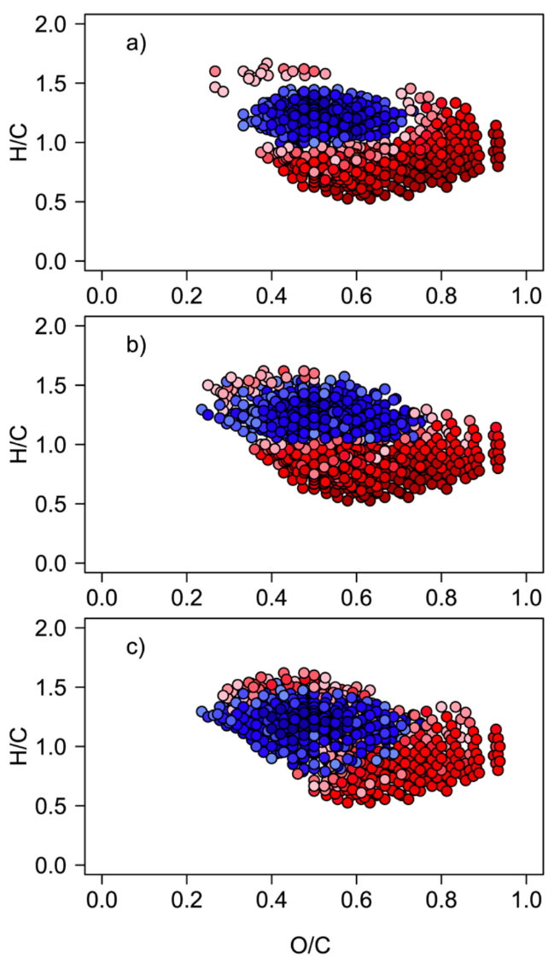
Dissolved Organic Matter in Arctic Rivers:
Synchronous molecular stability, shifting sources and subsidies
M.I. Behnke¹, J. McClelland², S. Tank³, A. Kellerman¹, R.M. Holmes⁴, R.G.M. Spencer¹
Florida State University; 2. University of Texas Marine Science Institute;
3. University of Alberta; 4. Woodwell Climate Research Center
Funding Grants: G.S. Boebinger (NSF DMR-1644779); Arctic Great Rivers Observatory (110774; 1602615; 1603149; 1602680; 1913888; 1914081; 1914215; NSF GRFP)
Climate change in the Arctic is thawing permafrost soils and changing vegetation, altering the amount and composition of organic matter transferred from land to ocean. Riverine samples of this dissolved organic matter (DOM) provide detailed information about changes occurring throughout vast Arctic watersheds - much like a medical doctor can take a blood sample and diagnose a patient’s health. The assessment shows how some DOM may be rapidly converted to greenhouse gases with ramifications for climate change, while other DOM may be moved from long-term storage on land to long-term storage in the ocean.
Water samples collected over six years from major Arctic rivers (www.arcticgreatrivers.org) were analyzed using the MagLab’s record-setting 21T ultra-high-resolution Fourier-transform ion cyclotron resonance mass spectrometer. This magnet system’s resolving power is capable of determining elemental composition for tens of thousands of individual molecules in a single water sample. Combined with isotopic data, these formulae revealed both a common core amongst samples, as well as unique tracers of seasonality and a changing Arctic.
These tracers showed a high-energy subsidy at the time of maximum spring river discharge, as well as more permafrost thaw leading to older more stable carbon exported to the coastal ocean. The findings highlight the molecular-level signature of a changing Arctic, as well as the coupling between changes on land and impact on the Arctic Ocean.
Molecular associations between individual formulae and bulk characteristics for the core Arctic riverine fingerprint (i.e. the formulae found in every sample). Significant Spearman rank coefficients (red = positive; blue = negative) between molecular formulae and a) dissolved organic carbon (DOC), b) specific UV absorbance at 254 nm, and c) Δ14C-DOC values. The blue universal central region is old, stable, microbially degraded DOM sourced from groundwater that appears to persist in the ocean. The red outer region is younger, freshly leached, aromatic DOM.
dissolved organic carbon (DOC)
specific UV absorbance at 254 nm
Δ14C-DOC values
Facilities and instrumentation used: Ion Cyclotron Resonance (21 T FT-ICR MS)
Citation: Behnke, M.I.; McClelland, J.W.; Tank, S.E.; Kellerman, A.M.; Holmes, R.M.; Haghipour, N.; Eglinton, T.I.; Raymond, P.A.; Suslova, A.; Zhulidov, A.V.; Gurtovaya, T.; Zimov, N.; Zimov, S.; Mutter, E.A.; Spencer, R.G.M., Pan‐Arctic Riverine Dissolved Organic Matter: Synchronous Molecular Stability, Shifting Sources and Subsidies, Global Biogeochemical Cycles, 35, e2020GB006871 (2021) DOI:10.1029/2020GB006871

Slide 2
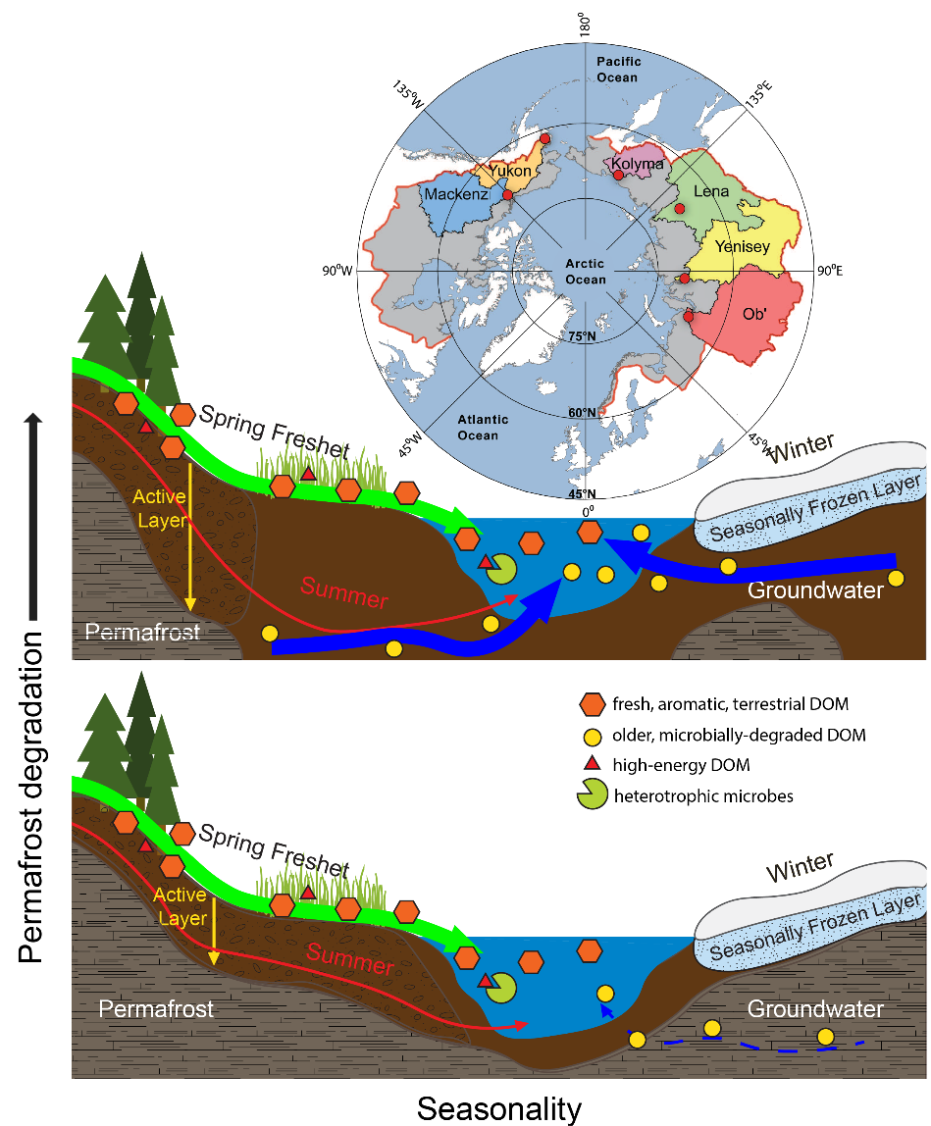
Dissolved Organic Matter in Arctic Rivers:
Synchronous molecular stability, shifting sources and subsidies
M.I. Behnke¹, J. McClelland², S. Tank³, A. Kellerman¹, R.M. Holmes⁴, R.G.M. Spencer¹
Florida State University; 2. University of Texas Marine Science Institute;
3. University of Alberta; 4. Woodwell Climate Research Center
Funding Grants: G.S. Boebinger (NSF DMR-1644779); Arctic Great Rivers Observatory (110774; 1602615; 1603149; 1602680; 1913888; 1914081; 1914215; NSF GRFP)
What is the finding? The source and composition of dissolved organic matter (DOM) in Arctic rivers is strongly tied to seasonality. Increases in Arctic permafrost thaw result in older and more stable DOM being exported to the Arctic Ocean. A unique set of high energy compounds appear in spring and can subsidize marine organisms at this important time for productivity.
Why is this important? Climate change is thawing permafrost soils in the Arctic, increasing the amount of time DOM spends in groundwater. This longer time increases the degree to which microbes modify the DOM, This microbial processing makes the DOM more stable. Increasing of permafrost thaw and groundwater inputs to rivers may increase the amount of stable, old DOM that rivers release to the Arctic Ocean, thereby increasing the ocean’s carbon sink.
Why did this research need the MagLab? The MagLab’s 21T Fourier-transform ion cyclotron resonance mass spectrometer measures the mass of molecules in complex mixtures with enough precision to determine the only possible molecular formulae of each molecule in the mixture. The 21 T instrument achieves the highest resolving power in the world, allowing the most accurate assessment of the tens of thousands of individual molecules found in Arctic rivers.
Map of the drainage basins of six Arctic rivers, with water
sampling points shown in red.
Facility used: Ion Cyclotron Resonance (21 T FT-ICR MS)
Citation: Behnke, M.I.; McClelland, J.W.; Tank, S.E.; Kellerman, A.M.; Holmes, R.M.; Haghipour, N.; Eglinton, T.I.; Raymond, P.A.; Suslova, A.; Zhulidov, A.V.; Gurtovaya, T.; Zimov, N.; Zimov, S.; Mutter, E.A.; Spencer, R.G.M., Pan‐Arctic Riverine Dissolved Organic Matter: Synchronous Molecular Stability, Shifting Sources and Subsidies, Global Biogeochemical Cycles, 35, e2020GB006871 (2021) DOI:10.1029/2020GB006871
Seasonality and permafrost degradation control the composition of Dissolved Organic Matter in Arctic rivers.

