Slide 1
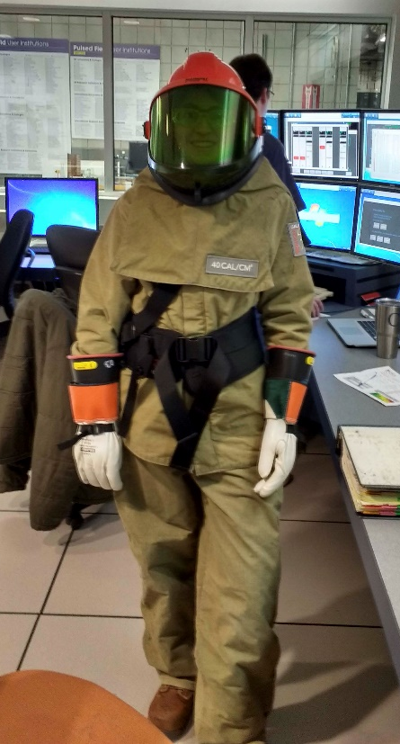
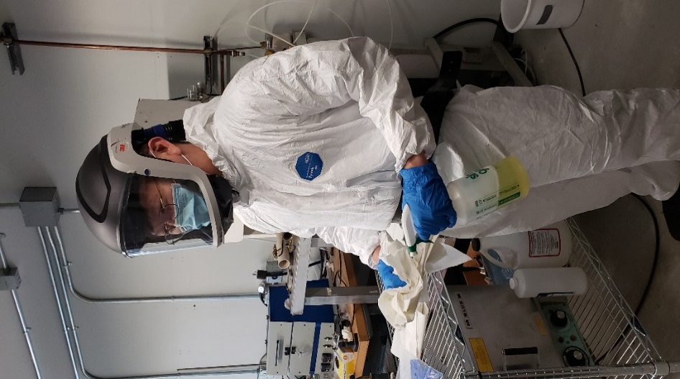
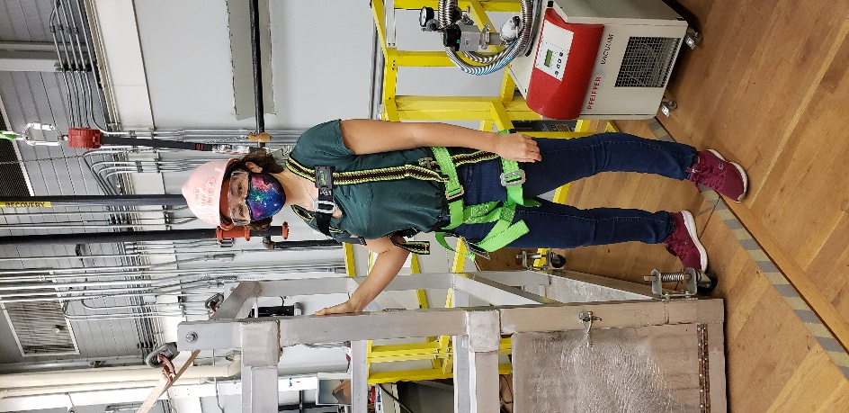
Above and beyond: Protecting MagLab researchers when conditions require specialized personal protective equipment (PPE)
Funding Grants: G.S. Boebinger (NSF DMR-1644779)
Personal protective equipment, commonly referred to as PPE, is gear or clothing used to protect the wearer from specific hazards and hazardous materials. It is the final protection system to be used when administrative and engineering controls do not reduce risk to an acceptable level.
Lab coats, safety glasses and disposable gloves are commonly found in the laboratory. However, at the MagLab some of our researchers must protect themselves from non traditional hazards, including arc flash, toxic dust or fumes, and working on elevated surfaces.
Julia Smith’s PPE protects her from an arc flash (type of hazardous electrical discharge that creates light, heat and vaporized metal) while testing high voltage equipment to ensure it has been de-energized.
Chongin Pak assisted in a glovebox cleanout that was used in arsenic chemistry related to superconducting research at the MagLab’s Applied Superconductivity Center. The powered air purifying respirator he is using pumps HEPA filtered air to a helmet combining respiratory, head, eye and face protection.
A fall arrest safety system is required because of the need to transport instrumentation and helium to the Millikelvin platform. Fall protection is required anytime the platform gate is open for transport. Elizabeth Green is utilizing a self-retracting lanyard and safety harness. The self-retracting lanyard, much like the seat and shoulder belt in a car, pulls out and retracts easily allowing the research to move around the platform. The fast-acting arrestor, when activated, will stop a fall and prevent serious injury.
Julia H Smith: Research Faculty, MagLab Condensed Matter Physicist
Chongin Pak: Postdoctoral Researcher in the MagLab’s Applied Superconductivity Center
Elizabeth L Green: MagLab Condensed Matter Physicist

