Slide 1


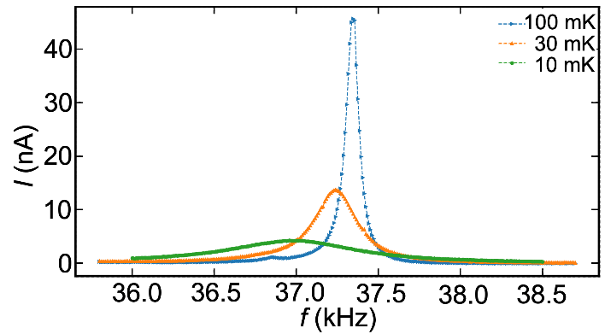
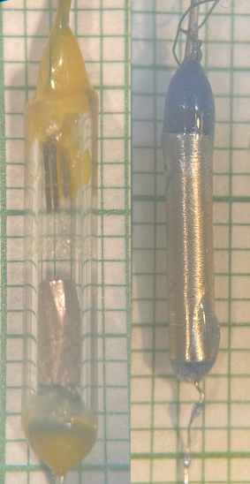
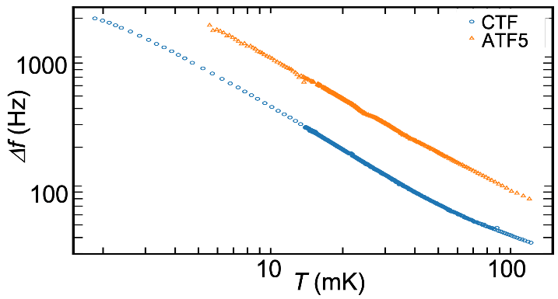
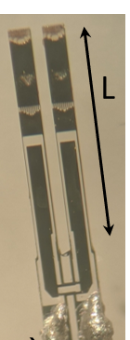
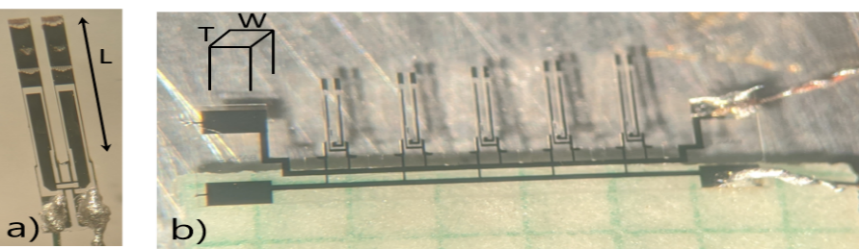
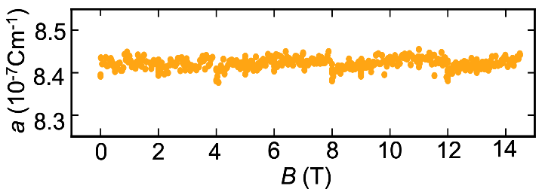
New high-magnetic-field thermometers for sub-millikelvin temperatures
Andrew J. Woods, Alexander M. Donald, Daniel M. Gitlin, Lucia Steinke
National High Magnetic Field Laboratory and University of Florida
Funding Grants: G.S. Boebinger (NSF DMR-1644779); L. Steinke (MagLab User Collaboration Grant, 2021-2022)
The MagLab’s High B/T facility at the University of Florida combines high magnetic fields with the extreme environment of ultra-low temperatures of order 1 mK. Most measurement techniques require adaptations to be successfully performed under these conditions, but specific heat and thermal transport are particularly challenging due to a lack of suitable thermometry. Here, MagLab scientists report progress on developing new thermometers, based on quartz tuning forks in liquid ³He, that will help realize these heavily-demanded user experiments.
The measurement principle relies on the temperature-dependent viscosity of liquid ³He, which leads to a temperature-dependent broadening of the Lorentzian vibration resonance curves. Despite being a measurement in liquid, tuning fork thermometers are one of the most promising candidates to realize miniature thermal probes for small solid crystals, since they are scalable to microscopic dimensions and compatible with both high magnetic fields and ultralow temperatures.
The newly developed thermometers will make the high B/T regime accessible to calorimetric and thermal transport measurements, enabling users to study superconductors, quantum critical behavior, quantum spin liquid states, and topological materials under these extreme conditions.
(a)
(b)
3 mm
(c)
(a) Resonance of a tuning fork in liquid ³He at three temperatures.
(b) Temperature-dependent resonance widths of two tuning forks.
(c) Calibration constant independence of magnetic field up to 14.5 Tesla.
Photos (by L. Steinke): Prototype thermometers photographed on mm paper.
Facilities and instrumentation used: MagLab High B/T facility, Bay 3, University of Florida, Gainesville, FL.
Citation: Andrew J. Woods, Alexander M. Donald, Lucia Steinke, “Developing compact tuning fork thermometers for sub-mK temperatures and high magnetic fields”, arXiv:2107.02387 (2020)

Slide 2
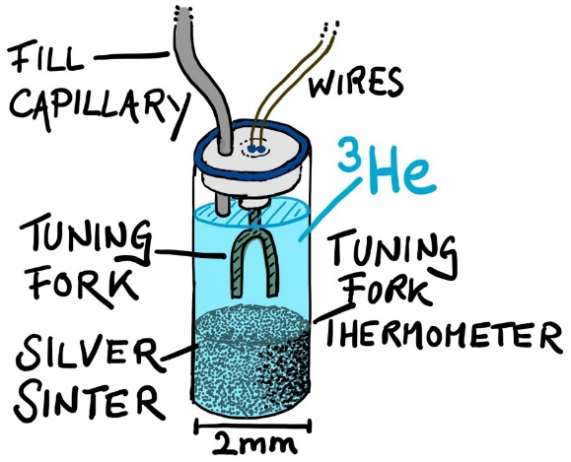
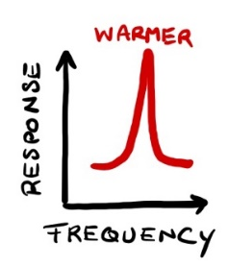

New high-magnetic-field thermometers for sub-millikelvin temperatures
Andrew J. Woods, Alexander M. Donald, Daniel M. Gitlin, Lucia Steinke
National High Magnetic Field Laboratory and University of Florida
Funding Grants: G.S. Boebinger (NSF DMR-1644779); L. Steinke (MagLab User Collaboration Grant, 2021-2022)
What is the finding? The scientists demonstrated that new thermometers based on vibrating quartz tuning forks (the same devices used in quartz watches) – when bathed in liquid ³He - can be used for temperature measurements in extreme experimental environments, such as temperatures of order one millikelvin, even when combined with high magnetic fields.
Why is this important? Temperature measurements, which seem straightforward at room temperature, become extremely difficult near absolute zero. If the object being measured is a small crystal or microscopic device that is also subject to a high magnetic field, a typical scenario for many experiments at the MagLab, there are limited options for temperature measurements necessary to determine quantities like heat capacity or thermal conductivity. These measurements are fingerprints of the underlying quantum states in the material under study. This experimental work was conducted during the pandemic and involved a graduate student, a postdoctoral researcher, an undergraduate student, and an early career faculty scientist.
Why did this research need the MagLab? The MagLab High B/T facility is the only user facility worldwide that offers sub-millikelvin temperatures in combination with high fields up to 16 Tesla, the extreme environment for which this new thermometer technology is most needed.
Tuning fork thermometers (left) consist of a quartz tuning fork contained in a small drop of liquid ³He, with a silver sinter heat exchanger to provide thermal contact.
They can be used to probe temperatures across a sample (below) by observing the shape of the tuning fork resonance curve, which gets wider as the ³He liquid gets colder and more viscous.
Drawings by L. Steinke.
Facilities and instrumentation used: MagLab High B/T facility, Bay 3, University of Florida, Gainesville, FL.
Citation: Andrew J. Woods, Alexander M. Donald, Lucia Steinke, “Developing compact tuning fork thermometers for sub-mK temperatures and high magnetic fields”, arxiv:2107.02387 (2020)

