Slide 1
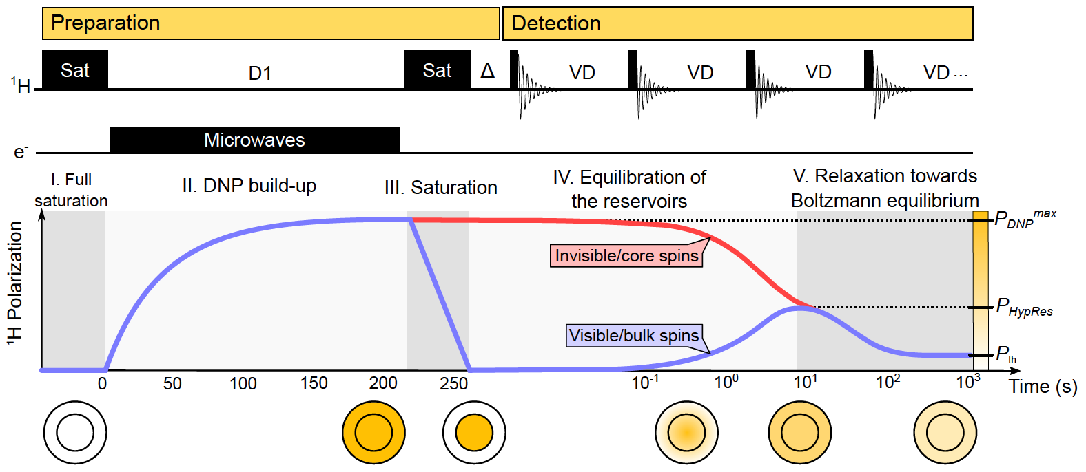
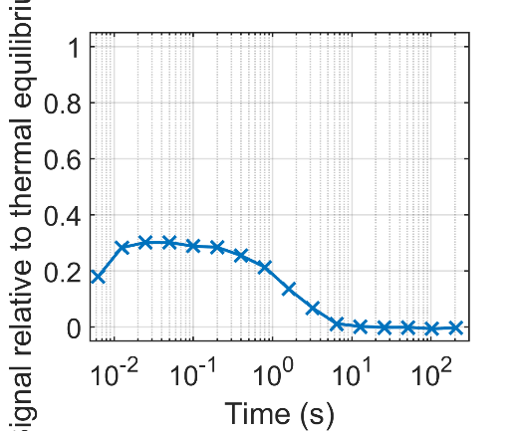
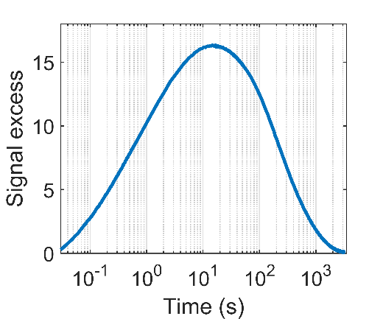
A new method for understanding dynamic nuclear polarization
Q. Stern¹, S. F. Cousin¹, F. Mentink-Vigier², A. C. Pinon³, S. J. Elliott⁴, O. Cala¹, S. Jannin¹
1. CNRS, ENS Lyon, UCBL, Univ. de Lyon, CRMN UMR 5280; 2. Nat’l High Magnetic Field Laboratory, Tallahassee, FL; 3. Swedish NMR Center, Univ. of Gothenburg, Sweden.; 4. Dept. of Chemistry, Univ. of Liverpool, UK
Funding Grants: S. Jannin (ERC 714519, MSC 766402); G. Boebinger (NSF/DMR 1644779); T. Cross (NIH S10 OD018519, NIH P41 GM12269801)
Dynamic nuclear polarization (DNP) is a technique that boosts the sensitivity of nuclear magnetic resonance (NMR) and magnetic resonance imaging (MRI) by orders of magnitude, enabling an ever-growing number of new applications. DNP uses microwave irradiation to transfer the electron spin polarization from polarizing agents to nearby nuclear spins. A crucial step in DNP is the spontaneous transfer of spin polarization from nuclear spins that are close to polarizing agents to nuclear spins that are further away (core and bulk spins, respectively). This mechanism is poorly understood.
MagLab users have introduced a simple method to monitor the polarization transfers, called hyperpolarization resurgence (HypRes). HypRes consists of creating a strong gradient of polarization between the core and bulk spins and observing the equilibration between them, which requires the ability to rapidly switch on and off the microwaves irradiating the sample that drive the DNP process. The MagLab has unique instrumentation that realizes these experimental conditions.
HypRes will permit testing the effects of various experimental parameters on polarization transfers, including polarizing agent structure, spin density, temperature, sample spinning, and sample composition. HypRes will thus provide needed experimental data to develop better theoretical models for describing polarization transfers.
¹H HypRes at 100 K under magic angle spinning DNP
¹H HypRes at 3.8 K under static DNP
Signal excess, relative to thermal equilibrium (-)
Figure: Top: The HypRes experiment, along with plots of ¹H polarization for bulk (blue) and core (red) spins. Bottom: Experimental demonstration of HypRes under magic angle spinning (left) and static (right) conditions showing delayed transfer of spin polarization from the core to the bulk. Microwave gating on the 600 MHz DNP platform at the MagLab was crucial for this experiment. (see citation below)
Facilities used: NMR/MRI, 600 MHz DNP MAS NMR
Citation: Stern, Q.; Cousin, S.; Mentink-Vigier, F.; Pinon, A.; Elliott, S.; Cala, O.; Jannin, S., Direct observation of hyperpolarization breaking through the spin diffusion barrier, Science Advances, 7, eabf5735 (2021) doi.org/10.1126/sciadv.abf5735

Slide 2
A new method for understanding dynamic nuclear polarization
Q. Stern¹, S. F. Cousin¹, F. Mentink-Vigier², A. C. Pinon³, S. J. Elliott⁴, O. Cala¹, S. Jannin¹
1. CNRS, ENS Lyon, UCBL, Univ. de Lyon, CRMN UMR 5280; 2. Nat’l High Magnetic Field Laboratory, Tallahassee, FL; 3. Swedish NMR Center, Univ. of Gothenburg, Sweden.; 4. Dept. of Chemistry, Univ. of Liverpool, UK
Funding Grants: S. Jannin (ERC 714519, MSC 766402); G. Boebinger (NSF/DMR 1644779); T. Cross (NIH S10 OD018519, NIH P41 GM12269801)
What is the finding? MagLab users have developed a new method called hyperpolarization resurgence (HypRes) to study how nuclear spins ”communicate” in the presence of unpaired electron spins. This is a crucial advance in a revolutionary technique called dynamic nuclear polarization (DNP), which is used to provide enormous signal enhancements in nuclear magnetic resonance (NMR) and magnetic resonance imaging (MRI) experiments.
Why is this important? NMR and MRI are used for a number of high-profile applications ranging from biological chemistry and in vivo imaging to materials science and drug discovery – yet NMR and MRI signals are often very weak. DNP helps to enhance sensitivity, but it relies on complex mechanisms, some of which are not fully understood, even after seventy years of research. The HypRes method is a tool to measure one of the important steps of DNP, namely the transfer of spin polarization between nuclei. Thus, HypRes will enable the study the influences of different experimental parameters on polarization transfers and thereby boost the performance of DNP, bringing to light many opportunities for studying a wider variety of important chemical and biological systems.
Why did this research need the MagLab? The MagLab has developed a unique DNP apparatus capable of switching a high-power microwave source on and off in a very short time. This capability is required to realize the HypRes technique.
Representation of the nuclei in a DNP sample
Invisible/core spins
Polarization
transfer
Visible/bulk spins
HypRes method
Applications
Magnetic resonance imaging (MRI)
Materials science and energy storage
Biological chemistry and drug discovery
Improved understanding
DNP
Optimized process
Figure 2. Top: Transfer of spin polarization around unpaired electrons from core to bulk nuclear spins. Bottom: HypRes will give us insight into making DNP NMR more efficient, opening studies on a variety of chemical and biological systems. Figure Credit: see citation below
Facilities used: NMR/MRI, 600 MHz DNP MAS NMR
Citation: Stern, Q.; Cousin, S.; Mentink-Vigier, F.; Pinon, A.; Elliott, S.; Cala, O.; Jannin, S., Direct observation of hyperpolarization breaking through the spin diffusion barrier, Science Advances, 7 (18), eabf5735 (2021) doi.org/10.1126/sciadv.abf5735

