Slide 1
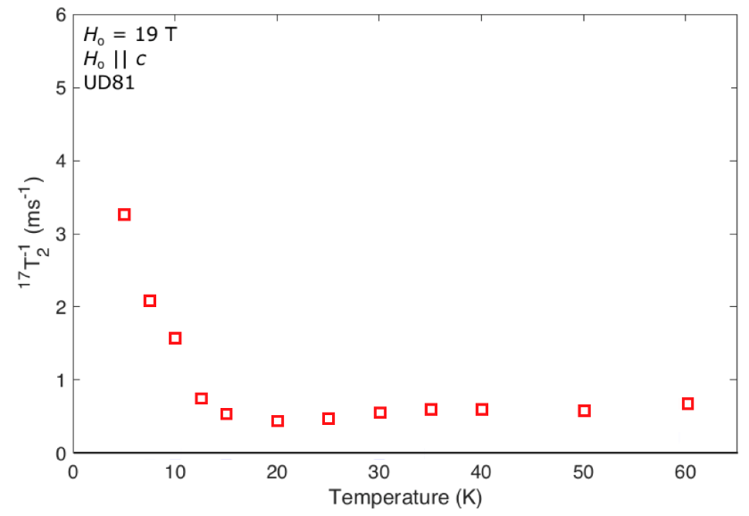
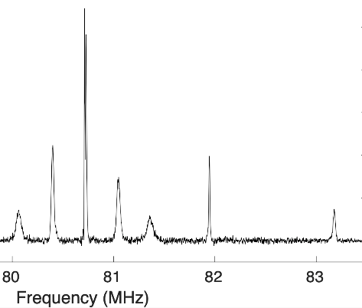
Spin Coherence in the vortex core of HgBa₂CuO_{4+δ}
as measured in the MagLab’s 32T Superconducting Magnet
Ingrid Stolt¹, Yizhou Xin¹, Mun Chan², A. P. Reyes³, E. L. Green³, S. K. Ramakishna³, W.P. Halperin
Northwestern University; 2. Los Alamos National Laboratory; 3. NHMFL-FSU;
Funding Grants: G.S. Boebinger (NSF DMR-1644779); W.P. Halperin (DOE DE-FG02-05ER46248)
Achieving quantum phase coherence in devices and materials is a key aspect of the technology of quantum information processing which underlies progress toward a quantum computer. A paradigm for this coherence is achieved with nuclear spin systems using nuclear magnetic resonance (NMR). Applications of coherent nuclear spin states are at the very heart of chemical, physical, and biological analysis of materials. This experiment identifies an important milestone in the application of NMR spin coherence at high magnetic fields.
NMR resolution improves dramatically with increasing magnetic field; however, achieving spin coherence restricts most experiments to superconducting magnets. The 32T all superconducting magnet recently developed at the MagLab increases the potential for realizing the improved spectral resolution afforded by high magnetic fields, while maintaining spin coherence. Here, MagLab users show the first demonstration of an NMR spin coherence experiment in this magnet. [1]
The application involves ¹⁷O NMR in a single crystal of the cuprate superconductor, HgBa₂CuO_{4+δ}. The multi-pulse experiment records a spin coherence time, T₂. The data discover spin dynamics in the vortices of magnetic flux in this superconducting compound that are most likely associated with the electronic bound states in the vortex cores. [1]
Planar
O(1)
site
Apical
O(2)
site
The underdoped cuprate crystal has a superconducting transition at 81K. The exponential spin-spin relaxation rate is shown in the figure above. The data suggest that the vortices freeze from their liquid state near 15K. The inset shows first quadrupolar satellite spectra for both planar O(1) and apical O(2) oxygen sites. The data T₂⁻¹, is the decoherence rate for the O(1). The line width of O(2) is temperature and magnetic field independent up to H = 30T, showing that the vortices do not form a lattice detectable by NMR linewidth down to 5K. However, the increase in the relaxation rate at low temperatures signals a new type of spin dynamic state.
Facilities and instrumentation used: DC Field Facility, 32T superconducting magnet and condensed matter NMR group.
[1] I. Stolt, PhD thesis Northwestern University, 2021

Slide 2
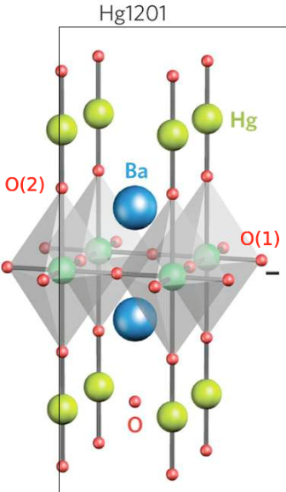
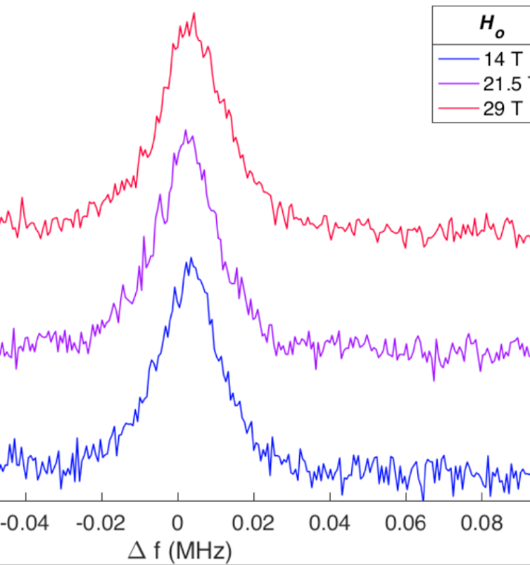
Spin Coherence in the vortex core of HgBa₂CuO_{4+δ}
as measured in the MagLab’s 32T Superconducting Magnet
Ingrid Stolt¹, Yizhou Xin¹, Mun Chan², A. P. Reyes³, E. L. Green³, S. K. Ramakishna³, W.P. Halperin
Northwestern University; 2. Los Alamos National Laboratory; 3. NHMFL-FSU;
Funding Grants: G.S. Boebinger (NSF DMR-1644779); W.P. Halperin (DOE DE-FG02-05ER46248)
What is the finding? This collaboration used nuclear magnetic resonance (NMR) for the first phase coherent nuclear spin experiments in the MagLab’s 32T superconducting magnet. As such, this is a seminal development for NMR technology, demonstrated in measurements of the decoherence rate T₂⁻¹ in 19T in the superconducting single crystal of HgBa₂CuO_{4+δ,} the first such measurements in very high field. The field independence of the spectral width up to 29T at the O(2) oxygen site shown at right proves that the superconducting vortices are spatially disordered.
Why is this important? Important application of phase coherent multi-pulse sequences include the detection of very slow diffusion in physical systems, such as glass forming materials, as well as in biological materials in which diffusion might play an important role in life processes. Spin coherent processes also play a key role for understanding weakly magnetic materials on the nanoscale, such as the case of superconducting vortices with an average separation of 10nm, as is achieved by applying a 32T magnetic field.
Why did this research need the MagLab? Critical to state-of-the-art oxygen NMR work [1] on spin coherence is the availability at the MagLab of a steady magnetic field in the 30T range that is not provided by pulsed, resistive, or 45T hybrid magnets…but is provided by the newly-available 32T all-superconducting magnet.
Measurements of the oxygen-17 spectra as a function of magnetic field at a temperature of 5K, are shown above to be independent of field for the O(2) apical site, see the figure above. This is in stark contrast to the planar oxygen O(1) site for which the spectral width increases linearly with magnetic field up to 30T (not shown). With this high resolution we conclude that there is no spatial ordering of superconducting vortices apparent at the apical site; nonetheless there is a spin density wave in the plane of the O(1) site associated with vortices which accounts for the magnetic field dependence of those spectra consistent with oxygen NMR studies and scanning tunneling microscopy on Bi₂Sr₂CaCu₂O₈.[1]
Facilities and instrumentation used: DC Field Facility, 32T superconducting magnet and condensed matter NMR group.
[1] I. Stolt, PhD thesis Northwestern University, 2021
Notes:
Para 3, line 2: changed “NHMFL” to “MagLab”.

