Slide 1
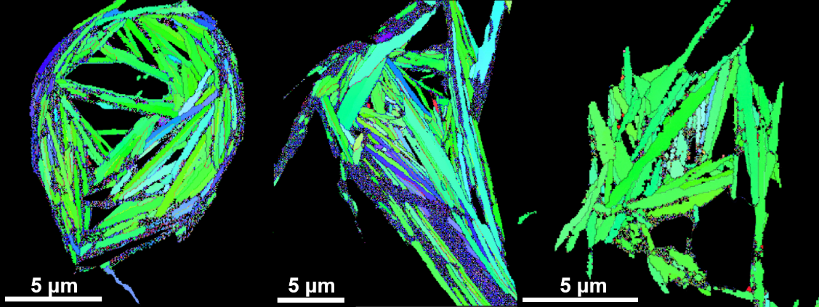
Advanced Microscopy for Better Nanostructural Insights
in Bi-2212 Round Wires
T.A. Oloye^{1,2}, M. Matras⁴, J. Jiang¹, S.I. Hossain^{1,2}, Y. Su^{1,*}, U. P. Trociewitz¹, E. E. Hellstrom^{1,2,3},
D. C. Larbalestier^{1,2,3}, and F. Kametani^{1,2,3}
¹ Applied Superconductivity Center, MagLab; ² Materials Science and Engineering, FSU; ³ FAMU-FSU Dept of Mechanical Engineering; ⁴ European Organization for Nuclear Research; * Now: Materials Science and Technology Division, Oak Ridge Nat’l Lab
Funding Grants: G.S. Boebinger (NSF DMR-1644779); DOE DE-SC0010421
Recent advances in precursor powder and processing technologies have helped to propel Bi-2212 Round Wires as a promising candidate for future high-field magnet applications. However, there is still a need to understand and optimize the processing parameters in a bid to push Bi-2212 Round Wire to the forefront as a viable technology.
Advanced microscopy techniques (Electron Back Scatter Diffraction Orientation Imaging Microscopy (EBSD-OIM) (Figure 1) and Transmission Electron Microscopy (TEM) (Figure 2)) allowed this research group to find nanostructural correlations in Bi-2212 Round Wire between processing parameters used in the heat treatment and superconducting properties that result. These results show that a new precursor powder combined with highly optimized processing parameters, including the cooling rate, play a vital role in the development of grain boundary cleanliness and high a-axis grain alignment (figure 2), both of which are necessary for high superconducting critical current density (J_{c}).
Understanding the particular roles that these factors play will help to unravel the complex interactions necessary for high J_{c} in Bi-2212 Round Wire, which is the key to unlocking the potential of this high-temperature superconductor for future applications in high-field magnets.
J_{c} [4.2K, 15T]
2610 A/mm²
J_{c} [4.2K, 15T]
6861 A/mm²
J_{c} [4.2K, 15T]
770 A/mm²
Figure 1: Electron micrograph of the cross sections of three Bi-2212 round wires with widely varying critical current densities (J_{c}) showing their a-axis grain alignments. The wire with the best a-axis alignment (far right, highest proportion of grains in green) had the highest J_{c} of 6861 A/mm² (at 4.2K and 15T).
Figure 2: Transmission Electron Microscope (TEM) images of the three wires showing grains and grain boundaries. Our results showed that the wire with the lowest J_{c} of only 684 A/mm² (measured at 4.2K and 15T) had high a-axis alignment but also had amorphous content at its grain boundaries, which acted as a current transport barrier and thus significantly lowered the J_{c} of the wire.
Facilities and instrumentation used: Applied Superconductivity Center (ASC – MagLab) Carl Zeiss 1540 EsB Scanning Electron Microscope (SEM), Thermo Fisher Scientific Helios G4 high resolution Scanning Electron Microscope (SEM), JEOL ARM 200CF atomic resolution Cs-corrected analytical Transmission Electron Microscope (TEM).
Citation: : Oloye, A. et al. Supercond. Sci. Technol. 34 035018 (2021) https://doi.org/10.1088/1361-6668/abd575

Slide 2
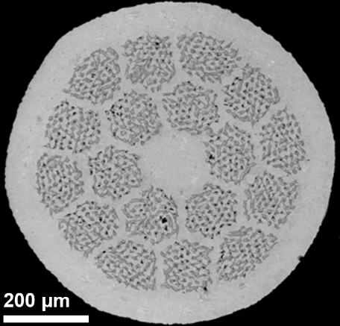
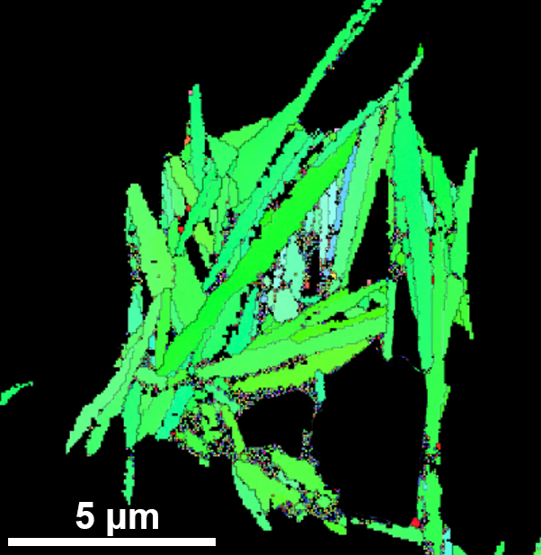
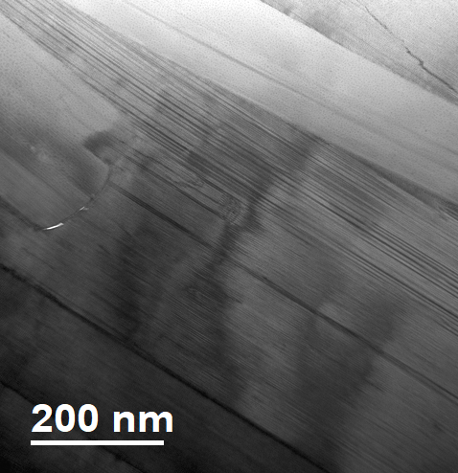
Advanced Microscopy for Better Nanostructural Insights
in Bi-2212 Round Wires
T.A. Oloye^{1,2}, M. Matras⁴, J. Jiang¹, S.I. Hossain^{1,2}, Y. Su^{1,*}, U. P. Trociewitz¹, E. E. Hellstrom^{1,2,3},
D. C. Larbalestier^{1,2,3}, and F. Kametani^{1,2,3}
¹ Applied Superconductivity Center, MagLab; ² Materials Science and Engineering, FSU; ³ FAMU-FSU Dept of Mechanical Engineering; ⁴ European Organization for Nuclear Research; * Now: Materials Science and Technology Division, Oak Ridge Nat’l Lab
Funding Grants: G.S. Boebinger (NSF DMR-1644779); DOE DE-SC0010421
What is the finding? Processing controls are found to impact grain orientation and grain boundary composition in Bi-2212 Round Wire to improve superconducting critical current density (J_{c}).
Why is this important? High-magnetic-field applications of Bi-2212 Round Wire will require a knowledge of how nanostructure influences the critical current density (J_{c}) and how this nanostructure can be optimized during the heat treatment processing of Bi-2212 Round Wire. The goal is to push Bi-2212 to the forefront of high temperature superconductors (HTS) to make next generation superconducting magnets that can be operated at higher fields, higher temperatures, and at lower cost.
Why did this research need the MagLab? The MagLab’s Applied Superconductivity Center provided both the expertise and the nanoscale imaging tools - Electron Back Scatter Diffraction (EBSD) and Transmission Electron Microscopy (TEM) – necessary to link critical current densities to nanostructure. The EBSD enabled us to visualize the important high J_{c} grain microstructures within the individual filaments, while the TEM revealed the nanostructural features of grain boundaries that are also necessary to develop high J_{c} .
Figure – (left) Image of the circular cross section of a high critical current density Bi-2212 round wire, showing how individual filaments (the dark spots) that carry superconducting current are arranged. (center) Electron Back Scatter Diffraction image showing an individual filament with grains and their alignment (green grains are aligned). Proper grain alignment facilitates high critical current density in these wires. (right) Transmission Electron Microscope image showing a cross section of a few grains and the boundaries between the grains, which play a vital role in how superconducting current is transported from grain to grain.
Facilities and instrumentation used: Applied Superconductivity Center (ASC – MagLab) Carl Zeiss 1540 EsB Scanning Electron Microscope (SEM), Thermo Fisher Scientific Helios G4 high resolution Scanning Electron Microscope (SEM), JEOL ARM 200CF atomic resolution Cs-corrected analytical Transmission Electron Microscope (TEM).
Citation: : Oloye, A. et al. Supercond. Sci. Technol. 34 035018 (2021) https://doi.org/10.1088/1361-6668/abd575

