Slide 1
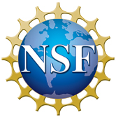
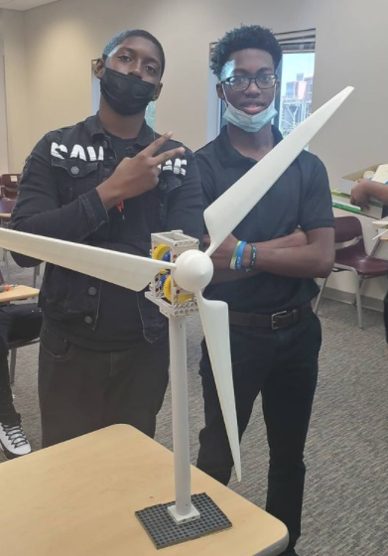
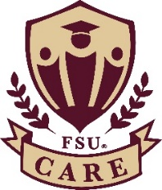
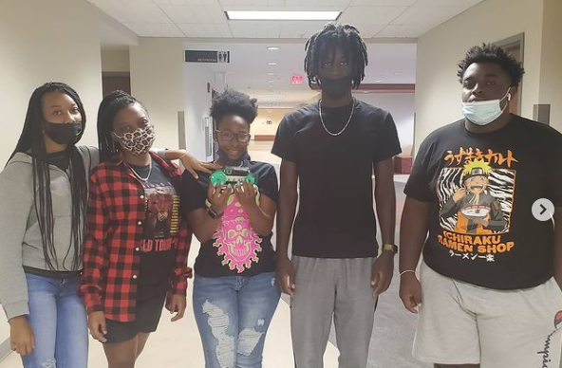
Engage Underrepresented Youth through the MagLab’s Camp TESLA
C.R. Villa¹, I. Williams²; C. Jones²; R.M. Hughes¹
1-Center for Integrating Research and Learning (CIRL) at the MagLab,
2- Florida State University Center for Academic Retention and Enhancement (CARE)
Funding Grants: G.S. Boebinger (NSF DMR-1157490, NSF DMR-1644779); I. Williams (FL DOE-371-95010-1S001)
What is the event? Florida State University’s College Reach-Out Program (CROP) welcomed students from three local Title-1 Schools ‒ schools that feature high school and middle school student populations that exceed 88% students of color ‒ to participate in an immersive residential summer program. To increase the STEM curriculum for their students, CROP teamed with the MagLab’s Center for Integrating Research and Learning (CIRL) to offer our hallmark “Camp TESLA” (Technology, Engineering, and Science in a Laboratory Atmosphere). The TESLA curriculum includes hands-on activities in electricity, magnetism, chemical reactions, genetics, astronomy, and geology. In addition, CIRL Director of K-12 Programs, Carlos R. Villa, led a workshop for the CROP educators to guide them through the curriculum activities before the camp and to answer any questions that arose during the camp.
Why is this important? Black/African-American and Latinx peoples are underrepresented in many fields of science, with these students being awarded fewer than 15% of the bachelor’s degrees awarded in physics [1]. Operated by FSU’s Center for Academic Retention and Enhancement (CARE), CROP seeks to improve college enrollment for underrepresented populations. CIRL’s work with the CARE program to serve a community of underrepresented students [2] is crucial to help connecting the students to STEM career options.
Why did this program need the MagLab? The success of the MagLab’s summer camps, including Camp TESLA, is due in large part to the expertise of our education staff who develop relevant and interactive activities that engage young people with information about exciting research at the MagLab. By partnering with CROP this summer, the MagLab was able to reach a more diverse audience of students thereby further supporting our mission to build a diverse STEM workforce.
(Left) CARE students Devon and Tajari were the first students to finish building their wind turbines during an activity on generators and renewable energy.
(Right) As they explored light and energy, the 11th and 12th grade CARE students built solar powered cars that they used to explore variables about light waves.
Facilities: MagLab’s Center for Integrating Research and Learning, FSU’s Center for Academic Retention and Enhancement
Citations:
[1] Degrees Awarded to Underrepresented Minorities, by Field. (n.d.). Retrieved August 31, 2021, from http://www.aps.org/programs/education/statistics/minoritydegrees.cfm
[2] About CARE | Center for Academic Retention & Enhancement. (n.d.). Retrieved August 31, 2021, from https://care.fsu.edu/about-care

