Slide 1
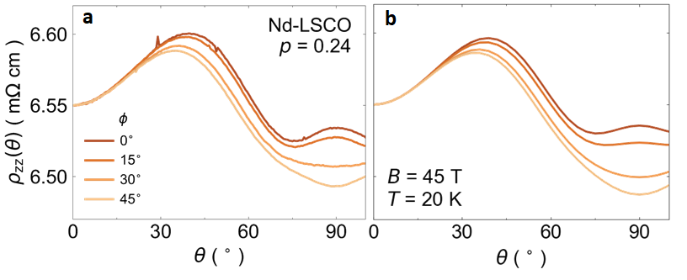
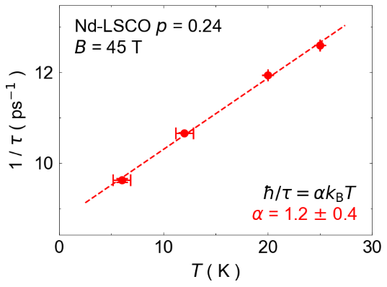
Linear-in temperature resistivity from isotropic Planckian scattering rate
G. Grissonnanche^{1,2}, Y. Fang², A. Legros^{1,3}, S. Verret¹, F. Laliberté¹,
C. Collignon¹, J. Zhou⁴, D. Graf⁵, P. A. Goddard⁶, Louis Taillefer^{1,7} & B. J. Ramshaw^{2,7}
Université de Sherbrooke; 2. Cornell University; 3. Université Paris-Saclay; 4. University of Texas at Austin;
5. National High Magnetic Field Laboratory; 6. University of Warwick; 7. Canadian Institute for Advanced Research
Funding Grants: G.S. Boebinger (NSF DMR-1644779); B.J. Ramshaw (NSF DMR-1752784); J.-S. Zhu (MRSEC DMR-1720595)
The “Strange Metals” are among the most fascinating of quantum materials, found in high temperature superconductors and twisted bilayer graphene. Yet, to date, they have resisted revealing their mysteries. Recently, a new fundamental limit of nature was proposed—the Planckian bound—which puts a limit on how often electrons can collide with each other.
To investigate the proposed Planckian bound, MagLab users studied Nd-LSCO, a superconducting cuprate crystal that exhibits this behavior down to low temperatures. With the sample in the world’s strongest static magnetic field, the MagLab’s 45T magnet, they measured resistivity as a function of applied magnetic field direction, a technique called angle dependent magnetoresistance (ADMR). The motion of the charged electrons is governed by the magnetic field in a way that depends on the collision time between electrons. Using ADMR and new algorithmic machinery that they developed, they not only measured the Planckian bound, but also demonstrated its impact on all directions of electron motion.
Understanding that the behavior of strange metals emerges from the Planckian bound stimulates a domain of research in which progress has stalled for decades. The intimate connection between strange metals, unconventional superconductivity, and magnetism suggests that the Planckian bound may ultimately hold the secret to how electrons pair in unconventional superconductors.
(a) ADMR of the cuprate Nd-LSCO with doping p = 0.24 as a function of magnetic field angle θ at a temperature of 20K and a magnetic field of 45T. (b) Simulations obtained from the new algorithmic machinery that can reproduce the behaviour of electrons in a metal from semi-classical theory, allowing researchers to measure the scattering rate.
(left) The Planckian bound ties the time τ between electron collisions to the temperature by the relation
ħ/τ = αk_{B}T, where α is a constant of order unity, ħ is Planck’s constant and k_{B} is the Boltzmann constant. Note that τ for Nd-LCSO satisfies the Planckian bound with α = 1.2 ± 0.4
Facilities and instrumentation used: 45T Hybrid magnet, DCFF
Citation: Grissonnanche, G.; Fang, Y.; Legros, A.; Verret, S.; Laliberte, F.; Collignon, C.; Zhou, J.; Graf, D.E.; Goddard, P.; Taillefer, L.; Ramshaw, B., Linear-in temperature resistivity from an isotropic Planckian scattering rate,
Nature, 595, 667-672 (2021) doi.org/10.1038/s41586-021-03697-8

Slide 2
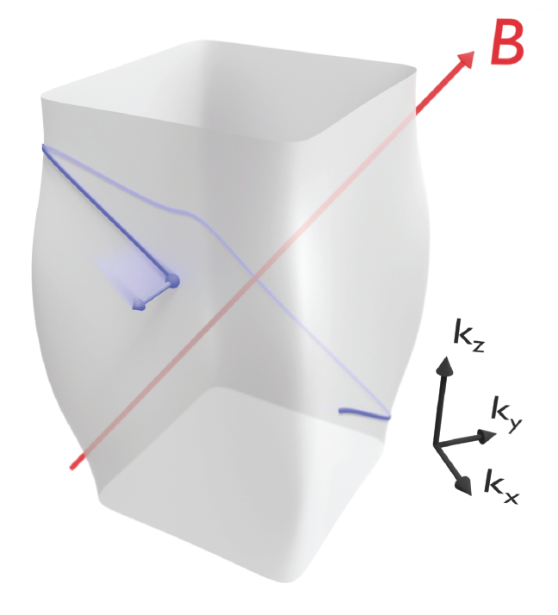
Linear-in temperature resistivity from isotropic Planckian scattering rate
G. Grissonnanche^{1,2}, Y. Fang², A. Legros^{1,3}, S. Verret¹, F. Laliberté¹,
C. Collignon¹, J. Zhou⁴, D. Graf⁵, P. A. Goddard⁶, Louis Taillefer^{1,7} & B. J. Ramshaw^{2,7}
Université de Sherbrooke; 2. Cornell University; 3. Université Paris-Saclay; 4. University of Texas at Austin;
5. National High Magnetic Field Laboratory; 6. University of Warwick; 7. Canadian Institute for Advanced Research
Funding Grants: G.S. Boebinger (NSF DMR-1644779); B.J. Ramshaw (NSF DMR-1752784); J.-S. Zhu (MRSEC DMR-1720595)
What is the finding? Electrons in metals behave like chaotic bumper cars, crashing into each other with great frequency. While they may be reckless drivers, this new result demonstrates that this chaos has a limit established by the laws of quantum mechanics.
Why is this finding important? MagLab users studied the strange metal phase of a high-temperature superconductor. Superconductivity has the potential to revolutionize the way we carry and store energy, but we still do not understand the workings of the most promising materials for this technology, a fact that delays their applications. The strange metal phase is just one facet of these superconductors, but a facet that plays a key role showing up at a quantum phase transition close to where superconductivity is the strongest. High magnetic fields revealed that the strangeness of these metals is dictated by a limit of physics so far unexplained: the Planckian bound. The Planckian bound limits how often electrons can collide with each other in a metal. Because limits in physics are the guardrails of new concepts, this discovery of the role of the Planckian bound is research that has been stalled for decades.
Why did this research need the MagLab? The 45T hybrid magnet – and the ability to stay at 45T for many hours at a time - was essential to suppress the superconducting state and measure the electron collision rates for many magnetic field orientations and temperatures.
In a magnetic field (red arrow), electrons, shown schematically in blue, move in orbits. These orbits are not circular because the electrons feel a force from the crystal lattice of the superconductor. By changing the orientation of the magnetic field, researchers can map out the entire profile of electron orbits, called a “Fermi surface”, and learn how the electrons scatter off each other when they collide. This research used a 45T magnetic field to reveal the signature of strange metal behavior, the “Planckian bound”, in a high-temperature superconducting material.
Facilities and instrumentation used: 45T Hybrid magnet, DCFF
Citation: Grissonnanche, G.; Fang, Y.; Legros, A.; Verret, S.; Laliberte, F.; Collignon, C.; Zhou, J.; Graf, D.E.; Goddard, P.; Taillefer, L.; Ramshaw, B., Linear-in temperature resistivity from an isotropic Planckian scattering rate,
Nature, 595, 667-672 (2021) doi.org/10.1038/s41586-021-03697-8

