Slide 1
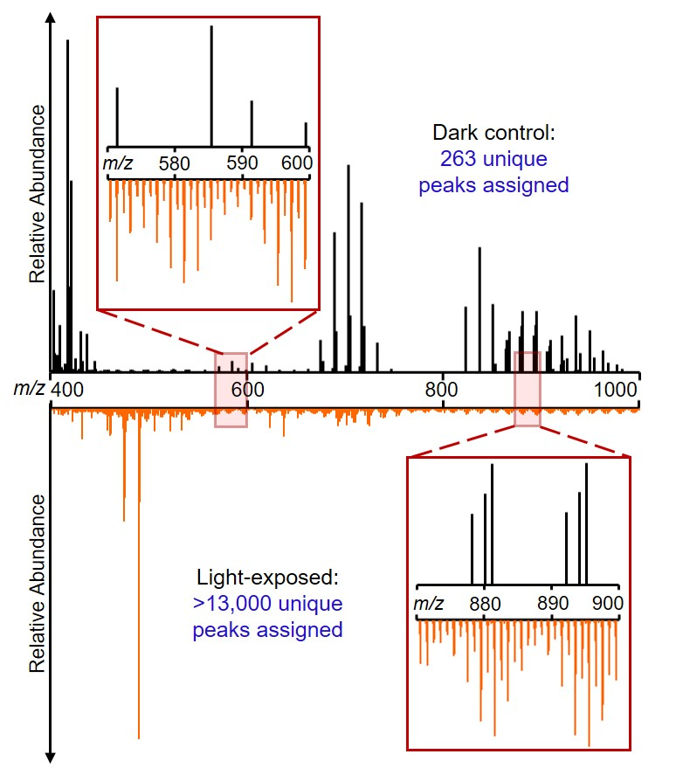
Sunlight converts plastics into complex chemical mixtures
Anna N. Walsh,^{1,2} Christopher M. Reddy,¹ Sydney F. Niles,³ Amy M. McKenna,³ Colleen M. Hansel,¹ and Collin P. Ward¹ 1. Woods Hole Oceanographic Institution; 2. Massachusetts Institute of Technology; 3. Florida State University
Funding Grants: G.S. Boebinger (NSF DMR-1644779); NSF Graduate Research Fellowship Program; The Seaver Institute, Gerstner Family Foundation; Woods Hole Oceanographic Institution
Plastics have long been assumed to be inert in the environment, with only physical fragmentation occurring. However, a growing body of evidence suggests that sunlight can chemically transform plastics into polymer-, dissolved-, and gas-phase products.
In this work, MagLab users studied the photochemical breakdown of four consumer polyethylene (PE) shopping bags from Target, Walmart, and CVS, as well as one pure PE film. Characterization of the additives in the plastics was paired with measurements of the amount and composition of organic chemicals produced from the plastics in the presence and absence of sunlight.
The MagLab’s 21 Tesla Fourier transform ion cyclotron resonance mass spectrometer has superior resolving power and mass accuracy to the orbitrap mass spectrometers used in previous studies, enabling discovery of ten-fold greater complexity of photoproduced chemicals. All plastics produced highly complex chemicals during sunlight exposure, but the amount and composition varied between the pure PE and consumer plastics. These findings challenge the long-held assumption that plastic is inert in the environment; instead, sunlight can break it down into a diverse suite of new compounds with unknown fates and impacts. They also highlight that transformation by sunlight depends on the additives in the plastic. As such, pure polymers, on which the research has largely focused to date, may not be sufficiently representative of the real plastics leaked into the environment.
Facilities/ Instrumentation: 21T FT-ICR mass spectrometer at ICR
21 T FT-ICR mass spectra of chemicals unique to dark control (black, top) and photoproduced (orange, bottom) for a CVS plastic bag. Thousands of oxygenated compounds were produced by sunlight, compared to only a few hundred that leached in the dark. These results are representative of the trends observed for all plastics tested.
Citation: Walsh, A. N.; Reddy, C. M.; Niles, S. F.; McKenna, A. M.; Hansel, C. M.; Ward, C. P. “Plastic Formulation Is an Emerging Control of Its Photochemical Fate in the Ocean.” Environ. Sci. Technol. 55 (18), 12383–12392 (2021). https://doi.org/10.1021/ACS.EST.1C02272.
Notes:
Congrats to you both! We would like to highlight this paper as one of the NSF Highlights for the ICR facility. This will be shared with the NSF and featured on the NHMFL website. Attached is the 2-slide template, and myself and Chris will help you revise and review. This one is due October 1, so if you could send us a draft around 9/27, that would be great.
You can see previous monthly highlights here : https://nationalmaglab.org/research/publications-all/science-highlights-all
Some more relevant ICR ones are here:
https://nationalmaglab.org/user-facilities/icr/publications-icr/highlights-icr/dissolved-organic-matter-in-arctic-rivers
https://nationalmaglab.org/user-facilities/icr/publications-icr/highlights-icr/sunlight-produces-water-soluble-chemicals-from-asphalt
The format for these highlights is two slides, as noted below. Most of this can be derived from the WHOI press release, which we can also try to link on the highlight.
Two slides of .ppt (see attached) – exceptions apply for Safety
The 1st slide is for scientists. It is to be the more technical of the two, it can have some jargon, provided the jargon is explained, as the audience is intended to be a non-expert scientific audience. The goal is to make the first slide understandable to an astrophysicist, as the Head of the NSF’s Mathematical and Physical Sciences Directorate is a prominent astrophysicist.
The 2nd slide is for general public/ non-scientists. It can have the same figure with a less complex description….or even a simpler figure. This slide should strive to avoid all jargon, unless it is explained in every day terms. Try to make this slide appealing to NSF Public Affairs folks.
Simplify terms.
Avoid unnecessary jargon or describe for non-scientists.
Including the 3 bold questions.
Title not exceeding 60 characters for web posting
A brief summary of one or two sentences that could be understood by any non-science major college student (text less than 450 characters or 80 words).

Slide 2
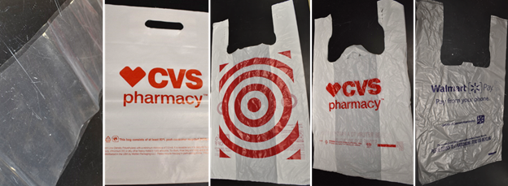
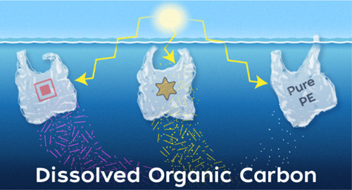
Sunlight converts plastics into complex chemical mixtures
Anna N. Walsh,^{1,2} Christopher M. Reddy,¹ Sydney F. Niles,³ Amy M. McKenna,³ Colleen M. Hansel,¹ and Collin P. Ward¹ 1. Woods Hole Oceanographic Institution; 2. Massachusetts Institute of Technology; 3. Florida State University
Funding Grants: G.S. Boebinger (NSF DMR-1644779); NSF Graduate Research Fellowship Program; The Seaver Institute, Gerstner Family Foundation; Woods Hole Oceanographic Institution
What is the finding? In a matter of weeks, sunlight can chemically transform marine plastics into thousands of compounds that dissolve in the ocean. The number and characteristics of these compounds differ between consumer plastic shopping bags (from Target, CVS, and Walmart) and pure polyethylene, the polymer used to make these bags. These differences are driven by chemicals added to the plastics to improve performance and appearance, as well as to lower costs.
Why is this important? Plastic was initially believed to be inert in the environment. This work contributes quantitative information to the growing understanding that sunlight can transform plastics into highly complex mixtures of chemicals with unknown fates and impacts. While plastics research to date has largely studied pure polymers, these results show that the various consumer plastics that are actually in the environment behave differently due to additives they contain. Therefore, understanding the fates and impacts of plastic pollution - and developing next generation materials that readily break down in the environment – will require a shift towards research that studies plastics that are more representative of those leaked into the environment.
Why did this research need the MagLab? The 21 Tesla Fourier transform ion cyclotron resonance mass spectrometer offers the highest mass resolving power and mass accuracy in the world. This MagLab magnet system allowed these MagLab users to measure at least ten times more sunlight-produced compounds than others had observed using less powerful mass spectrometers.
Sunlight breaks down plastics, creating thousands of compounds whose environmental impact is not understood.
Facilities and instrumentation used: This research was conducted in the 21 T FT-ICR mass spectrometer at the MagLab's ICR Facility.
Citation: Walsh, A. N.; Reddy, C. M.; Niles, S. F.; McKenna, A. M.; Hansel, C. M.; Ward, C. P. “Plastic Formulation Is an Emerging Control of Its Photochemical Fate in the Ocean.” Environ. Sci. Technol., 55 (18), 12383–12392 (2021). https://doi.org/10.1021/ACS.EST.1C02272

