Slide 1
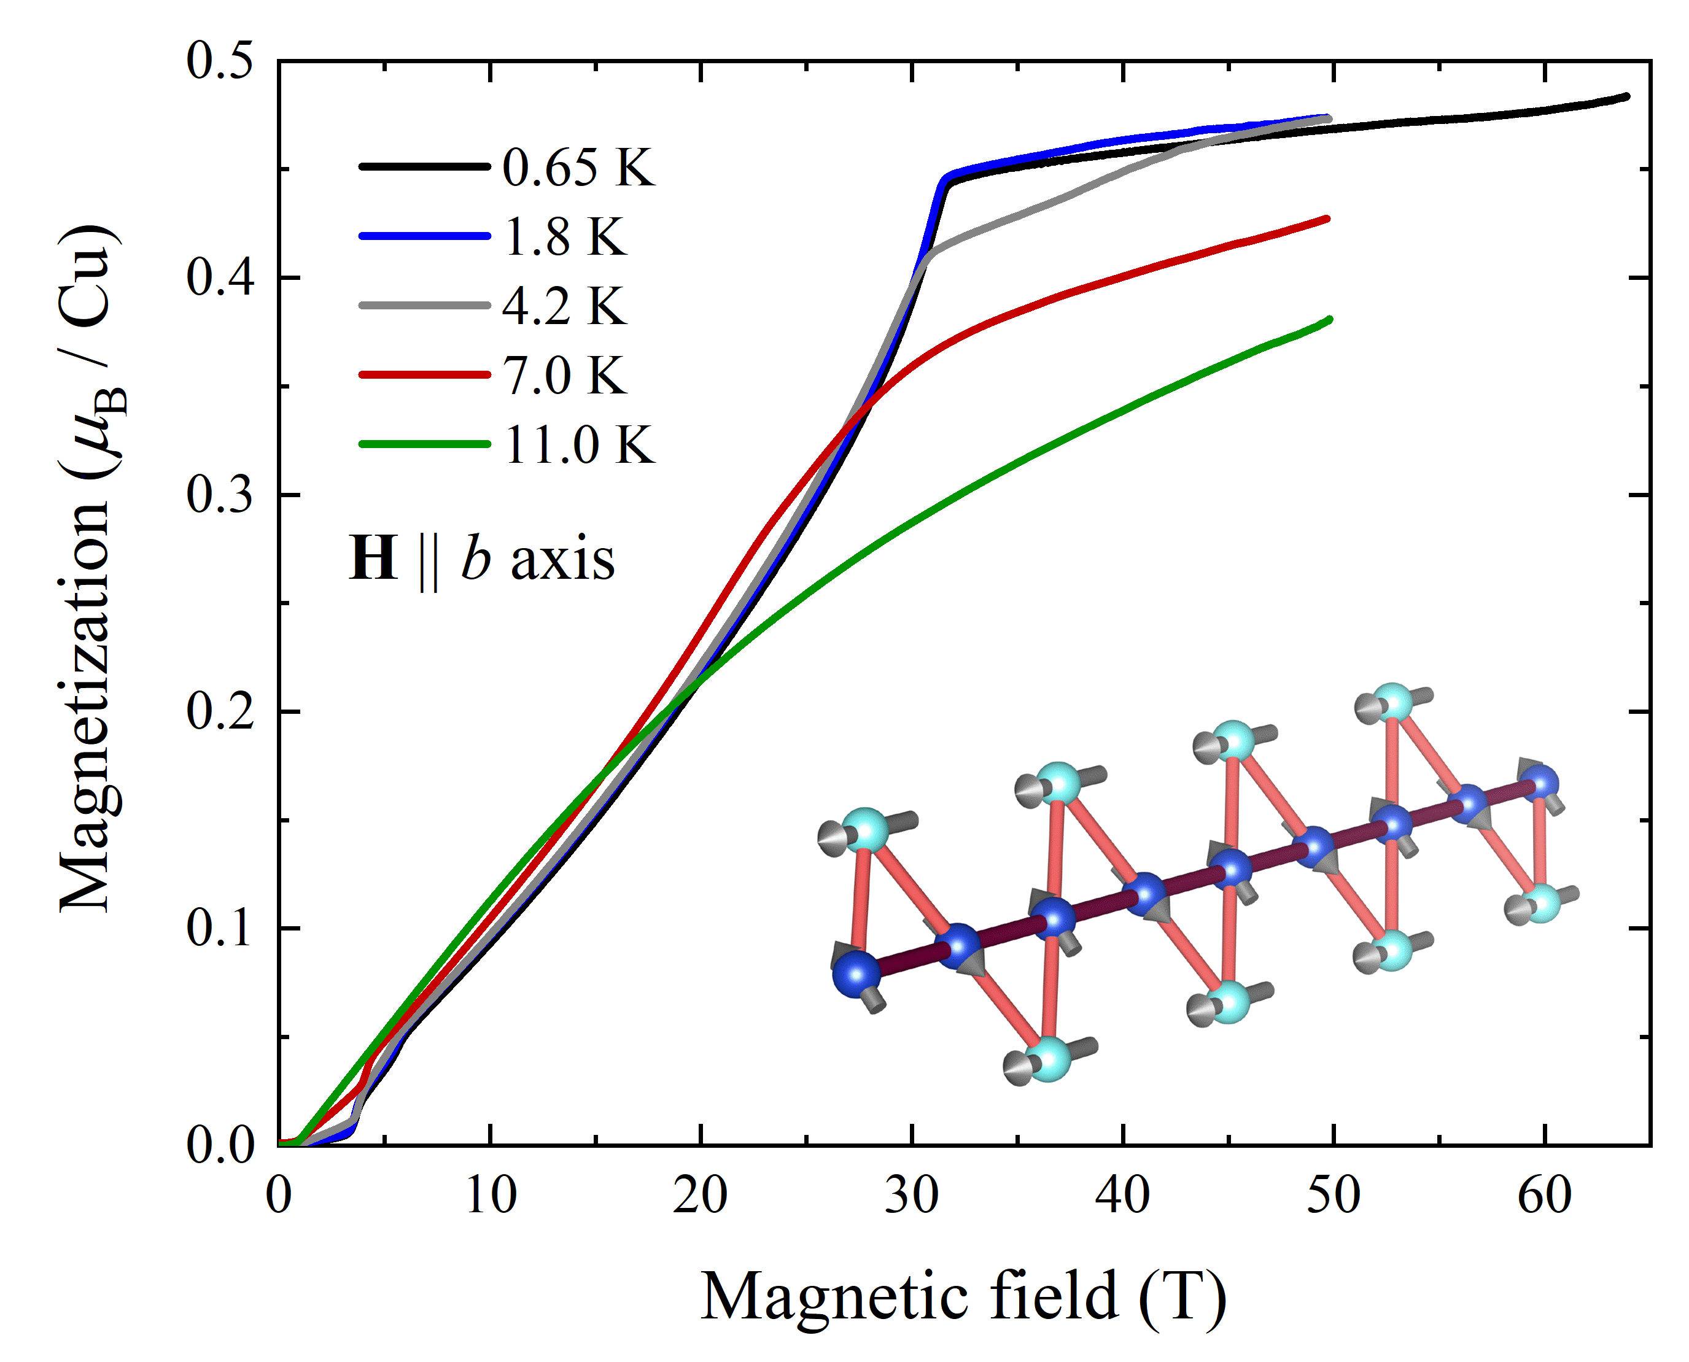
Unusual high-field state discovered in mineral atacamite Cu₂Cl(OH)₃
L. Heinze¹, H.O. Jeschke², I.I. Mazin^{3,4}, A. Metavitsiadis⁵, M. Reehuis⁶, R. Feyerherm⁶, J.-U. Hoffmann⁶, M. Bartkowiak⁶, O. Prokhnenko⁶, A.U.B. Wolter⁷, X. Ding⁸, V.S. Zapf⁸, C. Corvalán Moya^{9,8}, F. Weickert⁸, M. Jaime⁸, K.C. Rule¹⁰, D. Menzel¹, R. Valentí¹¹, W. Brenig⁵, and S. Süllow¹
1. IPKM, TU BS; 2. RIIS, Okayama University; 3. George Mason University; 4. QSEC, George Mason University; 5. ITP, TU BS; 6. HZB, Berlin; 7. IFW, Dresden; 8. NHMFL, LANL, Los Alamos; 9. CNEA, UNTREF, Argentina; 10. ANSTO, Australia; 11. ITP, Goethe-Universität Frankfurt
Funding Grants: G.S. Boebinger (NSF DMR-1644779), S. Süllow (DFG WO1532/3-2 and SU229/9-2)
Magnetically, the mineral atacamite can be called a “sawtooth chain” because, in its crystal structure, the copper ions carrying a magnetic moment are arranged in a chain of triangles resembling a saw (see Figure inset). In atacamite, all magnetic moments favor an antiparallel alignment with respect to their nearest neighbors, which, however, cannot be achieved. As such, the system is called “frustrated”. Frustrated systems can host a multitude of complex and novel states of matter, including classical and novel quantum spin liquids.
The model of the quantum sawtooth chain has attracted interest from theorists, and a “magnetization plateau” was predicted for certain sawtooth chain configurations. As such, there was a strong motivation to measure the magnetization of atacamite in pulsed magnetic fields in the quest to reach magnetization saturation. This experiment showed a surprising result that deviates from theory predictions: while a plateau-like region above 31.5T (see Figure) was indeed found, the plateau is much wider than expected and is found in an unexpected range of magnetic field. This implies that the novel plateau-like magnetization observed in atacamite is of an unknown nature not described by existing theoretical calculations for a bare chain and, instead, might be the result of a 3D chain network.
Future work will be directed towards a better understanding of the unexpected magnetic-field-induced state found in atacamite, knowledge that could help engineer future quantum spin liquid candidate materials.
Figure: In a high-field experiment at the MagLab, the magnetization of atacamite was measured up to 65T in pulsed magnetic fields. The magnetization is plateau-like above 31.5T. The inset shows part of the magnetic structure of atacamite in zero magnetic field.
Facilities and instrumentation used: National High Magnetic Field Laboratory (NHMFL), 65T Magnet at the Pulsed-Field Facility. Citation: Heinze, L.; Jeschke, H.O.; Mazin, I.I.; Metavitsiadis, A.; Reehuis, M.; Feyerherm, R.; Hoffmann, J.U.; Bartkowiak, M.; Prokhnenko, O.; Wolter, A.U.B.; Ding, X.N.; Zapf, V.; Corvalan Moya, C.; Weickert, D.F.; Jaime, M.; Rule, K.C.; Menzel, D.; Valenti, R.; Brenig, W.; Sullow, S., Magnetization Process of Atacamite: A Case of Weakly Coupled S = 1=2 Sawtooth Chains, Physical Review Letters, 126 (20), 207201 (2021) doi.org/10.1103/PhysRevLett.126.207201

Slide 2
Unusual high-field state discovered in mineral atacamite Cu₂Cl(OH)₃
L. Heinze¹, H.O. Jeschke², I.I. Mazin^{3,4}, A. Metavitsiadis⁵, M. Reehuis⁶, R. Feyerherm⁶, J.-U. Hoffmann⁶, M. Bartkowiak⁶, O. Prokhnenko⁶, A.U.B. Wolter⁷, X. Ding⁸, V.S. Zapf⁸, C. Corvalán Moya^{9,8}, F. Weickert⁸, M. Jaime⁸, K.C. Rule¹⁰, D. Menzel¹, R. Valentí¹¹, W. Brenig⁵, and S. Süllow¹
1. IPKM, TU BS; 2. RIIS, Okayama University; 3. George Mason University; 4. QSEC, George Mason University; 5. ITP, TU BS; 6. HZB, Berlin; 7. IFW, Dresden; 8. NHMFL, LANL, Los Alamos; 9. CNEA, UNTREF, Argentina; 10. ANSTO, Australia; 11. ITP, Goethe-Universität Frankfurt
Funding Grants: G.S. Boebinger (NSF DMR-1644779), S. Süllow (DFG WO1532/3-2 and SU229/9-2)
What is the finding? Scientists have discovered that applying an intense magnetic field to the mineral atacamite induces an unusual magnetic high-field state, where the magnetization flattens at around half of its full saturation value (see Fig. 1).
Why is this important? Atacamite is a so-called “frustrated” quantum magnet – a magnetic system in which the competition between the magnetic interactions is so strong that it can prevent the system from ordering. In such frustrated systems, a multitude of complex and novel magnetic states can arise, such as quantum spin liquids and magnetization plateaus. Identifying and characterizing model compounds of frustrated magnets is essential to understand the mechanisms behind still undiscovered novel states of matter that are predicted to host fractionalized excitations and may realize applications in metrology and quantum computing.
Why did this research need the MagLab? In order to drive atacamite into its plateau-like magnetization state, high magnetic fields were required in combination with very low (sub-Kelvin) temperatures. The high-field magnetization and magnetostriction measurements were essential to compare the magnetic behavior to theoretical calculations and to gain insights into the magnetic phase diagram of atacamite.
Figure: In a high-field experiment at the MagLab, the magnetization of atacamite was measured up to 65T in pulsed magnetic fields. The magnetization is plateau-like above 31.5T. The inset shows part of the magnetic structure of atacamite in zero magnetic field.
Facilities and instrumentation used: National High Magnetic Field Laboratory (NHMFL), 65T Magnet at the Pulsed-Field Facility. Citation: Heinze, L.; Jeschke, H.O.; Mazin, I.I.; Metavitsiadis, A.; Reehuis, M.; Feyerherm, R.; Hoffmann, J.U.; Bartkowiak, M.; Prokhnenko, O.; Wolter, A.U.B.; Ding, X.N.; Zapf, V.; Corvalan Moya, C.; Weickert, D.F.; Jaime, M.; Rule, K.C.; Menzel, D.; Valenti, R.; Brenig, W.; Sullow, S., Magnetization Process of Atacamite: A Case of Weakly Coupled S = 1=2 Sawtooth Chains, Physical Review Letters, 126 (20), 207201 (2021) doi.org/10.1103/PhysRevLett.126.207201

