Slide 1
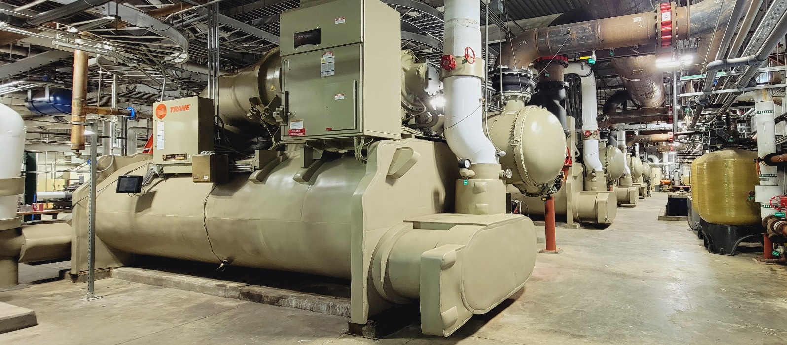
Updating MagLab Major Equipment: Chiller Replacement
and Mitigation of Oxygen Deficiency Hazards
Funding Grants: G.S. Boebinger (NSF DMR-1644779)
Scope of Work: Utilize the supplemental funding provided by the National Science Foundation to the MagLab’s DMR-1644779 Core Grant to replace four 20+ year old 2000-ton chillers in the MagLab’s physical plant at Florida State University. These chillers provide vast quantities of cooling water to the MagLab’s DC Magnet User Facility. The new chillers meet all of the cooling needs to operate the MagLab’s world-leading resistive and hybrid magnets, all while improving the MagLab’s reliability and “environmental friendliness”.
The refrigerant, R-1233ZD, is a next generation refrigerant with a low Global Warming Potential of less than 2 compared to the reference gas, carbon dioxide, which is assigned a value of 1. However, R-1233ZD could pose an oxygen deficiency hazard if it were to leak into the physical plant. As such, refrigerants operate at low pressures and are contained in a vacuum vessel, which virtually eliminates leaks and enables near-zero emissions. An extra layer of protection is offered by an alarm system that checks for the presence of R-1233ZD should a leak or unplanned event occur. Additional engineering controls both actively and passively disperse any leaked refrigerant to prevent an oxygen deficient environment.

Slide 2
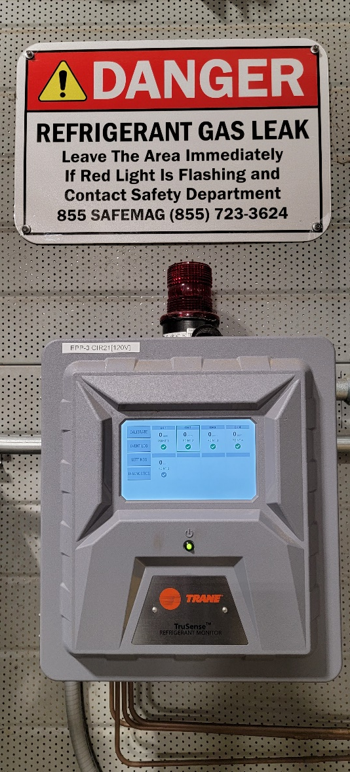
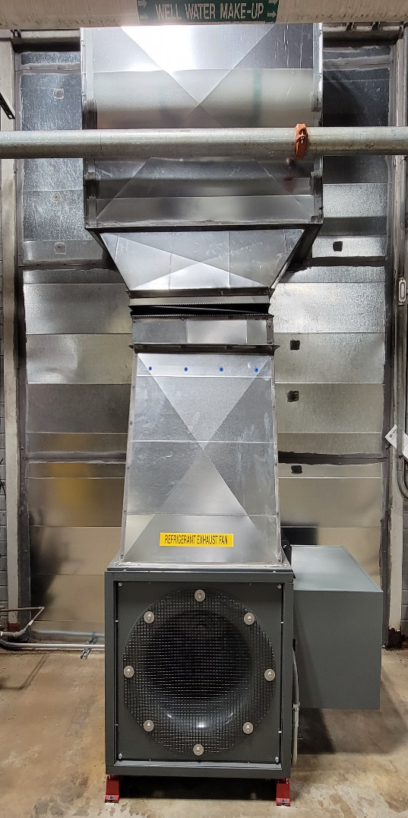
Updating MagLab Major Equipment: Chiller Replacement
and Mitigation of Oxygen Deficiency Hazards
Funding Grants: G.S. Boebinger (NSF DMR-1644779)
Engineering controls protect workers by both removing hazardous conditions and providing a warning system to alert the worker to potential hazards.
The refrigerant monitoring system provides continuous, real-time monitoring down to 1 ppm using Photoacoustic Infrared Technology. It enables the MagLab to maintain compliance with ASHRAE 15, the Environmental Protection Agency, the MagLab Oxygen Deficiency Hazard & Cryogen Safety Program, and Florida State University building codes.
The refrigerant monitoring system features:
Stability: Not affected by temperature and humidity swings, minimizing drift
High-Sensitivity Level: action level alarm set at 35 ppm, (800 ppm Time-weighted avg.)
Reliability: Safe continuous operation with advanced sensor diagnostics and predictive maintenance
Versatility: Safely shuts down online chillers, activates warning strobe lights/siren, and activates refrigerant dispersing fan.
Refrigerant Monitor and Warning System
Refrigerant Dispersing Fan located at ground level

