Slide 1
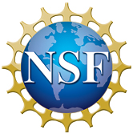
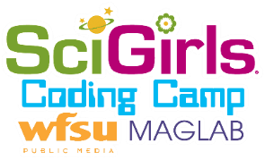
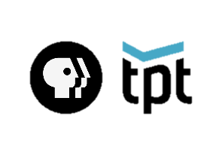
Expanding MagLab Coding Camp to Further Engage African American Girls
C.R. Villa¹, B. Hobbes², R.M. Hughes¹
1-Center for Integrating Research and Learning (CIRL) at the National High Magnetic Field Laboratory,
2- Florida A&M University Developmental Research School
Funding Grants: G.S. Boebinger (NSF DMR-1644779); R. Karl (NSF DRL-1712258)
What is the event? Since 2006, the National High Magnetic Field Laboratory (MagLab), through its Center for Integrating Research and Learning (CIRL), has offered a SciGirls Summer Camp to introduce middle school girls to various fields of science. The camp known as “Code: SciGirls” was created to increase the engagement in computer science studies and career paths for girls. In the summer of 2021, CIRL partnered with the Florida A&M University Developmental Research School to offer this coding experience to underrepresented minority middle school girls. The coding camp was led by Brooke Hobbes and included African-American role models who spoke on the importance of gender-equitable computer science instruction and empowered the girls with experiences and best practices to welcome, prepare, and build their identity in coding. The camp was held virtually due to COVID-19 over 5 days in July 2021.
Why is this important? Even though technology is pervasive in modern life, women, are underrepresented in STEM fields, especially computer science, compared to their overall representation in the U.S. population. In 2015, while 57% of professional occupations in the U.S. were held by women, only 25% of computing occupations were held by women [1]. Furthermore, the share of computer science degrees going to women is smaller than any other STEM field. Code: SciGirls [2] is designed to engage middle school girls in coding through online interactive programming which inspires and prepares them for future computer science studies and career paths.
Why did this program need the MagLab? The MagLab has been offering summer camps for nearly 15 years, including the SciGirls Coding Camp since 2017. This consistent commitment to girls in STEM led the SciGirls creators at Twin Cities Public Television to invite the MagLab to be a partner with them.
(Above) A Zoom portrait of the Code: SciGirls students and their three instructors.
(Right) SciGirls show off their coding abilities by holding up a coded micro:bit (top) and spelling out words in binary (bottom).
Facilities: Center for Integrating Research and Learning,
Florida A&M University Developmental Research School
Citations: [1] Professional Women: A Gendered Look at Inequality in the U.S. Workforce.
(n.d.). Department for Professional Employees, AFL-CIO. Retrieved from https://www.dpeaflcio.org/factsheets/professional-women-a-gendered-look-at-inequality-in-the-us-workforce
[2] NSF Award Search: Award # 1543209—SciGirls Code: A National Connected Learning Model to Integrate Computing in STEM Learning with Middle School Girls. (n.d.). Retrieved from https://www.nsf.gov/awardsearch/showAward?AWD_ID=1543209

