Slide 1
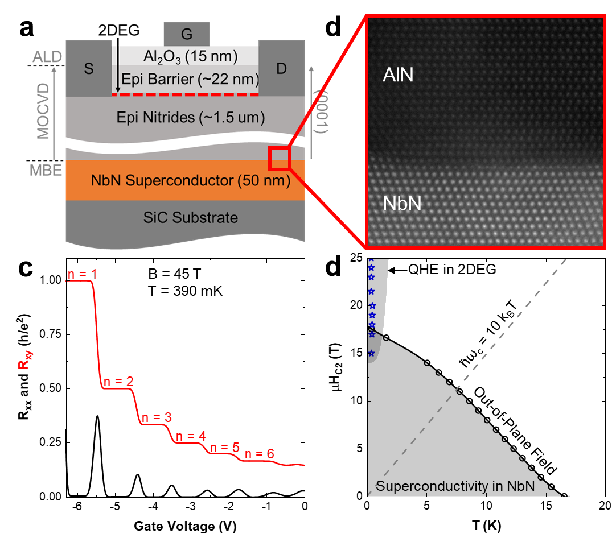
Quantum Rivals in Nitride Materials
P. Dang¹, G. Khalsa¹, C. S. Chang¹, D. S. Katzer², N. Nepal², B. P. Downey², V. D. Wheeler², A. Suslov³, A. Xie⁴, E. Beam⁴, Y. Cao⁴, C. Lee⁴, H. G. Xing¹, D. J. Meyer², D. Jena¹
1. Cornell University; 2. Naval Research Laboratory; 3. National High Magnetic Field Laboratory; 4. Qorvo, Inc.
Funding Grants: G.S. Boebinger (NSF DMR-1644779); D. Jena (NSF EFMA-1741694); C.S. Chang (NSF DMR-1539918 and MRSEC DMR-1719875); P. Dang (NSF DGE-1650441)
Nitride-based semiconductors are now widely employed in high-frequency and opto-electronics applications. However, nitrides are largely unexplored as hosts for quantum computation and cryogenic electronics. To demonstrate the feasibility of nitrides for these applications, MagLab users developed a nitride superconductor / semiconductor heterostructure in which these two quantum states occur and in which electron transport exhibits high performance at low temperatures.
In particular, the team investigated an epitaxial heterostructure that combines the semiconductor GaN with the superconductor NbN. They measured longitudinal resistance and the Hall resistance in the GaN two-dimensional electron gas as a function of magnetic field and gate voltage to explore the quantum Hall effect. They also measured the longitudinal resistance in the NbN superconducting layer as a function of temperature and magnetic field to determine the limits of superconductivity. They discovered that the quantum Hall state in GaN coexists with superconductivity in NbN in the same structure (Fig.1a) over a range of field and temperature.
If the semiconductor enters the quantum Hall state in proximity to a superconductor, one could achieve topological superconductivity, which can be used for quantum computing.
b
Fig.1 (a) Layer structure of the epitaxial nitride heterostructure. (b) High-resolution transmission electron microscopy image of the semiconductor /superconductor interface. (c) The quantum Hall effect in the GaN semiconductor. (d) The temperature and magnetic field region where superconductivity in NbN and the quantum Hall effect in GaN coexist.
Instrumentation used: 45T Hybrid magnet, DC Field Facility
Citation: Dang, P.; Khalsa, G.; Chang, C.S.; Scott Katzer, D.; Nepal, N.; Downey, B.P.; Wheeler, V.D.; Suslov, A.; Xie, A.; Beam, E.; Cao, Y.U.; Lee, C.; Muller, D.A.; Grace Xing, H.; Meyer, D.J.; Jena, D., An all-epitaxial nitride heterostructure with concurrent quantum Hall effect and superconductivity, Science Advances, 7 (8), eabf1388 (2021) doi.org/10.1126/sciadv.abf1388

Slide 2
Quantum Rivals in Nitride Materials
P. Dang¹, G. Khalsa¹, C. S. Chang¹, D. S. Katzer², N. Nepal², B. P. Downey², V. D. Wheeler², A. Suslov³, A. Xie⁴, E. Beam⁴, Y. Cao⁴, C. Lee⁴, H. G. Xing¹, D. J. Meyer², D. Jena¹
1. Cornell University; 2. Naval Research Laboratory; 3. National High Magnetic Field Laboratory; 4. Qorvo, Inc.
Funding Grants: G.S. Boebinger (NSF DMR-1644779); D. Jena (NSF EFMA-1741694); C.S. Chang (NSF DMR-1539918 and MRSEC DMR-1719875); P. Dang (NSF DGE-1650441)
What is the finding? A new device structure that combines a nitride semiconductor with a nitride superconductor is shown to exhibit two quantum states simultaneously - the quantum Hall state and superconductivity - that typically do not coexist.
Why is this important? Researchers studied two conventional materials: GaN (semiconductor) and NbN (superconductor). If the semiconductor enters the quantum Hall state in proximity to a superconductor, one could achieve topological superconductivity, which can be used for quantum computing. A difficulty with this approach is that the quantum Hall states in a semiconductor typically require high magnetic fields, but superconductivity is quenched at high magnetic fields, making coexistence difficult. By demonstrating that this nitride structure can host both phenomena simultaneously, this research teaches old dogs (i.e. GaN and NbN) a new trick. The nitride material system is among the most widely used and mature semiconductor technologies, making it very appealing for use in quantum computing applications.
Why did this research need the MagLab? The MagLab’s 45T magnet was essential to fully explore the quantum hall states in the nitride semiconductor prior to exploring the region in which they coexist with superconductivity.
b
Fig.1 (a) Layer structure of the epitaxial nitride heterostructure. (b) High-resolution transmission electron microscopy image of the semiconductor /superconductor interface. (c) The quantum Hall effect in the GaN semiconductor. (d) The temperature and magnetic field region where superconductivity in NbN and the quantum Hall effect in GaN coexist.
Instrumentation used: 45T Hybrid magnet, DC Field Facility
Citation: Dang, P.; Khalsa, G.; Chang, C.S.; Scott Katzer, D.; Nepal, N.; Downey, B.P.; Wheeler, V.D.; Suslov, A.; Xie, A.; Beam, E.; Cao, Y.U.; Lee, C.; Muller, D.A.; Grace Xing, H.; Meyer, D.J.; Jena, D., An all-epitaxial nitride heterostructure with concurrent quantum Hall effect and superconductivity, Science Advances, 7 (8), eabf1388 (2021) doi.org/10.1126/sciadv.abf1388

