Slide 1
Understanding how fungi build their protective cell walls
Arnab Chakraborty¹, Liyanage D. Fernando¹, Wenxia Fang², Malitha C. Dickwella Widanage¹,
Pingzhen Wei², Cheng Jin^{2,3}, Thierry Fontaine⁴, Jean-Paul Latgé⁵, Tuo Wang¹
Department of Chemistry, Louisiana State University; 2. Guangxi Academy of Sciences, China; 3. Institute of Microbiology, China; 4. Institut Pasteur, France; 5. University of Crete, Greece
Funding Grants: G.S. Boebinger (NSF DMR-1644779); Tuo Wang (NIH AI149289)
Life-threatening fungal infections and the insufficient efficacy of existing drugs call for the development of new antifungal agents. The polysaccharides in fungal cell walls are absent in humans, making them uniquely suitable as the target for future antifungal treatments.
An international user collaboration accessed a MagLab 18.8T magnet instrumented with unique MagLab probes, enabling solid-state Nuclear Magnetic Resonance (NMR) on the living cells of a major pathogenic fungus, Aspergillus fumigatus, to provide a molecular-level model of cell walls.
Four natural mutants of Aspergillus fumigatus were found to substantially reshuffle the polysaccharide composition to increase the rigidity and hydrophobicity of cell walls. This explains how fungi respond to biosynthesis deficiencies and re-build the cell wall for better protection and survival.
These findings have advanced our understanding of the supramolecular assembly of biopolymers in fungal cell walls. This approach provides a readily applicable method for evaluating the structural responses of fungal cell walls to genetic mutations and external stresses, such as novel antifungal compounds and other environmental stimuli.
Left panel: Structural model of fungal cell walls supported by extensive solid-state NMR data. The fungal cell wall is a complex network formed by five major types of polysaccharides and proteins. The dashed line separates the outer (above) and inner (below) domains of the cell wall that contain different polymers. Right panel: Representative 2D ¹³C-¹³C correlation NMR spectrum from intact cells of the Aspergillus fumigatus fungus. With the high resolution afforded by the MagLab’s unique NMR probes, carbon connectivity of cell wall polysaccharides can be resolved.
Facility used: 800MHz with MagLab probes at NMR/FSU facility.
Citation: Chakraborty, A.; Fernando, L.D.; Fang, W.; Dickwella Widanage, M.C.; Wei, P.; Jin, C.; Fontaine, T.; Latge, J.P.; Wang, T., A molecular vision of fungal cell wall organization by functional genomics and solid-state NMR, Nature Communications, 12, 6346 (2021) doi.org/10.1038/s41467-021-26749-z

Slide 2
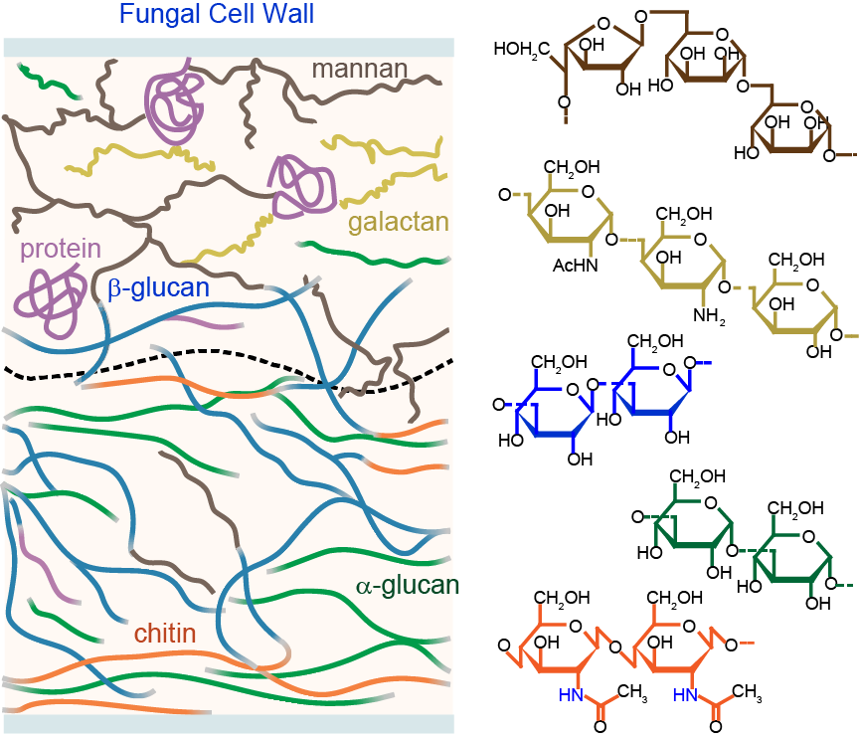
Understanding how fungi build their protective cell walls
Arnab Chakraborty¹, Liyanage D. Fernando¹, Wenxia Fang², Malitha C. Dickwella Widanage¹,
Pingzhen Wei², Cheng Jin^{2,3}, Thierry Fontaine⁴, Jean-Paul Latgé⁵, Tuo Wang¹
Department of Chemistry, Louisiana State University; 2. Guangxi Academy of Sciences, China; 3. Institute of Microbiology, China; 4. Institut Pasteur, France; 5. University of Crete, Greece
Funding Grants: G.S. Boebinger (NSF DMR-1644779); Tuo Wang (NIH AI149289)
What is the finding? The cell wall, the protective armor of fungi, is a complex network formed by five major types of carbohydrate polymers. Nuclear Magnetic Resonance (NMR) spectroscopy resolved the spatial assembly of fungal cell walls and showed that mutants produce stiffer and more water-proof cell walls for better protection and survival. This novel mechanism enables these microbes to reconstruct their cell walls in response to stresses.
Why is this important? Fungi are an emerging threat to human health, causing life-threatening infections in 2-3 million patients every year, with high mortality rates of 20-95% even after treatment. With the limited efficacy of commercially available drugs and the upsurge of drug resistance, the need for novel antifungal compounds is on the rise. Understanding the molecular architecture of fungal cell walls and their structural responses to stresses will guide the development of antifungal drugs that target the molecules in their cell walls.
Why did this research need the MagLab? The samples being studied are living and intact fungal cells. These complex systems pose severe demands on NMR experiments, requiring high sensitivity and resolution. This research is enabled by the MagLab’s high-field 18.8 T NMR magnet and the state-of-the-art homebuilt probes available at the MagLab.
The fungal cell wall is a network of five carbohydrates and proteins. The dashed line separates the outer (above) and inner (below) domains of the cell wall. Note that molecules are packed differently in the inner and outer domains, which leads to different properties. The same color-coding is used in the cell wall model (at left) and the specific sugar structures (at right).
Facility used: 800MHz with MagLab probes at NMR/FSU facility.
Citation: Chakraborty, A.; Fernando, L.D.; Fang, W.; Dickwella Widanage, M.C.; Wei, P.; Jin, C.; Fontaine, T.; Latge, J.P.; Wang, T., A molecular vision of fungal cell wall organization by functional genomics and solid-state NMR, Nature Communications, 12, 6346 (2021) doi.org/10.1038/s41467-021-26749-z

