Slide 1
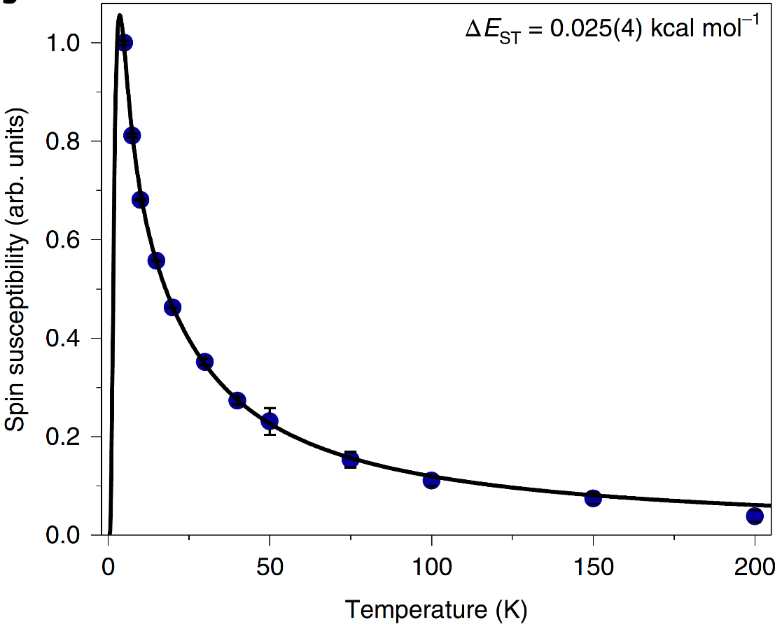
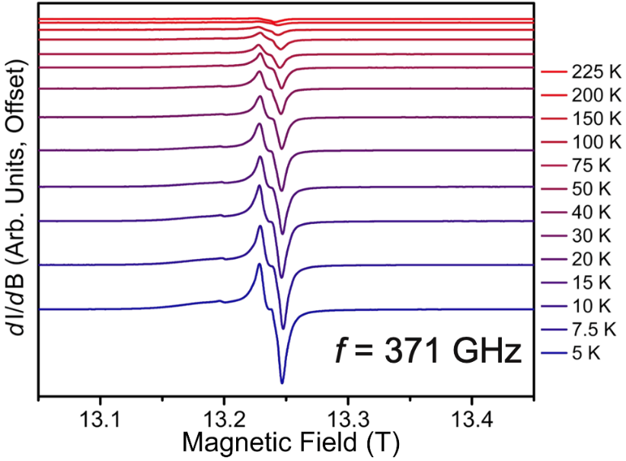
Isolation of a Triplet Benzene Dianion
C. A. Gould¹, J. Marbey^{2,3}, V. Vieru⁴, D. A. Marchiori⁵, R. D. Britt⁵, L. F. Chibotaru⁴, S. Hill^{2,3} and J. R. Long^{1,6}
1. UC Berkeley; 2. NHMFL; 3. Florida State University; 4. KU Leuven; 5. UC Davis; 6. LBNL
Funding Grants: G.S. Boebinger (NSF DMR-1644779); J. R. Long (NSF CHE-1610226);
S. Hill (NSF DMR-1610226); R. D. Britt (NIH 1R35GM126961); V. Vieru (Flemish Science Foundation)
Baird’s rule predicts that cyclic molecules with 4n π-electrons (n = positive integer) should be aromatic in the triplet state; aromaticity implies complete delocalization of the two unpaired electron spins associated with the S = ½ + ½ = 1 (triplet) state and an undistorted planar ring system. Unfortunately, efforts to realize such ring systems have been stymied by their tendency to distort into structures favoring a fully spin-paired singlet (S = 0) ground state, with a large energy gap to the excited triplet state.
This work demonstrates that the elusive benzene diradical dianion can be stabilized through creation of an unusual metallo-ligand that enforces a tightly constrained inverse sandwich structure, with a metal ion (orange in the Figure) on each face of the central ring system. The benzene dianion possesses two additional electrons in the π-system, i.e., a total of 6 + 2 = 8 π-electrons. High-field EPR measurements were then employed in which the metal ions are non-magnetic yttrium(III), revealing paramagnetic signals consistent with a triplet (S = 1) benzene diradical at temperatures down to 5 K. Meanwhile, X-ray diffraction finds aromaticity, consistent with Baird’s rule.
This fundamental research demonstrates how molecular symmetry, rigidity and even magnetic exchange coupling can be leveraged to preferentially stabilize and study a desired electronic/magnetic state in an organic molecule.
C
N
Y or Gd
Figure: (main panel) Spin susceptibility deduced from the high-field EPR spectra in the inset, for the compound: [K(18-crown-6)(THF)₂]₂[M₂(BzN₆-Mes)] (M = Y, Gd; BzN₆-Mes = 1,3,5-tris[2′,6′-(N-mesityl)dimethanamino-4′-tert-butylphenyl]benzene), also shown in the inset. The EPR spectra were recorded in derivative mode, dI/dB, where I is the microwave intensity transmitted through the sample and B the applied magnetic field. The spin susceptibility is obtained via double-integration of the dI/dB signal.
Facilities and instrumentation used: EMR program, 15/17 Tesla Transmission Spectrometer, 371GHz Microwave Source.
Citation: Gould, C.A.; Marbey, J.; Vieru, V.; Marchiori, D.A.; Britt, R.D.; Chibotaru, L.; Hill, S.; Long, J.R., Isolation of a Triplet Benzene Dianion, Nature Chemistry, 13, 1001-1005 (2021) doi.org/10.1038/s41557-021-00737-8

Slide 2
Isolation of a Triplet Benzene Dianion
C. A. Gould¹, J. Marbey^{2,3}, V. Vieru⁴, D. A. Marchiori⁵, R. D. Britt⁵, L. F. Chibotaru⁴, S. Hill^{2,3} and J. R. Long^{1,6}
1. UC Berkeley; 2. NHMFL; 3. Florida State University; 4. KU Leuven; 5. UC Davis; 6. LBNL
Funding Grants: G.S. Boebinger (NSF DMR-1644779); J. R. Long (NSF CHE-1610226);
S. Hill (NSF DMR-1610226); R. D. Britt (NIH 1R35GM126961); V. Vieru (Flemish Science Foundation)
What is the finding? This study reports stabilization of the elusive benzene radical dianion with a magnetic ground state, that is, a doubly reduced form of the benzene molecule in which the two unpaired electrons align their magnetic moments, giving rise to a total spin S = ½ + ½ = 1 (triplet) ground state. High-field electron paramagnetic resonance (EPR) studies were employed in order to confirm the magnetic state of this unusual molecule.
Why is this important? This study demonstrates how coordination chemistry can be leveraged to stabilize a desired electronic/ magnetic state in an organic molecule. Specifically, this approach enables isolation of a negatively charged (2−) benzene dianion in which the magnetic S = 1 (triplet) state—typically a high-energy excited state in such ring-like organic molecules—instead exists as the well-isolated molecular ground state. In turn, this enabled verification of a decades-old theoretical model predicting a delocalized nature of the unpaired electrons on the benzene ring.
Why did this research need the MagLab? Measurements at multiple high magnetic fields and frequencies (a factor of four above commercial spectrometers) available at the MagLab were essential in order to deconvolute several contributions to the EPR spectra. In particular, separating the contributions from intra-molecular and inter-molecular interactions is impossible at low magnetic fields. In this way, analysis of spectra recorded at 13T and 371GHz provides information on the isolation of the S=1 state, without dependence on other unknown interactions.
evidencing aromaticity,
the delocalization of
unpaired electron spins
bond length
equalization,
The metal ions result in
C
N
M = Y or Gd
Figure: (left) The six-carbon benzene ring (highlighted in green) is stabilized via the surrounding rigid ligand scaffold, with the pair of metal ions (M = Y or Gd) above and below, further promoting the magnetic (triplet) ground state. The delocalized nature (aromaticity) of the unpaired electrons manifests as an equalization of the carbon-carbon bond lengths (right), resulting in an undistorted ring structure.
Facilities and instrumentation used: EMR program, 15/17 Tesla Transmission Spectrometer, 371GHz Microwave Source.
Citation: Gould, C.A.; Marbey, J.; Vieru, V.; Marchiori, D.A.; Britt, R.D.; Chibotaru, L.; Hill, S.; Long, J.R., Isolation of a Triplet Benzene Dianion, Nature Chemistry, 13, 1001-1005 (2021) doi.org/10.1038/s41557-021-00737-8

