Slide 1


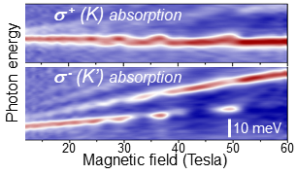
New correlated quasiparticles in an atomically-thin semiconductor
Jing Li¹, Mateusz Goryca¹, Junho Choi¹, Xiaodong Xu², Scott A. Crooker¹
NHMFL, Los Alamos National Laboratory; 2. University of Washington
Funding Grants: G.S. Boebinger (NSF DMR-1644779)
S. A. Crooker (DOE ‘Science of 100T’ & Los Alamos LDRD); X. Xu (DOE-SC0018171)
In atomically-thin semiconductors such as monolayer MoS₂ or WSe₂, many-body correlations can manifest in optical spectra when electron-hole pairs (excitons) are photoexcited into a Fermi sea of mobile electrons. At low background electron densities, the formation of negatively charged excitons (X⁻) is well documented. However, in WSe₂ monolayers, it has been known since 2013 that an additional strong absorption resonance, often called X⁻’, emerges at high electron density. Its origin has remained elusive to date.
Here, researchers use magnetic fields to 60T to investigate the X⁻’ state via polarized absorption spectroscopy of gated WSe₂ monolayers. Field-induced filling and emptying of the upper electron levels in the K’ valley (see Figure) causes repeated quenching of the corresponding σ⁻ polarized optical absorption. Surprisingly, these quenchings are accompanied by absorption changes to higher energy levels in both K and K’ valleys, which are unoccupied. These results cannot be reconciled within any single-particle picture, and demonstrate that X⁻’ is a many-body state with inter-valley correlations.
These high-magnetic field results evidence new classes of correlated many-body quasiparticles that can emerge when an “impurity” (here, the exciton) is coupled to not just one, but multiple reservoirs of electrons, each having distinguishable spin and valley quantum numbers. This work may have implications for other multi-valley materials, including silicon.
A
σ⁺
σ⁻
A: Optical absorption of monolayer WSe₂, showing neutral excitons (X⁰) at zero doping, charged excitons (X⁻) at low electron doping, and the mysterious X⁻’ state at high doping.
absorption
B: In large fields, σ ⁺ circularly-polarized absorption to the unoccupied K valley is modulated when electrons fill/empty the opposite K’ valley. The mysterious X⁻’ is therefore a many-body state, comprising a spin-up exciton in K coupled to multiple (up to three) different electron reservoirs, each with distinguishable spin and valley quantum numbers.
B
Facilities used: 65 T pulsed magnets at the Pulsed Field Facility.
Citation: Li, J.; Goryca, M.M.; Choi, J.; Xu, X.; Crooker, S., Many-Body Exciton and Intervalley Correlations in Heavily Electron-Doped WSe2 Monolayers, Nano Letters 22, 426 (2022) doi.org/10.1021/acs.nanolett.1c04217
Notes:
How to compress files size:
On PowerPoint, you can save the attached image (Right click on an image -> Select “Save as picture” -> Then you save the image as PNG). PNG is the image compression without losing the image quality. You replace the original image with the PNG one on PowerPoint. This should reduce the PowerPoint file size.
One thing to be careful about is that you should enlarge your image a bit on PowerPoint before saving so is to avoid losing much resolution.

Slide 2
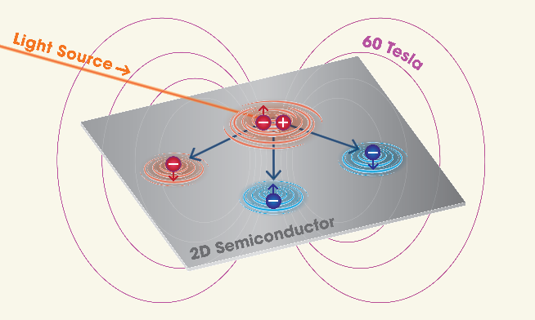
New correlated quasiparticles in an atomically-thin semiconductor
Jing Li¹, Mateusz Goryca¹, Junho Choi¹, Xiaodong Xu², Scott A. Crooker¹
NHMFL, Los Alamos National Laboratory; 2. University of Washington
Funding Grants: G.S. Boebinger (NSF DMR-1644779)
S. A. Crooker (DOE ‘Science of 100T’ & Los Alamos LDRD); X. Xu (DOE-SC0018171)
What is the finding? Using optical spectroscopy in pulsed magnetic fields, researchers find that electrons in the atomically-thin semiconductor WSe₂ can exhibit new types of collective interactions by coupling to not just one, but multiple reservoirs of so-called “distinguishable” electrons.
Why is this important? A central tenet of quantum mechanics is that of distinguishable versus indistinguishable particles. For example, two electrons with the same momentum and spin orientation are indistinguishable and cannot occupy the same region of space. In contrast, two electrons with opposite spin direction are distinguishable, and can overlap in space and interact accordingly. Usually, interactions occur between an electron and a single reservoir of distinguishable electrons. However, in the atomically-thin semiconductor WSe₂, four types of electrons are possible: spin-up or spin-down, with momentum +K or -K. This allows electrons to form entirely new types of multi-particle states by interacting simultaneously with multiple electron reservoirs that are quantum-mechanically distinguishable, opening a frontier to new classes of correlated quasiparticle states.
Why did this research need the MagLab? The key observation required large magnetic fields to force the repeated filling and emptying of up to three distinguishable electron reservoirs that provided evidence of the new correlated quasiparticle states in this atomically-thin semiconductor.
A
A) Device schematic: a single atomic layer of the semiconductor WSe₂ is sandwiched between ultra-smooth slabs of boron nitride (hBN) and is electrically contacted with sheets of few-layer graphene (FLG). The entire assembly is placed over an optical fiber to perform optical studies in pulsed magnets.
B
artwork: Caroline McNiel, NHMFL
B) The data show that when light creates an “exciton” in the WSe₂, it interacts simultaneously with not just one but multiple reservoirs of electrons, each with a different set of spin (up or down) and momentum (+K or –K) degrees of freedom.
Facilities used: 65T pulsed magnets at the Pulsed Field Facility.
Citation: Li, J.; Goryca, M.M.; Choi, J.; Xu, X.; Crooker, S., Many-Body Exciton and Intervalley Correlations in Heavily Electron-Doped WSe2 Monolayers, Nano Letters 22, 426 (2022) doi.org/10.1021/acs.nanolett.1c04217

