Slide 1
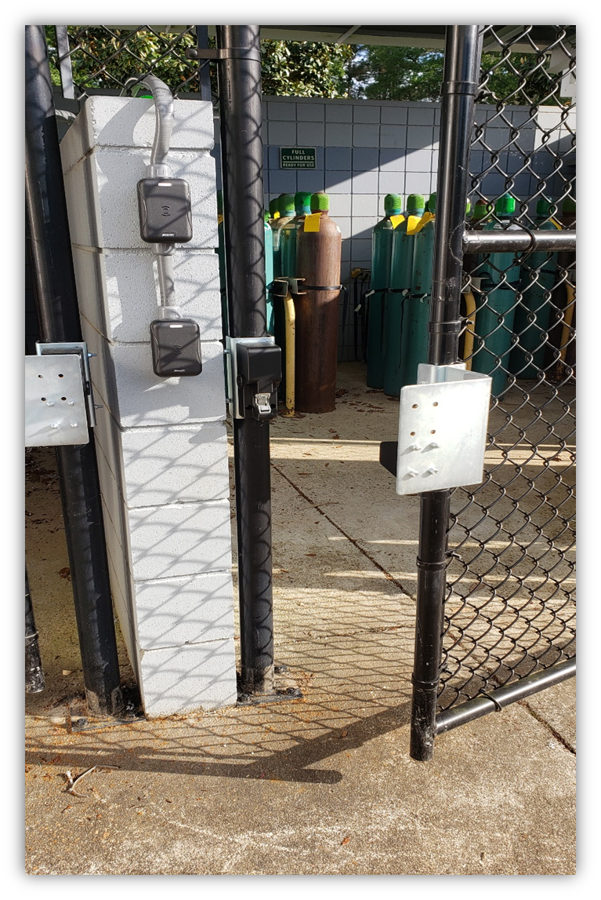
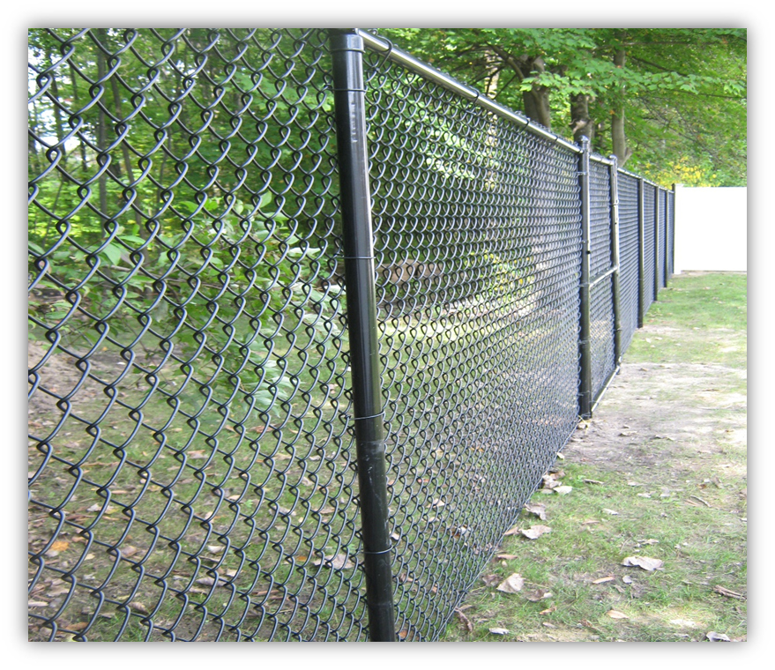
Security upgrades at the MagLab in response to security audit
Funding Grants: G.S. Boebinger (NSF DMR-1157490, NSF DMR-1644779)
The MagLab’s Safety group performs an internal security audit annually. They partner with Florida State University Police Department (FSU PD) every other year at a minimum – or more frequently as needed – to bring the additional perspective to the MagLab’s security audit.
During the most recent security audit, the FSU PD made recommendations to further increase safety and security at the MagLab. The safety department worked with FSU PD to create a work plan to implement the recommendations.
Upgrades include:
A panic alarm installed at the front desk in the MagLab Atrium (Fig. 1). This provides the front desk receptionist immediate access to an alarm in the event of an intruder or other emergency.
Six-foot-high perimeter fencing that replaced four-foot-high fencing (Fig. 2). The increased height of the fence is a more suitable deterrent against trespassers.
Cylinder storage card reader access (Fig. 3). Installing the card readers adds an additional level of security that prevents non-authorized personnel from gaining entry to compressed gas cylinders.
Additional surveillance cameras installed in areas where no camera coverage previously existed, thereby increasing perimeter surveillance capabilities.
FSU upgraded the MagLab’s million-dollar fiber optic network. The increased data capacity enables operation of the enhanced security camera systems in conjunction with FSU’s Safety and Security Initiatives.
Fig. 1 Panic alarm at the front desk.
Fig. 3 Card reader at entry to gas cylinder storage area.
Fig. 2 New six-foot-high fencing.

