Slide 1
Crossover between strongly coupled and weakly coupled exciton superfluids
X. Liu¹, J.I.A. Li^{2,3}, K. Watanabe⁴, T. Taniguchi⁵, J. Hone², B.I. Halperin¹, P. Kim¹, C.R. Dean²
1. Harvard University; 2. Columbia University, 3. Brown University;
4,5. National Institute for Materials Science, Japan
Funding Grants: Dean (DE-SC0019481; DMR-2011738), Kim (N00014-18-1-2877; W911NF-14-1-0247; ECS-00335765), Halperin (DMR-1231319), Hone (DMR-2011738), Taniguichi and Watanabe (PMJCR15F3), Liu (DE-SC0012260), G.S. Boebinger (NSF DMR-1644779)
Condensation of paired fermions into a quantum ground state represents one of the most spectacular many-body effects in strongly interacting systems. Depending on the strength of the interactions, the paired fermions can be tightly bound – as in a Bose-Einstein Condensate (BEC) - or can be so large as to overlap with other pairs – as in Bardeen Cooper Schrieffer (BCS) pairing. Understanding that these two BEC and BCS pairing limits represent a continuum in a single phase diagram is one of the great theoretical achievements over the past century. Although well established in ultracold Fermi gas experiments, observation of BEC-BCS crossover in electronic systems has remained challenging owing to the limited ability to tune electron interactions in solid sate materials.
MagLab users studied graphene double layers separated by an atomically thin insulator. Under applied magnetic field, electrons and holes couple across the barrier to form bound magneto-excitons. Using temperature-dependent Coulomb drag and counterflow current measurements in bilayer graphene, researchers were able to continuously tune the magneto-exciton condensate through the entire phase diagram from strong to weak coupling. This tunability of fermion pairing in a solid-state device enables the investigating of fermion condensates of various pairing strengths and may lead to an improved understanding of the connection between the BEC-BCS crossover and unconventional superconductivity.
a)
b)
(a) Theoretical phase diagram for exciton condensates spanning strong to weak coupling regime. (b) Magneto-transport data verifying the expected boundaries of the phase diagram
(c) Illustration of the quantum hall magneto-excitons in graphene double layers. Energy and length scales associated with exciton pairing in a graphene double-layer structure under a magnetic field can be widely tuned since the Interlayer Coulomb coupling U depends on the interlayer separation d, whereas intralayer Coulomb repulsion E_{c} is determined by the field dependent magnetic length l_{B}.
c)
Facilities and instrumentation used: DC Magnet Facility, 31T resistive magnet
Citation: Liu, X.; Li, J.I.A.; Watanabe, K.; Taniguchi, T.; Hone, J.; Halperin, B.I.; Kim, P.; Dean, C.R., Crossover between strongly coupled and weakly coupled exciton superfluids, Science, 375 (6577), 205-209 (2022) doi.org/10.1126/science.abg1110

Slide 2
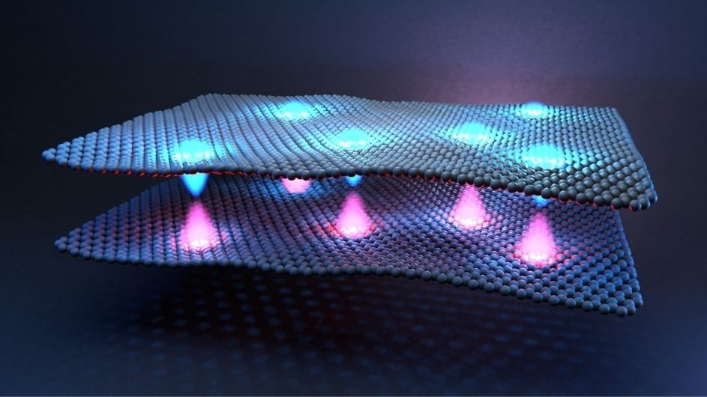
Crossover between strongly coupled and weakly coupled exciton superfluids
X. Liu¹, J.I.A. Li^{2,3}, K. Watanabe⁴, T. Taniguchi⁵, J. Hone², B.I. Halperin¹, P. Kim¹, C.R. Dean²
1. Harvard University; 2. Columbia University, 3. Brown University;
4,5. National Institute for Materials Science, Japan
Funding Grants: Dean (DE-SC0019481; DMR-2011738), Kim (N00014-18-1-2877; W911NF-14-1-0247; ECS-00335765), Halperin (DMR-1231319), Hone (DMR-2011738), Taniguichi and Watanabe (PMJCR15F3), Liu (DE-SC0012260), G.S. Boebinger (NSF DMR-1644779)
What is the finding? In the late 1970s it was proposed that electron-hole pairs could become superfluid at very high temperatures. However, realizing a system of strongly interacting electron-hole pairs has remained a technical challenge. In this work, MagLab users find that fully-tunable exciton condensates can be induced in graphene by using strong magnetic fields.
Why is this finding important? Superconductors – materials that can carry electrical current without energy loss, result when electrons in a material pair up. The long-standing problem is that the exact way in which these electrons pair is often unclear, limiting our ability to engineer materials properties, for example by driving up the temperature at electron pairs form. The ability to dynamically adjust the pairing strength with magnetic field allowed researchers, for the first time, to experimentally map the associated phase diagram. This both confirms the prior theory but also establishes magneto-condensates as a model system to study fundamental questions of how electrons pair to form exotic quantum states.
Why did this research need the MagLab? The exciton superfluid we study in graphene only forms in the presence of high magnetic fields and at very low temperatures. The MagLab is one of the only places in the world that enables researchers to simultaneously address these two needs in the right way to perform this experiment.
Schematic of excitons forming between two graphene layers. By using a technique developed at Columbia University to create layered stacks of different atomically-thin materials, the research team added layers of insulating boron nitride between the graphene sheets. This created physical distance between electrons on one graphene sheet (blue) and holes on another (violet). Changing the number of insulating layers between the graphene sheets controls the binding strength between the electrons and holes, while varying the external magnetic field adjusts the interaction between bosonic excitons consisting of bound electron-hole pairs.
Facilities and instrumentation used: DC Magnet Facility, 31T resistive magnet
Citation: Liu, X.; Li, J.I.A.; Watanabe, K.; Taniguchi, T.; Hone, J.; Halperin, B.I.; Kim, P.; Dean, C.R., Crossover between strongly coupled and weakly coupled exciton superfluids, Science, 375 (6577), 205-209 (2022) doi.org/10.1126/science.abg1110

