Slide 1
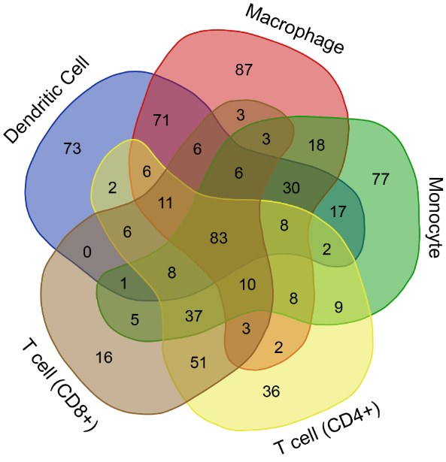
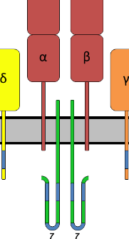
The Blood Proteoform Atlas:
A reference map of proteoforms in human blood cells
Rafael D. Melani¹, Vincent R. Gerbasi¹, Lissa C. Anderson², et al.
Northwestern University; 2. National High Magnetic Field Laboratory
Funding Grants: G.S. Boebinger (NSF DMR-1644779); Neil L. Kelleher (Paul G. Allen Frontiers Program award 11715; HuBMAP grant UH3 CA246635-02; NIH P41 GM108569); and others
Nearly all our cells contain the same DNA blueprint, yet humans are a complex amalgamation of ~200 different cell types of various functions. Mass spectrometry-based protein analysis (proteomics) has cemented the linkage between protein biology and cellular phenotype. However, previous efforts to compositionally map proteins (PTN) across different cell and tissue types do not capture posttranscriptional and posttranslational processing. These dictate the distinct molecular proteoforms active in cells.
Melani et al. compiled a Blood Proteoform Atlas, a clarified map of ~30,000 unique proteoforms (PFR) as they appear in 21 different blood cell types. The MagLab’s 21 tesla FT-ICR mass spectrometer contributed nearly a third of the atlas’ proteoforms while comprising ~15% of the total instrument time devoted to what is now the largest “top-down” proteomics study ever conducted. This patient-specific, cell type-specific, and proteoform-specific data enabled the discovery of 24 biomarkers for liver transplant rejection.
This advancement marks the beginning of a new era for more precise study of proteins in specific cells— the Human Proteoform Project. As the atlas grows, discoveries about fundamental biology, disease, aging and new therapeutics will accelerate.
T-cell Surface Glycoprotein Complex
The Human Proteoform Project separates cell types found in blood. Proteoforms are identified using top-down proteomics enabled by the uniquely high mass resolving power, mass accuracy, sensitivity, and efficiency of the MagLab’s 21T FT-ICR mass spectrometer. This enables the construction of a series of Venn diagrams of proteoforms identified in different cell types found in human blood (example shown at left). In this case the T-cell Surface Glycoprotein Complex is found in both T-cell (CD8+) and T cell (CD4+) cells. The entirety of this information on blood proteoforms is deposited in the Blood Proteoform Atlas (BPA) website.
Instrumentation used: 21 Tesla Fourier-Transform Ion Cyclotron Resonance (21T FT-ICR) Magnet System Image Credit: Rafael D. Melani
Citation: Melani, R.D., Gerbasi, V.R., Anderson, L.C., Sikora, J.W., Toby, T.K., Hutton, J.E., Butcher, D.S., Negrão, F., Seckler, H.S., Srzentić, K., Fornelli, L., Camarillo, J.M., LeDuc, R.D., Cesnik, A.J., Lundberg, E., Greer, J.B., Fellers, R.T., Robey, M.T., DeHart, C.J., Forte, E., Hendrickson, C.L., Abbatiello, S.E., Thomas, P.M., Kokaji, A.I., Levitsky, J., & Kelleher, N.L. (2022) The Blood Proteoform Atlas: A reference map of proteoforms in human hematopoietic cells. Science, 375 (6579), 411-419. https://doi.org/10.1126/science.aaz5284

Slide 2
The Blood Proteoform Atlas:
A reference map of proteoforms in human blood cells
Rafael D. Melani¹, Vincent R. Gerbasi¹, Lissa C. Anderson², et al.
Northwestern University; 2. National High Magnetic Field Laboratory
Funding Grants: G.S. Boebinger (NSF DMR-1644779); Neil L. Kelleher (Paul G. Allen Frontiers Program award 11715; HuBMAP grant UH3 CA246635-02; NIH P41 GM108569); and others
What is the finding? Melani et al. compiled a Blood Proteoform Atlas (BPA), a clarified map of ~30,000 distinct molecular forms of proteins, or “proteoforms”, as they appear in 21 different blood cell types. With the BPA as a reference, this team of MagLab users, headed by Melani, examined proteoforms in patient blood samples and developed a panel of 24 biomarkers for liver transplant rejection.
Why is this important? Through employment of state-of-the-art instrumentation, including the MagLab’s 21T FT-ICR mass spectrometer, proteoforms were identified intact in a form of “top-down” analysis rather than cutting them into small pieces (as is standard practice). This advancement realizes a truly molecular-level understanding of cell type and marks the beginning of a new era for more precise study of proteins in specific cells— the Human Proteoform Project.
Why did this research need the MagLab? High-throughput identification of proteoforms from complex biological samples requires instrumentation capable of high mass resolving power, mass accuracy, sensitivity, and efficiency. The 21 tesla FT-ICR mass spectrometer is state-of-the-art in all these facets and contributed nearly a third of the BPA’s proteoforms while accounting for only ~15% of the total instrument time devoted to the project.
Workflow for the Human Proteoform Project separates cell types found in blood. Proteoforms are identified using top-down proteomics enabled by the uniquely high mass resolving power, mass accuracy, sensitivity, and efficiency of the MagLab’s 21T FT-ICR mass spectrometer. Proteoforms identified in human blood are deposited in the Blood Proteoform Atlas (BPA) website.
Instrumentation used: 21 Tesla Fourier-Transform Ion Cyclotron Resonance (21T FT-ICR) Magnet System Image Credit: Rafael D. Melani
Citation: Melani, R.D., Gerbasi, V.R., Anderson, L.C., Sikora, J.W., Toby, T.K., Hutton, J.E., Butcher, D.S., Negrão, F., Seckler, H.S., Srzentić, K., Fornelli, L., Camarillo, J.M., LeDuc, R.D., Cesnik, A.J., Lundberg, E., Greer, J.B., Fellers, R.T., Robey, M.T., DeHart, C.J., Forte, E., Hendrickson, C.L., Abbatiello, S.E., Thomas, P.M., Kokaji, A.I., Levitsky, J., & Kelleher, N.L. (2022) The Blood Proteoform Atlas: A reference map of proteoforms in human hematopoietic cells. Science, 375 (6579), 411-419. https://doi.org/10.1126/science.aaz5284

