Slide 1
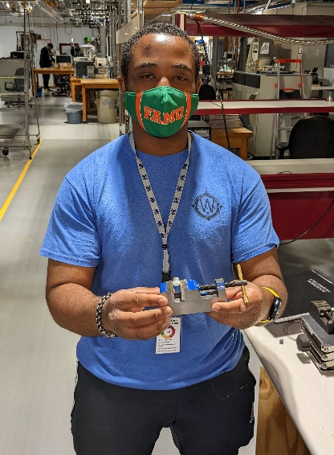
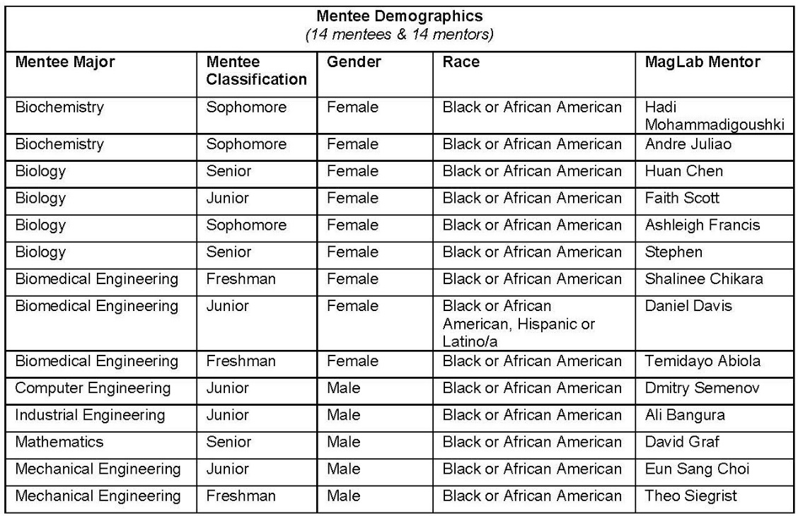
Magnetic Momentum Scholars Program:
Diversifying Awareness of STEM Opportunities and Careers
K. W. Johnson
Center for Integrating Research and Learning at the National High Magnetic Field Laboratory
Funding Grants: G.S. Boebinger (NSF DMR-1644779)
What is the program? The Magnetic Momentum Scholars Program is a partnership between the National High Magnetic Field Laboratory (MagLab) and Florida A&M University (FAMU), the third largest Historically Black University in the United States and the only public Historically Black University in Florida. The Magnetic Momentum Program pairs FAMU undergraduate students with MagLab STEM mentors for a six-week / twenty-hour-per-week rotational internship experience that expands their knowledge of physics, materials research, chemistry, biology, and engineering career paths at the MagLab and beyond. Skills development includes laboratory instrumentation, techniques, and programming, as well as materials synthesis, computer modeling, data analysis, and machine learning.
Why is this important? African American/Black, Latina/o/x and Indigenous peoples are underrepresented in STEM fields compared to their overall representation in the U.S. population. Through the Magnetic Momentum Program, the MagLab exposes a select group of undergraduate students to STEM career opportunities about which many were previously unaware, enabling them to build confidence in their own ability to pursue a future STEM career.
Why did this program need the MagLab? The MagLab is located in close proximity to FAMU. The MagLab’s CIRL group conceived of the Magnetic Momentum Program and connected the FAMU students with a diverse group of MagLab scientists and engineers skilled in mentoring, thus advancing the MagLab’s mission of broadening participation and building a diverse STEM workforce.

